Slide 1
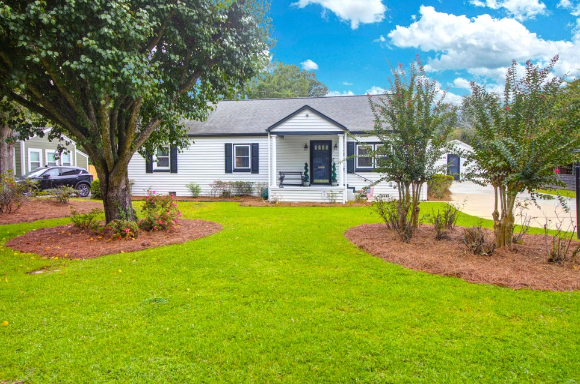
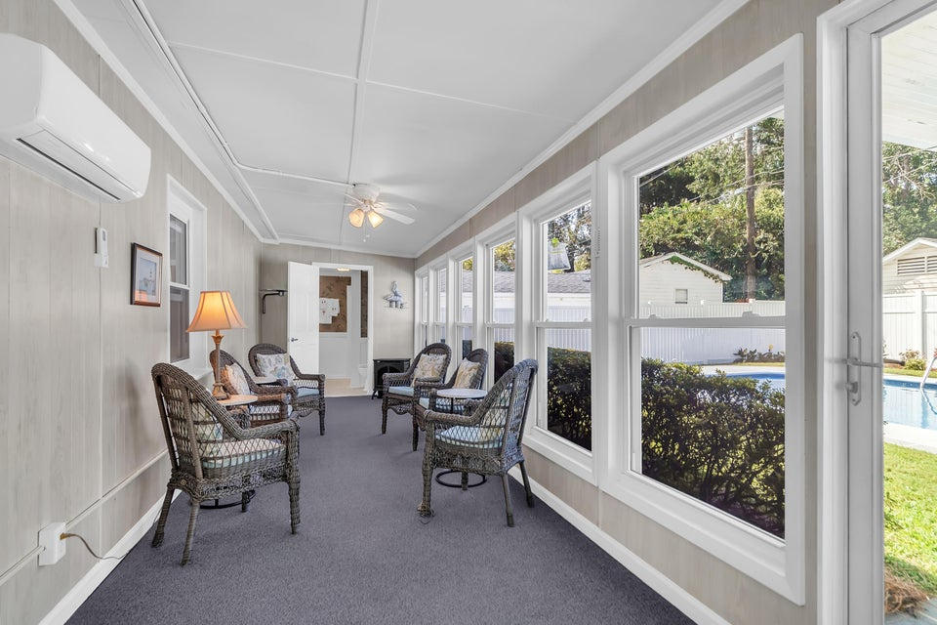
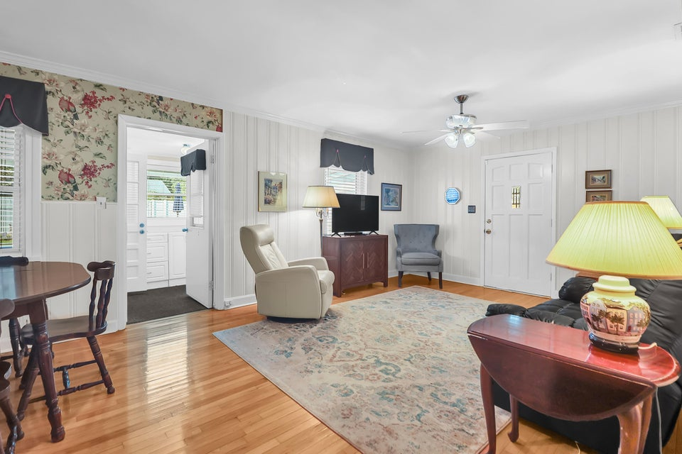
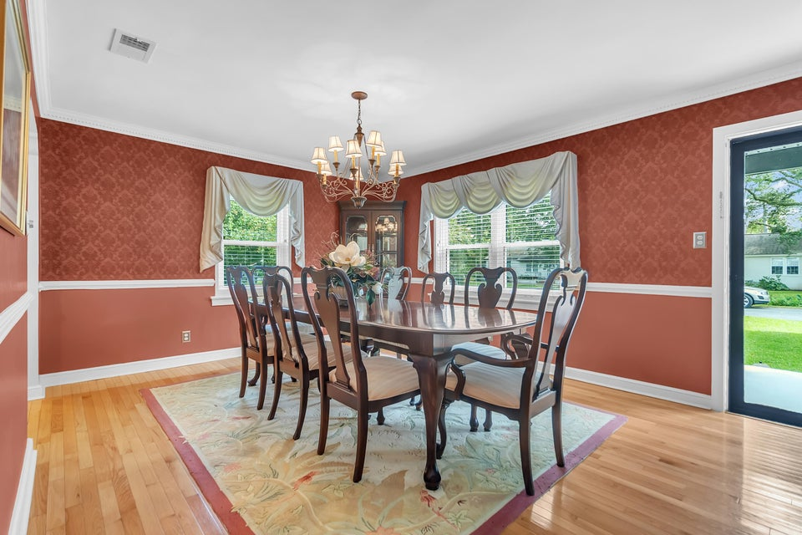
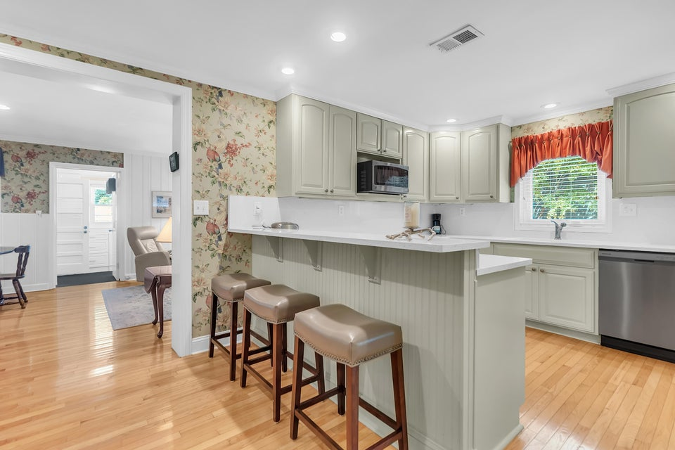
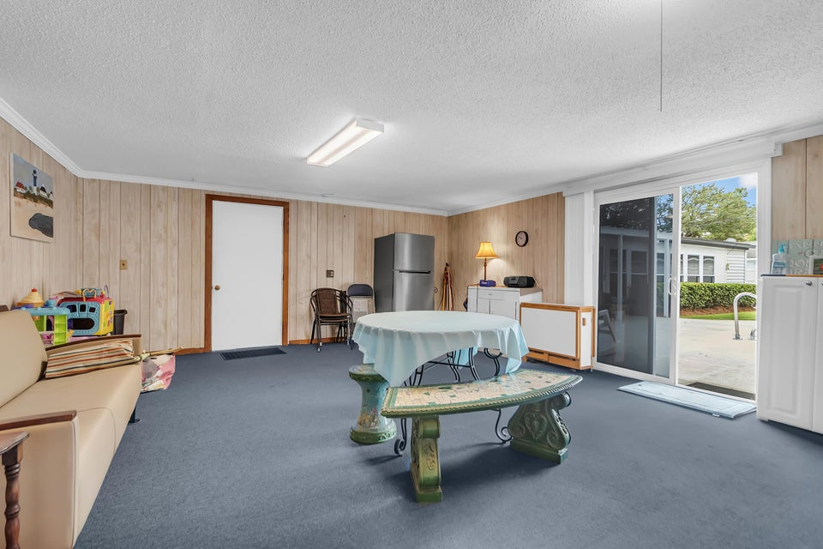
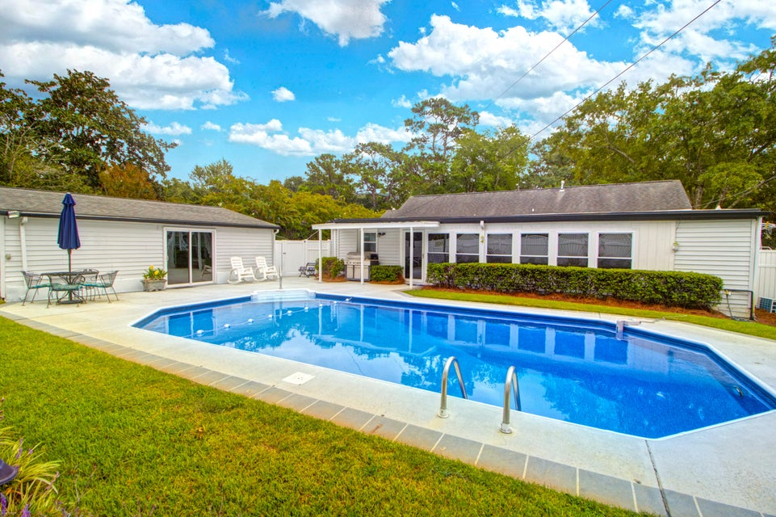

Riverland Terrace Opportunity
2078 SAINT JAMES DRIVE
CHARLESTON, SC 29412 | MLS# 25024859 | $999,000
4 BEDROOM | 2 BATH | 2,448 SF
Discover one of the city's most beloved neighborhoods—Riverland Terrace—and this well-loved home, priced under both an April 2025 and a September 2025 appraisal, This home is part of an estate and has 4 nicely sized bedrooms, two full baths and is ready for you to move in and enjoy as is or renovate to suit your personal style. A bright sunroom offers a perfect spot to relax or entertain, while the kitchen features granite countertops, breakfast bar, a smooth cooktop, and ample cabinetry along with a built-in pantry and a pantry closet! The family room kitchen, dining room and hallways feature lovely oak hardwoods all in very good condition, enhancing the warmth of the space, while carpet in the bedrooms, sunroom, and laundry provides comfort. The bathrooms have tiled flooring Windows have been updated. The exterior features lovely landscaping ana privacy fence in the backyard . Enjoy summer days by the pleasant in-ground pool, and take advantage of the large pool house, which is equipped with a window unit and could be transformed into anything you desire. Whether you're looking to settle in as-is or craft a personalized living space, this property suits either choice. Located just a few blocks from the Riverland Terrace boat landing and within walking distance of local favorites like The James, the Terrace Theatre, and Miller's All Day, you'll have plenty of opportunities to enjoy dining and shopping right at your doorstep. Plus, being just a quick seven-minute drive from downtown Charleston means you have the best of both worlds - a peaceful neighborhood feel with easy access to the best of downtown Charleston.

