Slide 1
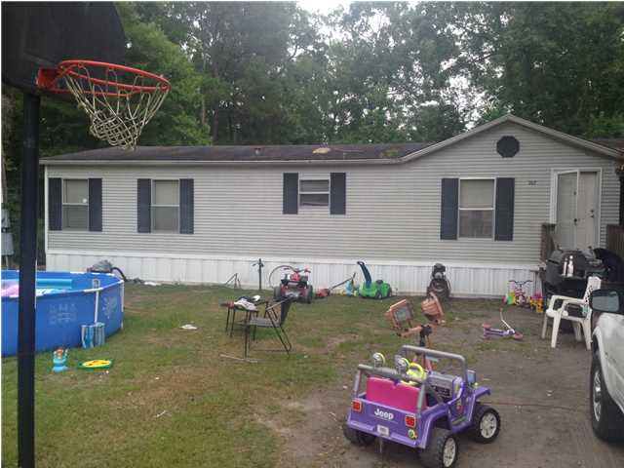

Great Opportunity!
207 George Keen Dr
Pinehill Acres ~ Summerville ~ MLS# 1419017 ~ $89,000
$500 agent bonus with BIC approval and closed by 9/31/2014
Great opportunity for a rental or fixer upper to occupy. Located in the Pinehill Acres area in Summerville, this property is a quick drive from the interstate making the commute easy for everywhere! Home sits on a nearly 1/2 acre lot, so space is not an issue.
Price as is where is: $69,000, the owner will fix and sell for $89,000.
Corwyn J. Melette, BIC
Accredited Buyer Representative
843-619-0071
corwyn@corwynmelette.com
Corwyn J Melette & Associates
PO Box 2175
Goose Creek, SC 29445 www.corwynmelette.com

