Slide 1
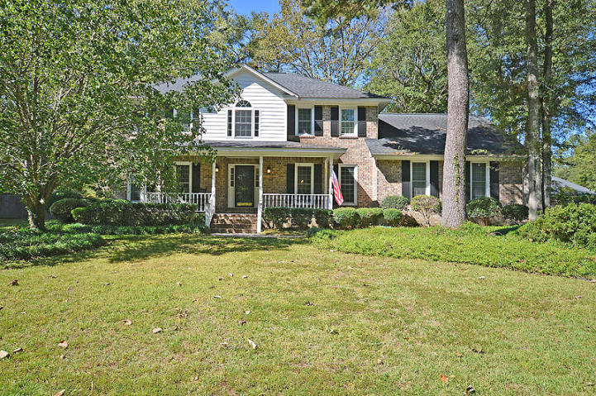
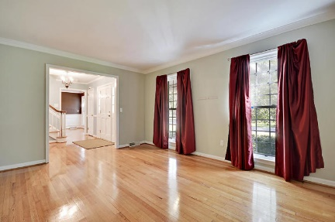
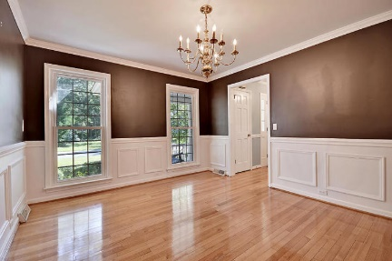
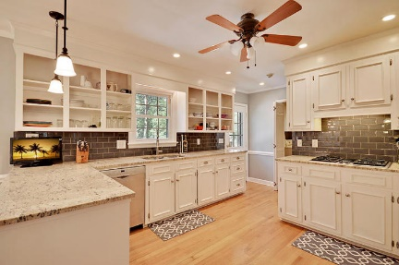
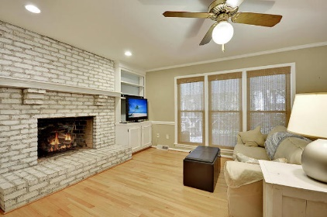
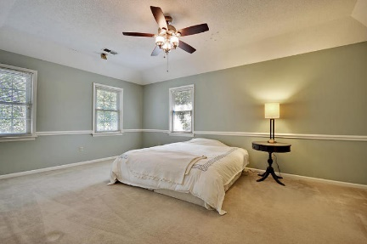
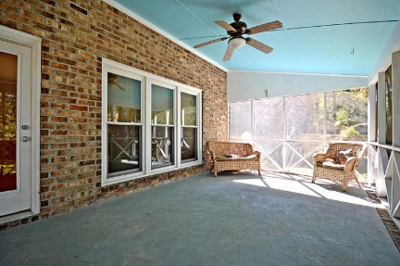
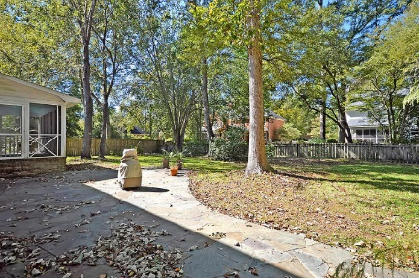
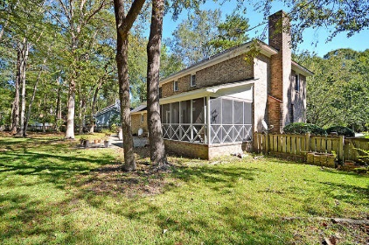


Summerville Beauty In Established Neighborhood!
207 High Grove Rd
Ashborough East
Summerville, SC 29485
MLS# 17028656
$329,000
4 Bedrooms | 2½ Baths | 2,850 sf
Great home located in the sought after Ashborough East community! This home is ready for you to move right in! Great curb appeal with welcoming front porch with a porch swing! Upon entering, you'll immediately notice the beautiful wood floors. To the left is a large formal living room or office. To the right, you'll find the dining room, right off the kitchen, perfect for entertaining. The kitchen is a chef's delight with a gas cooktop, stainless steel appliances, granite countertops, pantry, large eat in kitchen area with built in shelving! The kitchen overlooks the family room which has tons of built ins for storage and a gorgeous fireplace! Off the family room, you'll find a huge screened in porch overlooking the back patio and gorgeous fenced in backyard!!
This home has two staircases! One by the front door and one in the back of the home by the kitchen! Upstairs, you'll find the spacious master bedroom that has a walk in closet, separate tub and shower, dual vanities. Three more good sized bedrooms are upstairs plus another full bath. The bonus over the garage is a great flex space! So many uses plus tons of attic space. Ashborough East is a great neighborhood close to so much! Great community pool, playground, tennis courts and clubhouse. Come see this home today!!
Larry & Kathy Mazalatis
Larry Cell 843-693-0529
Kathy Cell 843-693-0159
Office 843-871-9133
AGENTOWNED PREMIERE GROUP | 1800 TROLLEY RD | SUMMERVILLE, SC 29485

