Slide 1
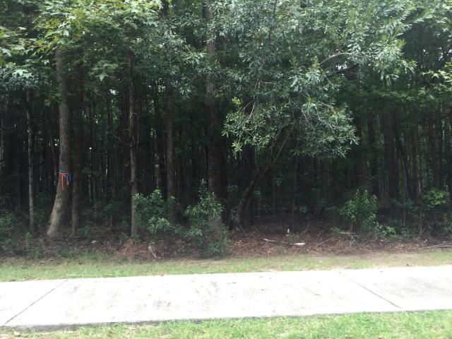
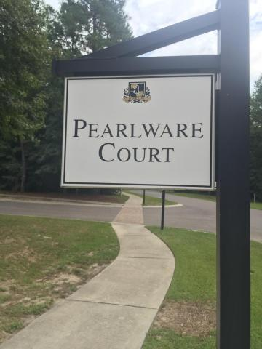
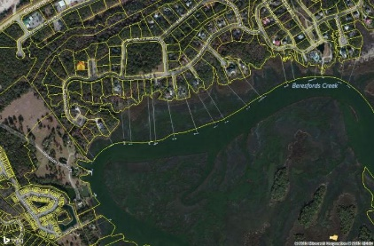
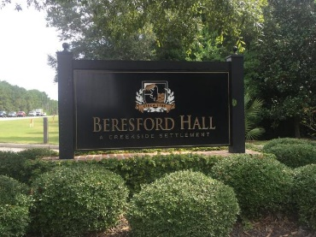
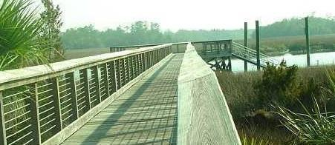
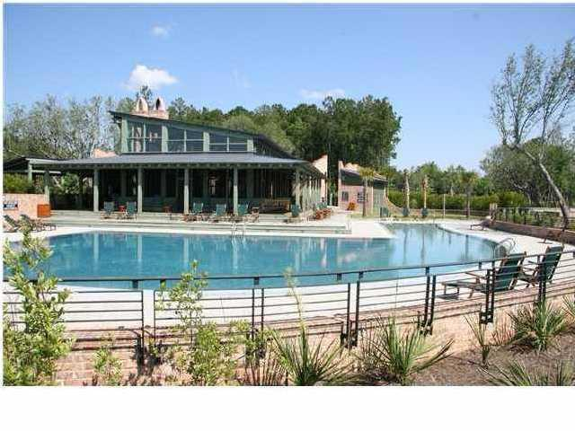


207 Pearlware Court Beresford Hall Charleston, SC 29492 MLS# 15024853 | $225,000
New lot in gated community
Beautiful .64 of an acre level wooded lot on secluded street in gated Beresford Hall. This is the perfect lot for building a natural landscaped home that will be private, but still easy to get to work on Monday. Beresford Hall off Clements Ferry Road is a wonderfully landscaped gated community with large wooded naturally landscaped lots and community dock, boat ramp, play park, walking trials, and pool! The neighborhood is close to local shopping and grocery stores and is a short drive to downtown Charleston with 5-star restaurants, world class shopping and iconic history as well as a short drive to the beaches, the airport, Boeing and Daniel Island. Come take a look because you will not find another community that offers as much as Beresford Hall.
Stan Huff
843-670-2835 stan.huff@agentowned.com
Jill Marcacci
843-297-5590 jill@agentowned.com
www.agentownedrealty.com
AgentOwned Realty Co. Preferred Group, Inc. | 824 Johnnie Dodds Blvd | Mt Pleasant, SC 29464

