Slide 1
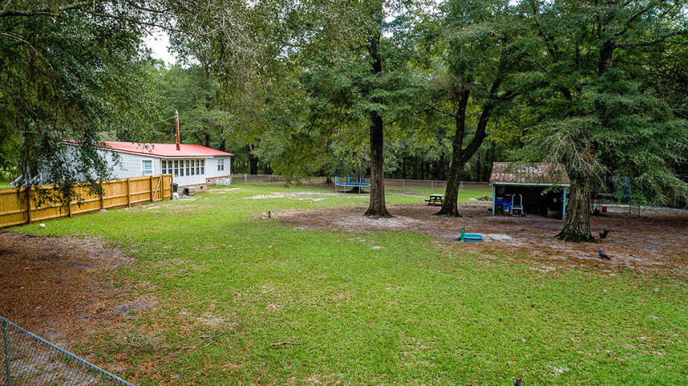
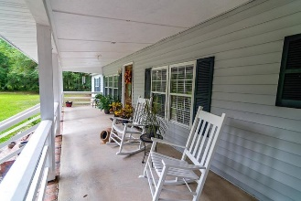
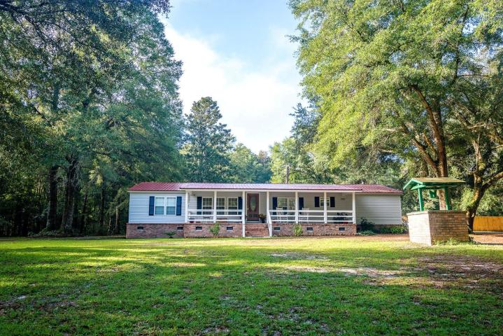
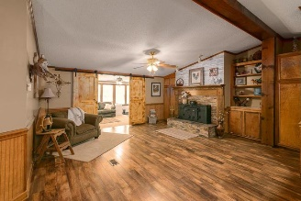
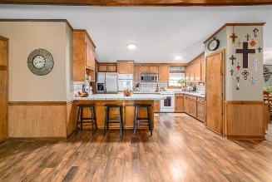
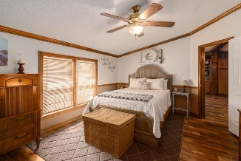
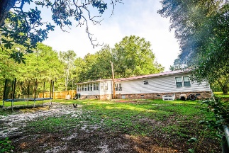
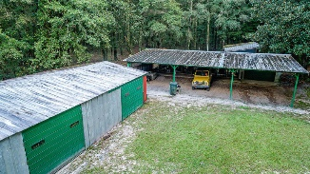
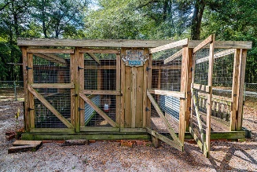

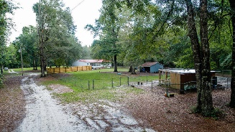


207 Shad Lane Ridgeville, SC 29472 ~ MLS# 18025764 ~ $285,000
Country living at it's best!
An Outdoorsman Dream! 2087sq.ft. on 5 Acres!
Located in the D2 school District, This lovely 3 bedroom 2 bath home is situated on a serene 5 acres with access to the Edisto River, The 252 square foot front porch welcomes you home and is a great place to sit and enjoy all of Nature's wonders. As you enter, you'll be greeted by a floor plan, with a great flow for entertaining and everyday living. Enjoy cool evenings in front of the cozy wood burning fireplace, in the family room. Kitchen is large and has a long peninsula, perfect for extra seating, tile counter tops, double ovens, electric cooktop, built in microwave, lots of cabinets and counter space. Master bedroom is spacious with two closets, a huge bathroom en-suite with separate jetted tub and shower, is separated from the two secondary bedrooms. There is a separate dining room and an additional living space. The bright sunroom overlooks the backyard area with chicken coop complete with roaming chickens(chickens are negotiable). The home has newer windows, roof about 1 years old, extensive custom mouldings and built-ins. Store your boat, car, and toys in the huge storage shed. There are 14 dog runs, 3 other outbuildings, all have electricity and water, can be used as storage, work shop, multitude of other possible options. Multiple fenced areas. Dog runs have their own septic tank,( drain line replaced 2018). Zoned AC, it allows residential, agricultural, hunting uses. Bring your Horses, as they are okay too. According to County Zoning, Subdividing may be possible. An absolute must see with too many great features to list here, Schedule your showing today!
Asking $1,200,000
MLS# 17023051
3,692 SqFt
4 Bed/3½ Baths
Short Drive to Historic Downtown Charleston & Beaches
Jacqui Swain (843) 295-9484 jacquiswainc21@gmail.com www.JacquiSwain.c21.com
Century 21 Expert Advisors
100 Seven Oaks Lane
Summerville, SC 29485

