Slide 1
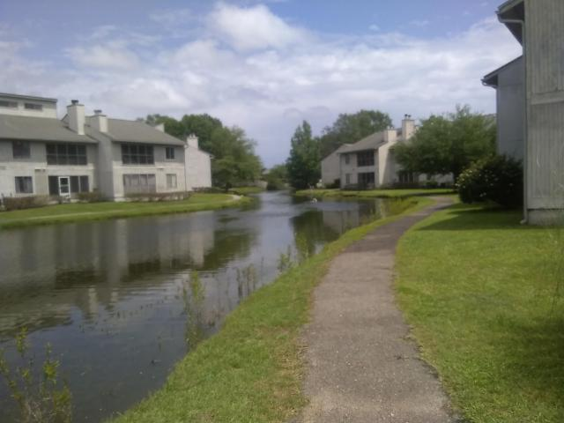
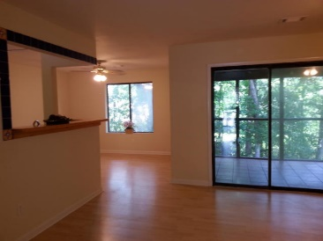
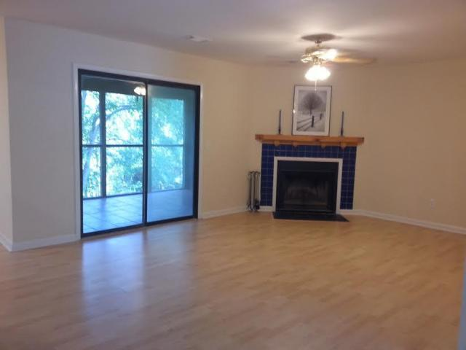
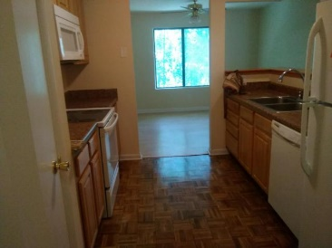
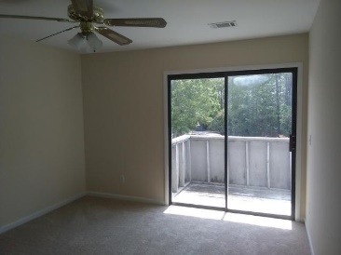
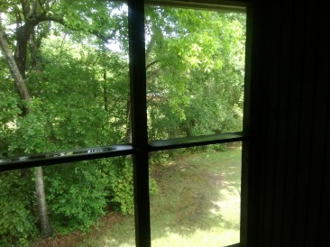
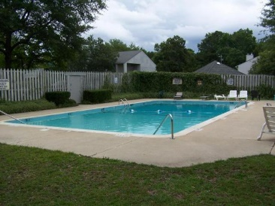

207 Waterwood Drive
Greenslake Condominiums
Goose Creek, SC 29445
MLS# 17014126
$68,000
Move in Ready
$25K Price Reduction!
This place has it all with a fantastic price tag. This 2 Bedroom 2 Bath , 2nd story Condo has a fireplace, A very Private and spacious tiled screened in back porch, and a front balcony that can be accessed from either Bedroom. Both Bedrooms have a ceiling fan and new stain master carpet. The Kitchen has a new stove, new fridge, and new over the counter microwave a pantry and beautiful refinished floors. Stroll around the lake past the ducks and over to the community pool. Seller will pay two thousand in closing costs and provide a AHS warranty on the home. This regime requires owner's occupy.
Gerri Sandford
(843) 817-8762
gsandford29455@gmail.com
Anchor Line Realty LLC
1619 Samuel Rd
Charleston, SC 29412

