Slide 1
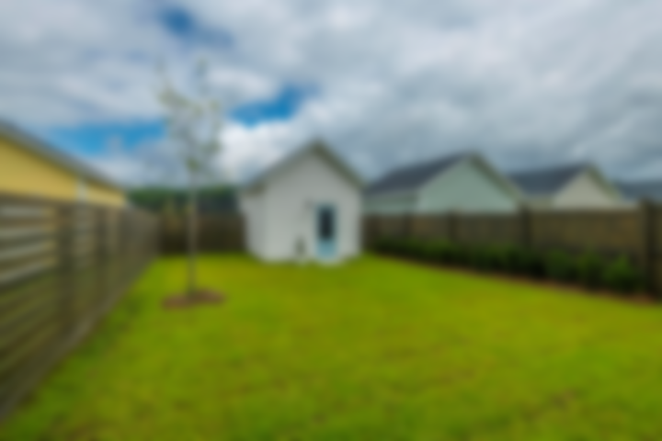
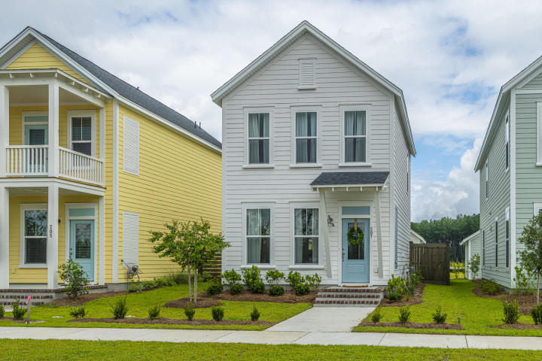
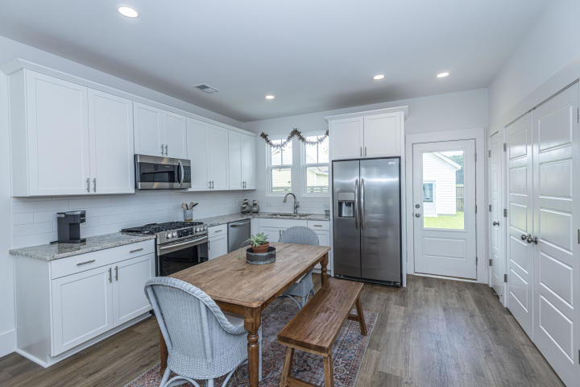
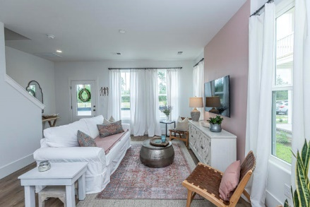
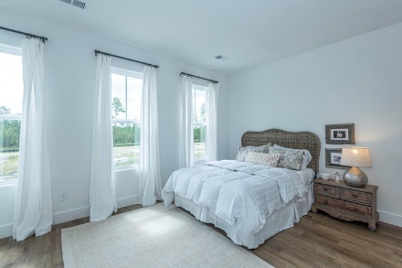
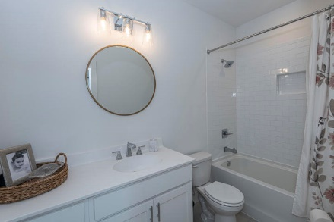
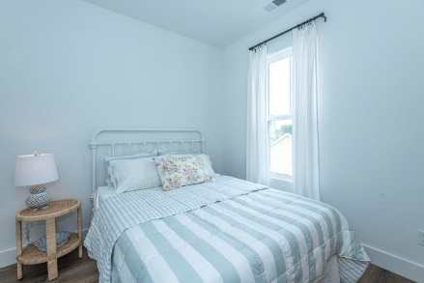
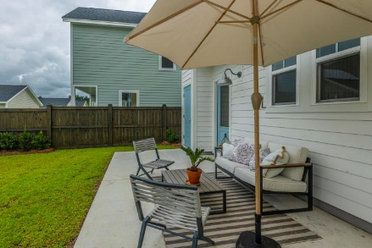
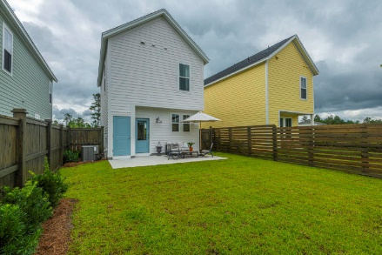
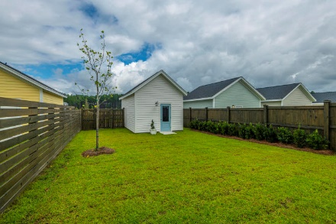
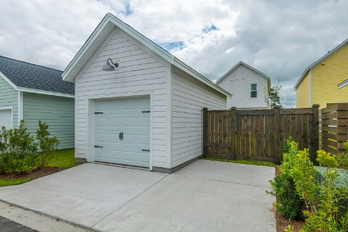

Open House Saturday 2-4pm
207 Winding Branch
Nexton | Summerville, SC 29486 | MLS# 20018905 | $263,000
Brand New Home Ready for you to move in! As you walk in you will notice how easy this floor plan lives. Shows like a model home. The main floor has a Family room and Kitchen that hosts a dining area. Laundry and Powder room with bead board on the main level. Upstairs you will find two nice size bedrooms both with en-suite bathrooms. Enjoy the fenced in yard with patio and a one car garage with additional off street parking spots. The upgrades in this home include: Luxury plank vinyl flooring throughout Bead board in the powder room, 8 inch baseboards on first floor and 6 inch baseboards upstairs, subway tile in both bathrooms, upgraded vanities in both bathrooms, 10 X 18 patio, added two windows in the living room, added bump out to living room, Fully fenced in yard with two gates, upgraded granite in kitchen, upgraded kitchen cabinets and hardware, and pine floor stairs. Why wait for your home to be build when you can move in sooner! Call for your tour.
Carolina One Real Estate
195 W Coleman Blvd
Mt Pleasant, SC 29464-3495
Jennie Hood Emerson (843) 327-0384
jhood@carolinaone.com
www.yourcharlestonhomes.com

