Slide 1

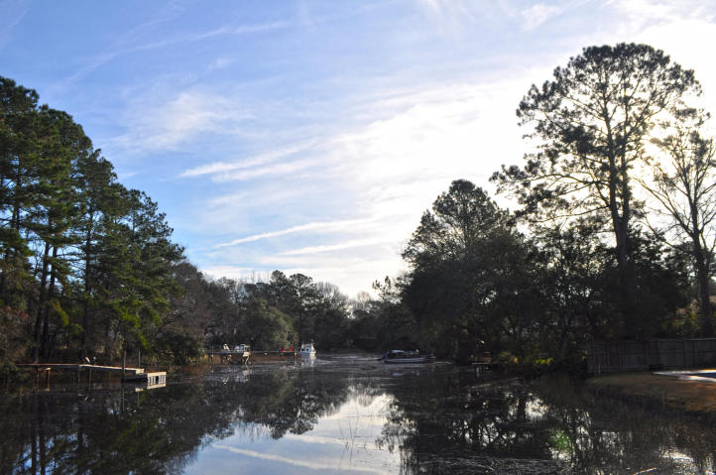
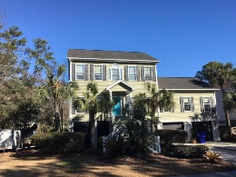




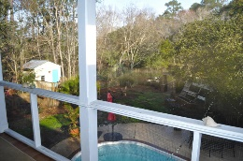
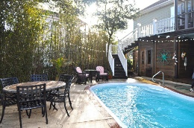
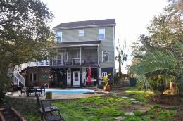
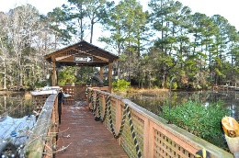
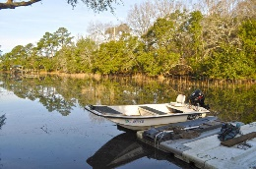


Waterfront in West Ashley!
2082 S Shore Drive Oakland • Charleston, SC 29407 MLS# 18004424 • $549,900
Stunning home on Tidal Creek leading to the Stono River. Home has dock w/ in-ground pool, pool house, & beautifully landscaped lot. Home is professionally decorated - includes bamboo flooring downstairs and brand new carpeting in Master & Upstairs bedrooms. Crown moulding, concrete mantle in Great Room with Gas Logs. Kitchen has granite counter-tops and stainless steel appliances (gas range) and pantry. Large master is on the main level with walk-in closet and double sinks in bath-separate shower. Formal Dining room off Great Room. New front porch and back of home has screened-in porch w/deck to pool area. Upstairs has 2nd master suite and 2 other nice sized BR's. Great storage and kitchen, 2 car garage. Full bath under home. Creek is 4-5' at high tide, during full moons-up to 8 feet.
Lisa Stine, REALTOR
(843) 364-5359 lisastine61@gmail.com
Elaine Brabham and Associates, LLC • 1890 Sam Rittenberg Boulevard, Suite 217 • Charleston, SC 29407

