Slide 1
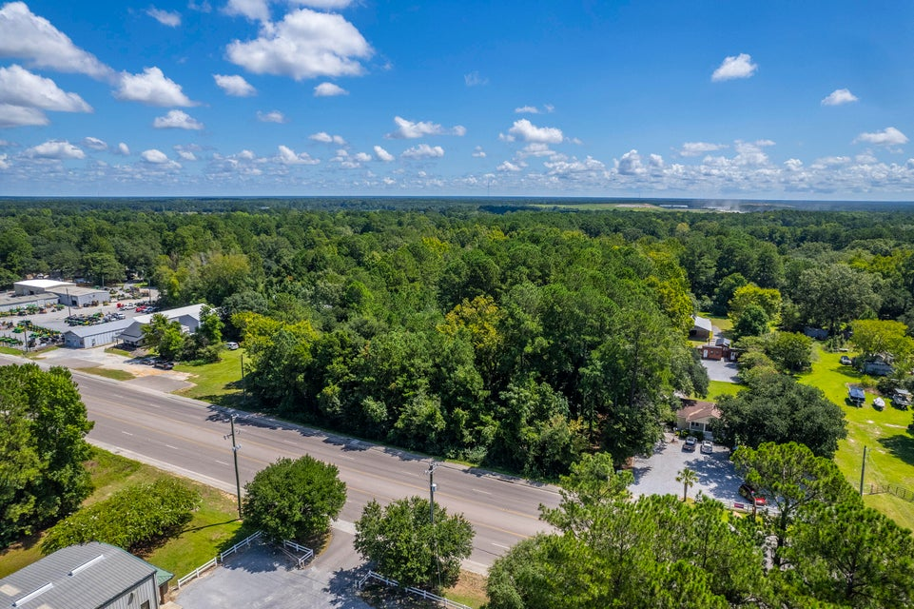
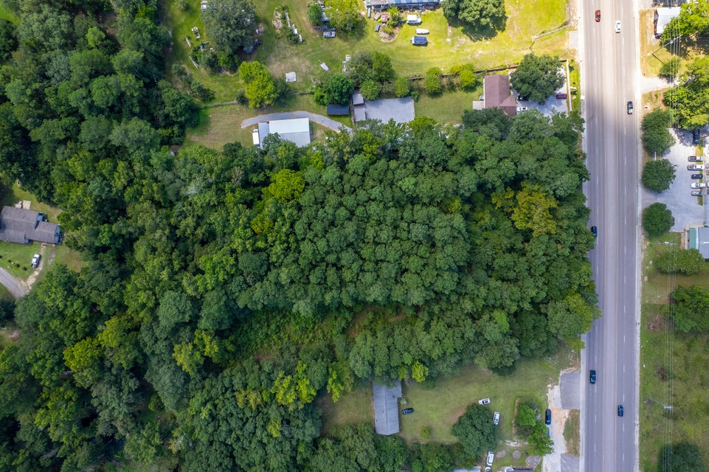
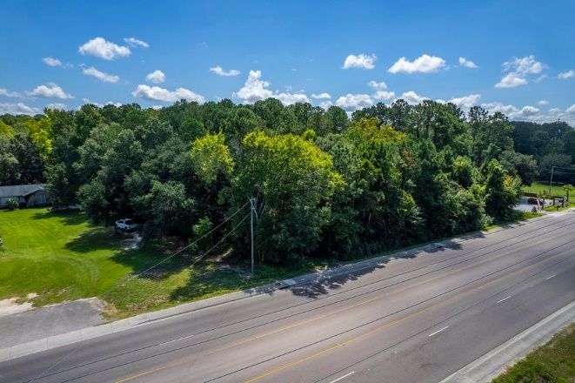
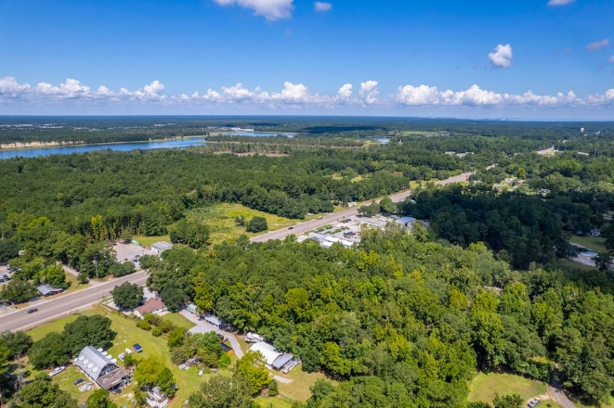
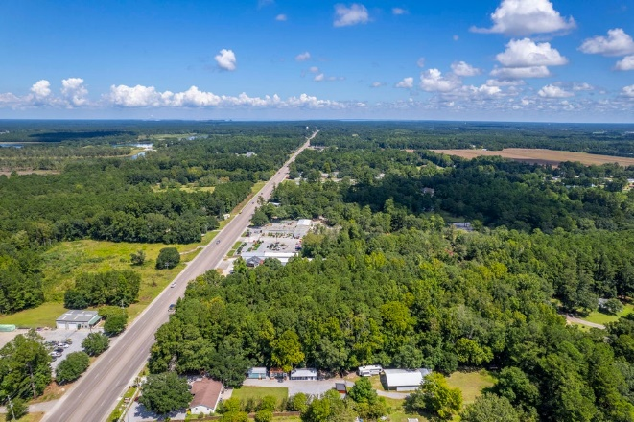


2086 S Live Oak Drive
Moncks Corner, SC 29461 | MLS# 24021217 | $567,000
Moncks Corner! Road Frontage Commercial Use!
Two adjacent parcels, TMS#1800004002 &1800004003 are being combined with a total acreage of 3.24 from recent survey.
Lots are raw land on the Hwy 17A corridor (aka S. Live Oak Dr) between Carnes Crossroad and Moncks Corner. Great traffic count and almost 200 feet of road frontage with curb already cut for driveways.
Zoned General Commercial and County says water is available.
Kelly Rozier
(843) 209-3129
kellywrozier@gmail.com
Brand Name Real Estate
4 Carriage Lane Suite 106
Charleston, SC 29407

