Slide 1
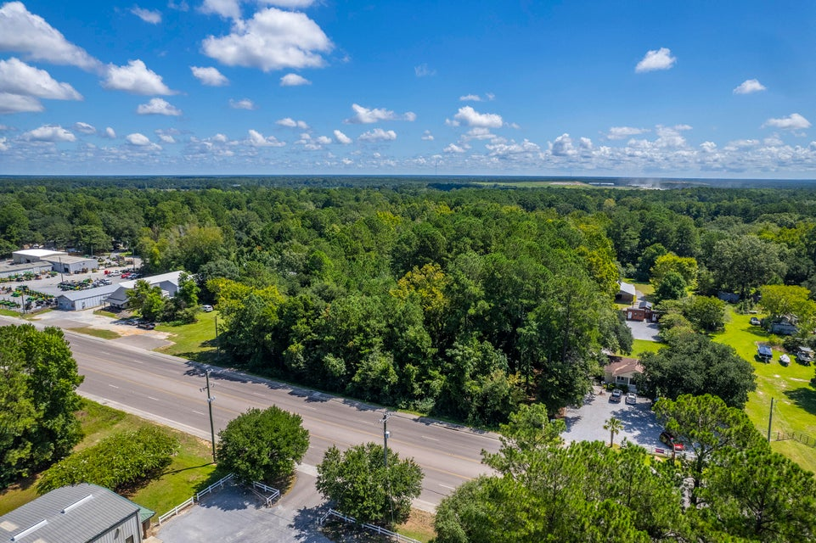
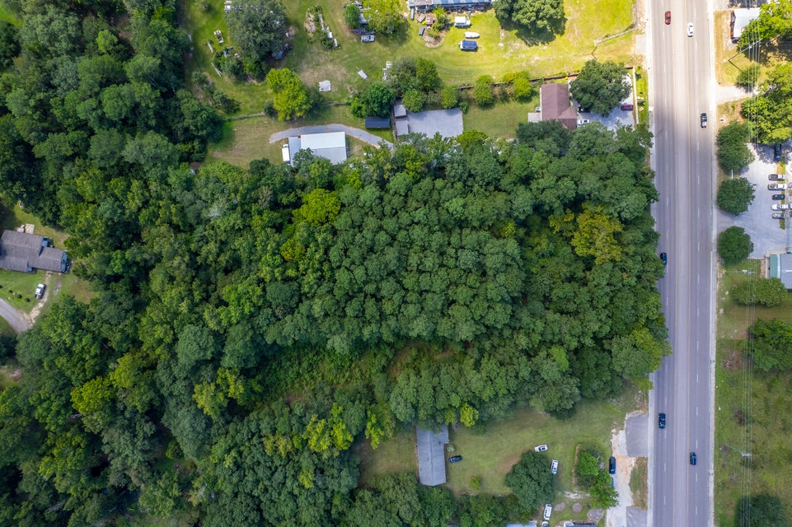
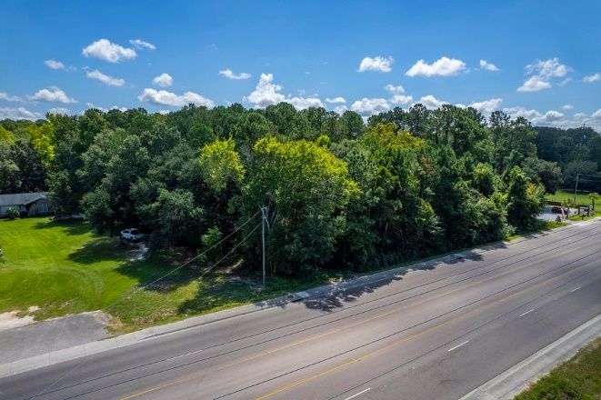
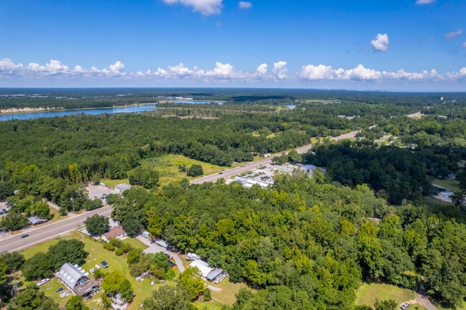
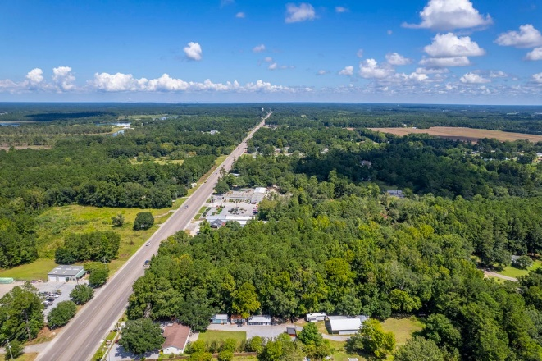


2086 S Live Oak Drive Moncks Corner, SC 29461 | MLS# 25025680 | $484,000
ROAD FRONTAGE! COMMERCIAL USE! 2+ ACRES!
Raw land on the Hwy 17A corridor (aka S. Live Oak Dr) between Carnes Crossroad and Moncks Corner.
Great traffic count with road frontage and curb already cut for driveways.
Zoned General Commercial and County says water is available.
Kelly Rozier
(843) 209-3129
kellywrozier@gmail.com
Brand Name Real Estate
4 Carriage Lane Suite 106
Charleston, SC 29407

