Slide 1
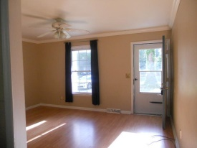
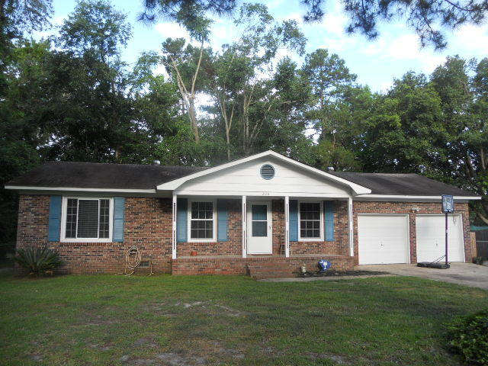
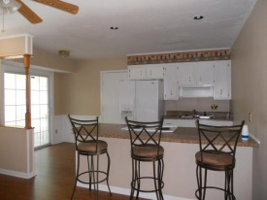
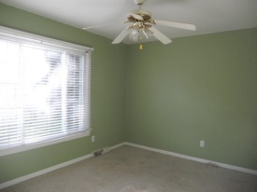
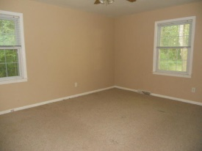
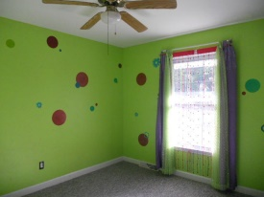
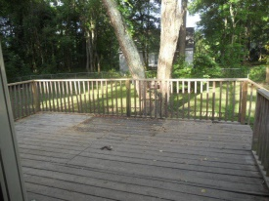

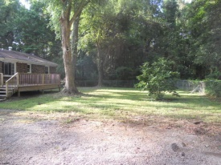


Just Listed! Dorchester Dist 2 Schools!
2+ Acres!
208 Mary Celestia Dr
Warington
Summerville, SC 29483
MLS# 15014335 | $121,000
3 Bed | 1 Bath
Great starter home in desirable Dorchester school district. 3 bedroom 1 bath brick home on .25 of acre lot. Home features living room and den with eat in kitchen. Part of the garage was built in and used as office space. Originally a 1.5 bath home, the current seller removed fixtures to expand master closet. According to seller, plumbing is in place to convert back to a half bath.
Connie White, Broker
C: 843-532-3356
conniesyouragent@gmail.com
Charleston Homes
111 Spring Hall Dr
Goose Creek, SC 29445

