Slide 1
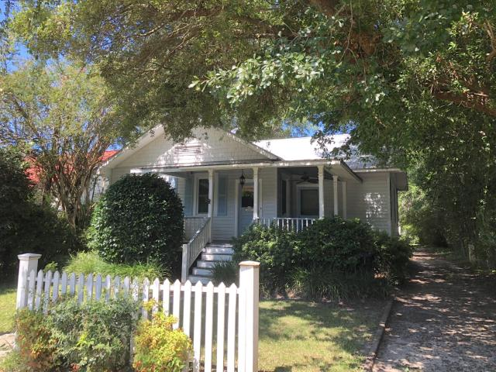
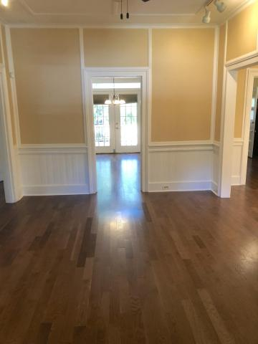
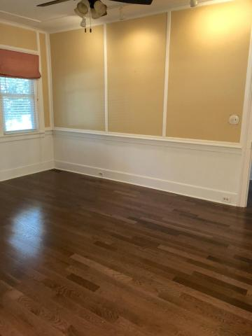
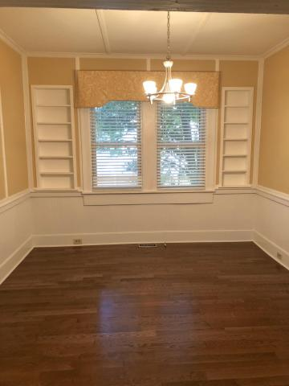
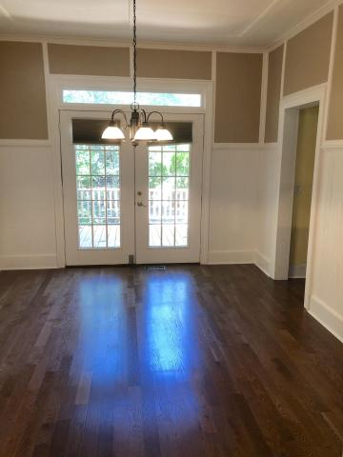
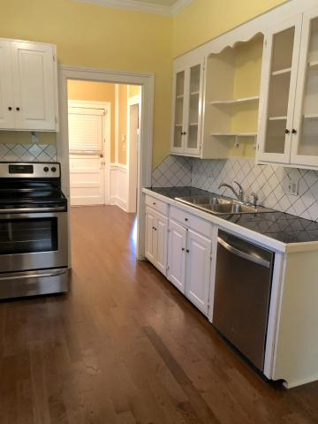
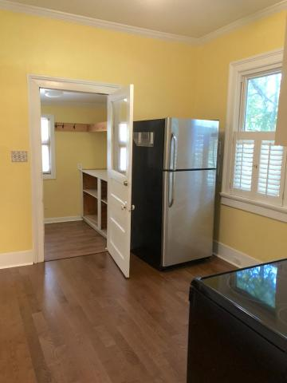
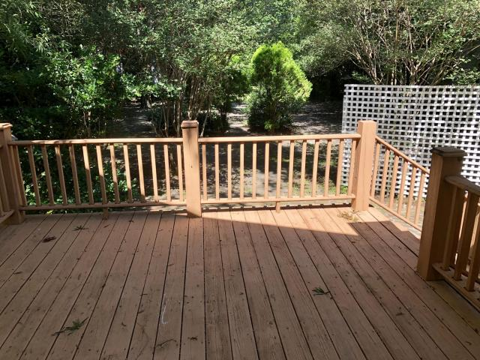
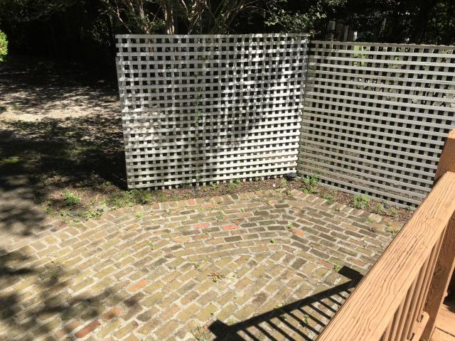
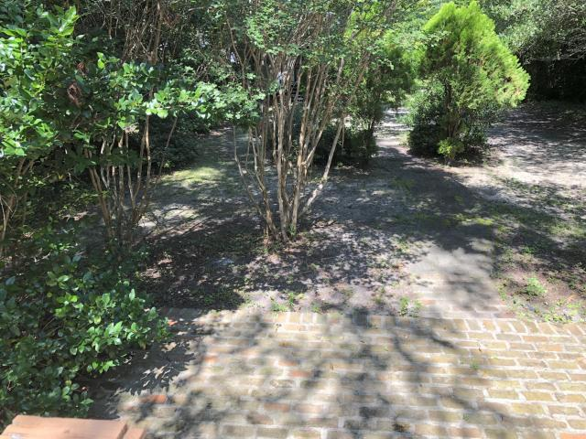


Summerville Short-term Rental - 6 mo/1year lease!!
208 S Magnolia Street
Historic District
Summerville, SC 29483
MLS# 18024425
$1,600/Mo
2 Bedrooms | 1 Baths | 1,000 sf
Want to walk to town for dinner or go to the farmer's market? All just one block away!! This charming home is located right in Historic Summerville and offers a large front porch, wood floors throughout, large living room, office area with built in book shelves, dining room, kitchen with newer appliances, laundry room with w/d hook up, two bedrooms and one full bath. There is a large deck off the back of the home as well as a brick patio for grilling. Yard maintenance is included in your rent as well as access to a large shed for additional storage. Come see this home today!
Larry & Kathy Mazalatis
Larry Cell 843-693-0529
Kathy Cell 843-693-0159
Office 843-871-9133
AGENTOWNED PREMIERE GROUP | 1800 TROLLEY RD | SUMMERVILLE, SC 29485

