Slide 1
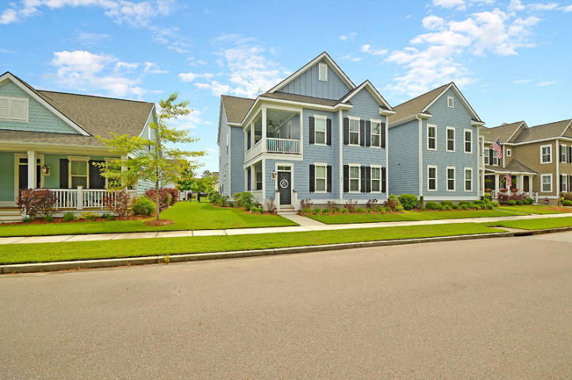
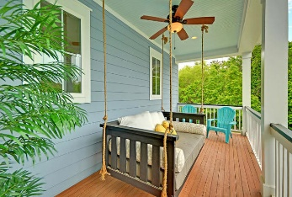
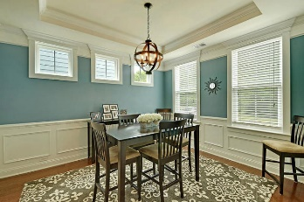
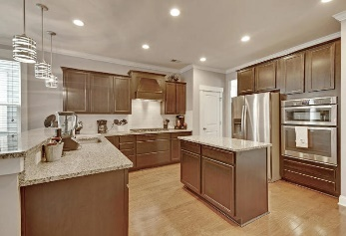
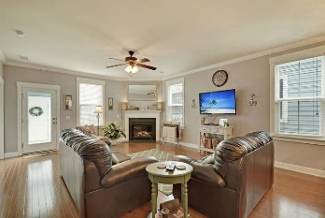
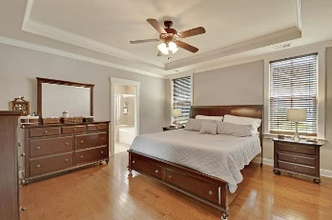
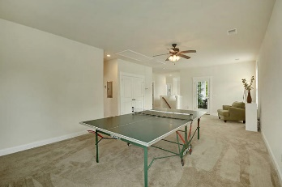
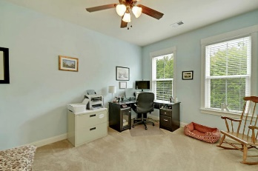
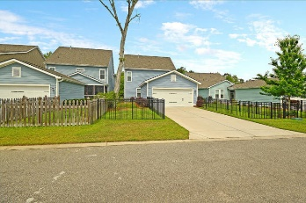
$500 Agent Bonus
208 Sweetspire Lane
Daniels Orchard
Summerville, SC 29483
MLS# 19013316
$374,900
Free Home Warranty with acceptable offer! Extremely well maintained Charleston style home located in downtown Summerville! Double porches, both equipped with Lowcountry Swing Beds, give a quiet and relaxing view of the woods next door. Inside, this popular layout is open and inviting. Formal dining room with gorgeous moulding and tray ceilings welcome you into the home. The upgraded kitchen opens up the living area, making it perfect for entertaining. This kitchen has everything including granite countertops, tile backsplash, stainless steel appliances with built in gas range, and island. Downstairs has hardwood floors, gas fireplace, and crown moulding throughout. Master bedroom is located downstairs and offers plenty of room. Large walk in closet, his and her sinks, garden tub and stand up shower. Upstairs, the large loft area offers plenty of options as a second family room or entertainment area. The three bedrooms upstairs are all great size, with two rooms connected by a Jack and Jill bath. Out back you will find a 2 car garage with plenty of storage, a large driveway to park multiple vehicles, and completely fenced in yard. A great location, with shopping and dining a short drive way, come schedule your viewing today! Ready to view now?
Make sure you check out the 3d tour! https://my.matterport.com/show/?m=mfjMbUarqKb
Sean Harrington
(843) 226-9652 | sean@milerproperties.com

