Slide 1
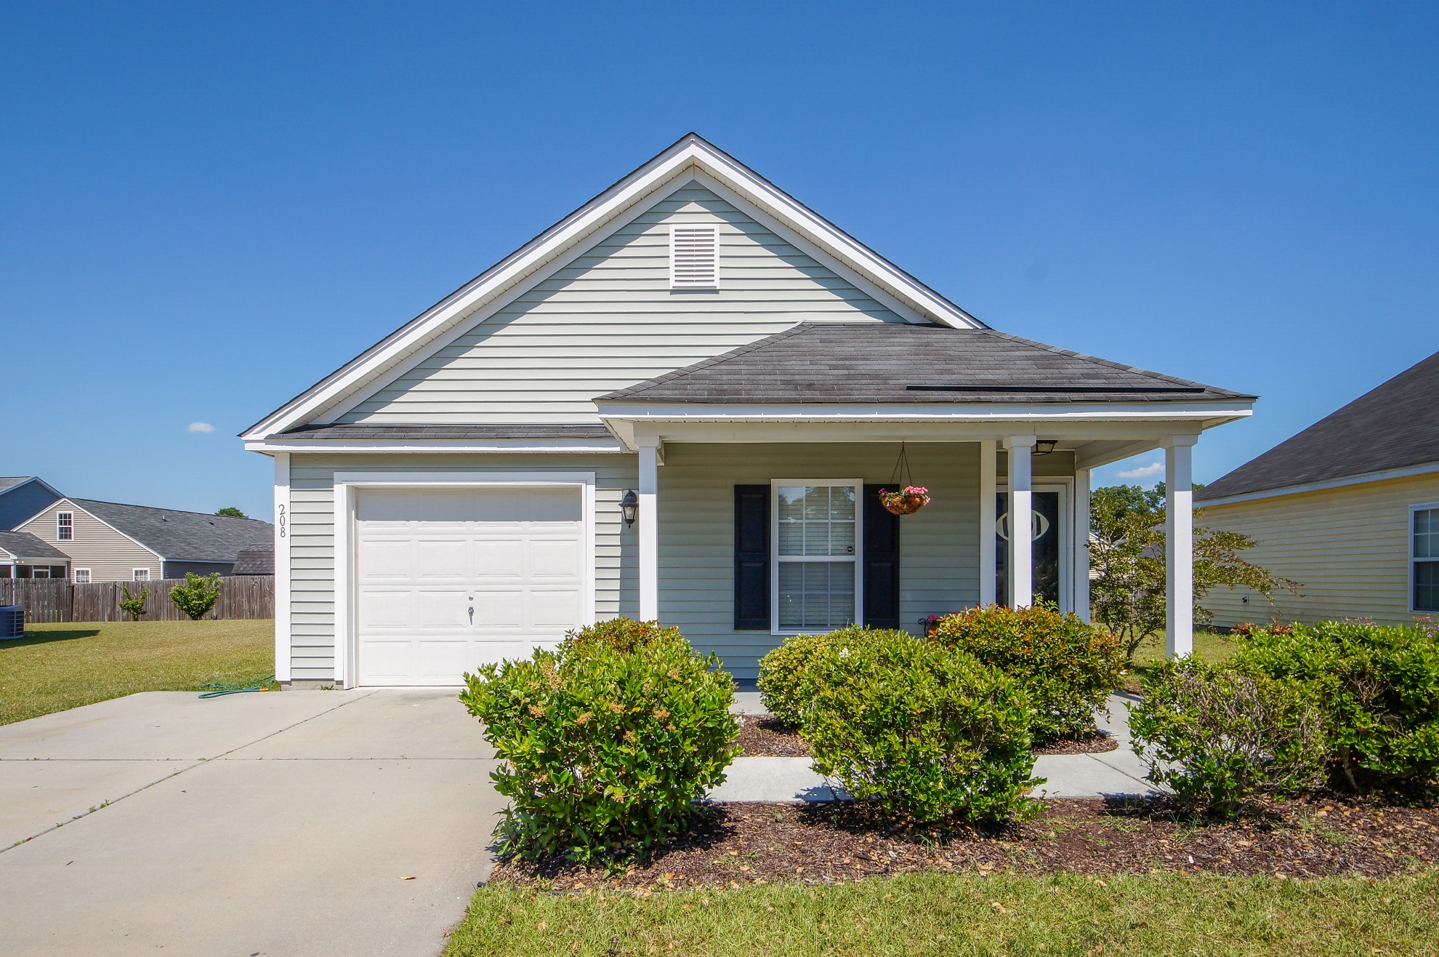
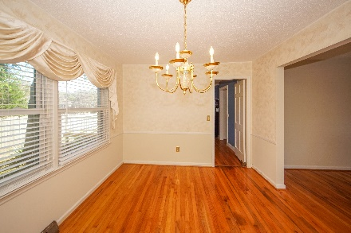
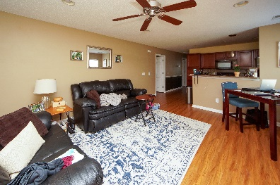
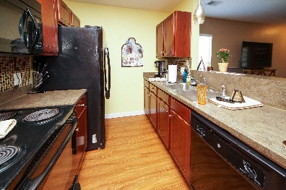
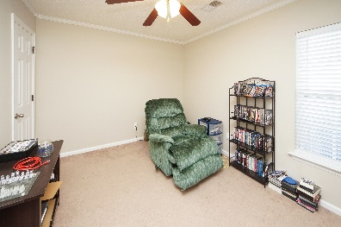
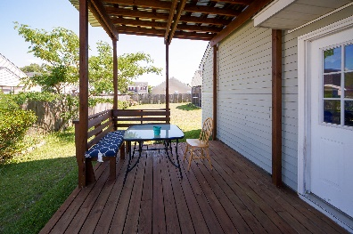
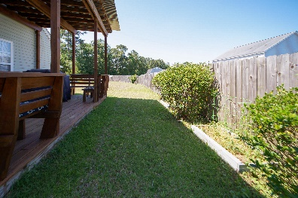


208 Briarbend Road Longleaf :: Goose Creek, SC 29445 MLS# 21023204 :: $220,000
Otranto Beauty
$318,000
Just Listed
Charming 3 bedroom 2 bath home includes black appliances with space saver microwave, upgraded maple cabinets, upgraded kitchen countertops, vinyl flooring and upgraded carpet. A nice deck as been added on the back of the house for family entertainment. Enjoy the quietness of a cul-de-sac and the play park is in walking distance to the home.
Come take a virtual tour: https://charlestonvirtualhomes.com/1180303
Connie White, Broker
843-532-3356
connie@chrepros.com · conniewhiterealestate.com
Charleston Homes · 597 Old Mt. Holly Road · Suite 301 · Goose Creek, SC 29445

