Slide 1
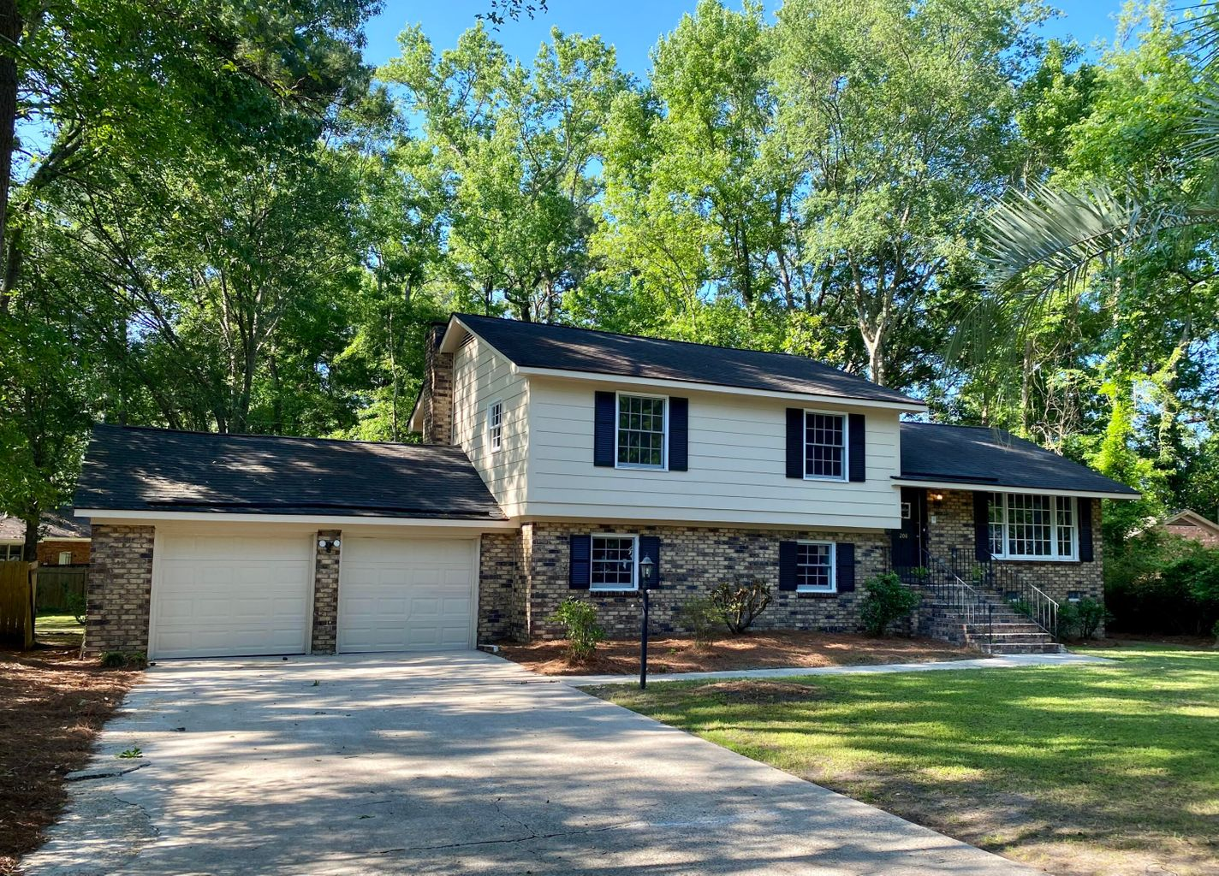
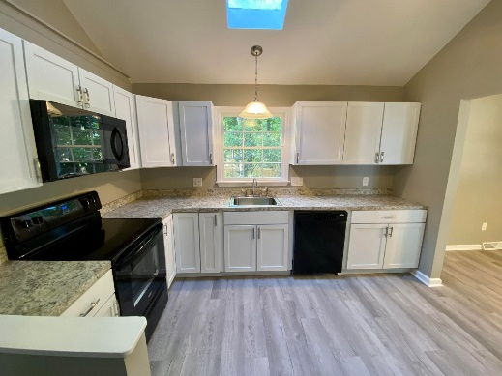
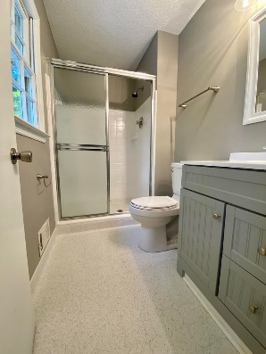
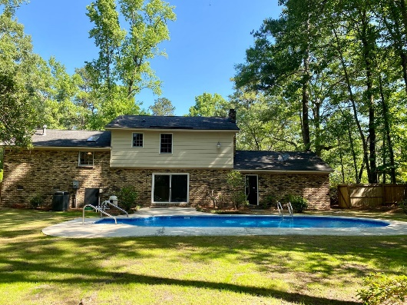
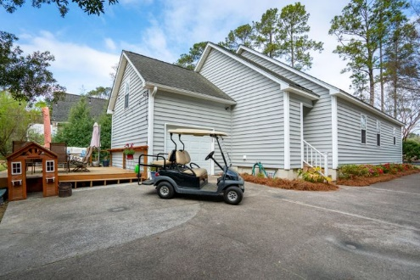


Just Listed, Lots Of Updates And Inground Pool!
Immaculate and well cared for home in the heart of Summerville. Open floor plan downstairs, oversized master suite with his and hers closets and en suite bathroom, with new granite recently installed. Two additional bedrooms with a bathroom right off main living area. Good sized FROG and a nice deck off the back of the house. Stainless steel appliances in the open kitchen with a bar top for easy living and plenty of cabinet space. The best part is your proximity to Historic downtown Summerville. It is an easy golf cart ride to all the shops, dining, and attractions this area has to offer. This is a very well cared for home and it shows.
208 Foxcroft Lane
Kings Grant | Summerville, SC 29485
MLS# 22012850 | $360,000
Updated home in a well established neighborhood. Massive fenced yard with an inground pool, just in time for summer. All new kitchen and bathrooms, as well as all new paint and flooring throughout home. Good sized 2 car garage. Tons of amenities in neighborhood too; large pool and clubhouse, tennis courts, pickleball, 70 plus acres green space and trails, and a private boat ramp. Located in highly desirable DD2 School district.
Justin Natale
843-437-9739 | jnatale1982@gmail.com
www.theblvdcompany.com
The Boulevard Company, LLC | 806 Johnnie Dodds Blvd Ste 100 | Mt Pleasant, SC 29464

