Slide 1

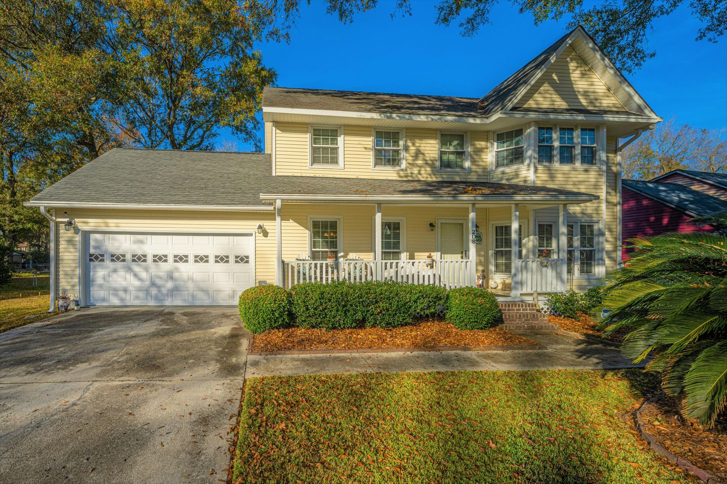
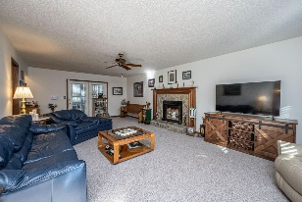
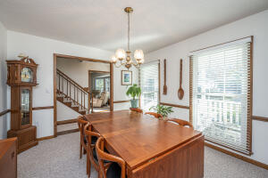
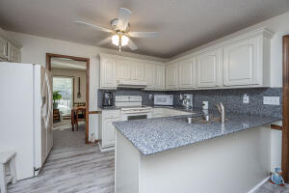
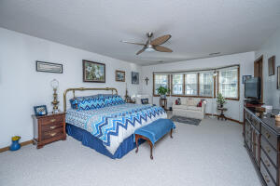
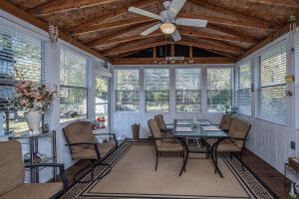


LOADED WITH UPDATES!
New Pipes, Windows, HVAC, Siding, Remodeled Hall Bath
208 Travelers Rest Boulevard
Quail Arbor V ~ Summerville, SC 29485
MLS# 22000003 ~ $330,000
DDII! Convenient location! Sought after Quail Arbor V! Meticulously maintained one owner home! .36 Acre lot! Located off Trolley Rd near shopping and convenient to downtown Smvlle and Dorchester Rd. Walk up the full front porch and begin to unwind. A great spot to have a cold beverage and relax. But there are other options for relaxation and privacy, wait until you see the 14 x 14 Sunroom! Enter the foyer and to the left find the separate dining room and to the right the huge family room, or continue down the hall to the kitchen. Kitchen has workable counter space, a great eat-in area with bay window, light and bright! Family can converse while the cook is at work. Pantry is located on way to the laundry and garage. If prefer formal gathering space, the dining room offers plenty of room for larger gatherings. Half bath is located off the hallway. Family room is enormous! This is a great place for entertaining or quiet family time. Fireplace and wet bar included. Off the family room is the place you will want to spend much of your time, it is a 3 season room and is not included in the square footage. Continue your outdoor living area to the deck and patio. This semi private backyard has room to run and play! Not your cookie cutter neighborhood!. Upstairs find the 3 bedrooms. Master is huge with dual walk-in closets. Secondary bedrooms offer plenty of room. Hall bath has been remodeled with tile walk in shower, new vanity and flooring. This home has been meticulously maintained and has many upgrades. Home has been replumbed, resided to vinyl siding, windows replaced, ductwork replaced during ownership. Is under a termite bond. Main bathroom upstairs was remodeled and has a walk in shower. Call to tour this wonderful home!
Laurie Loparo
(843) 442-1290 | laurieloparo@gmail.com
www.lauriesellscharleston.com
Carolina One Real Estate | 873 Orleans Road, Ste 102 | Charleston, SC 29407-5753

