Slide 1
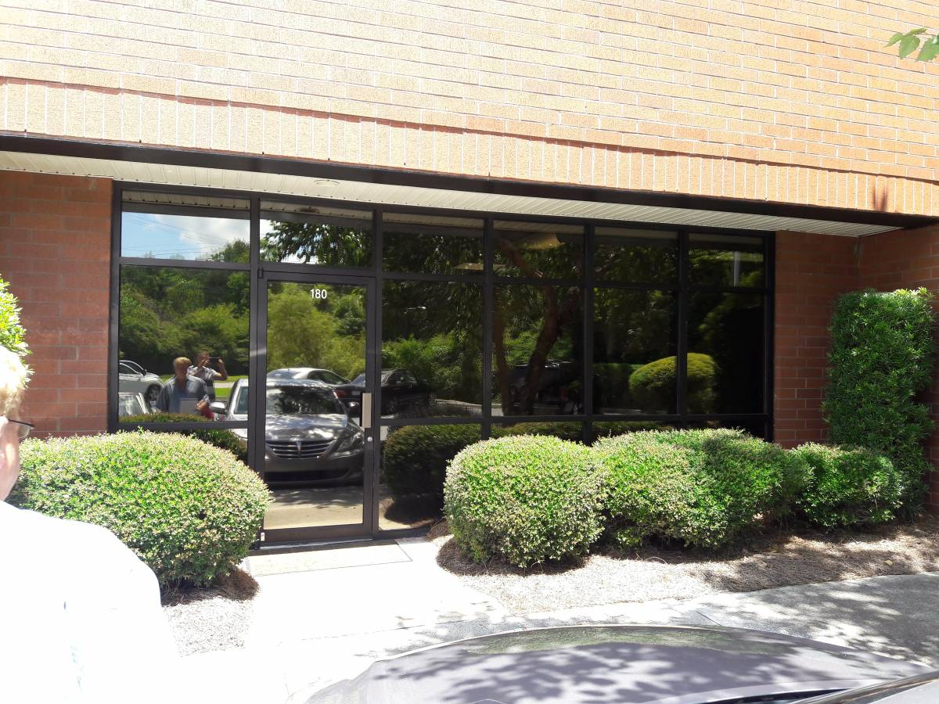
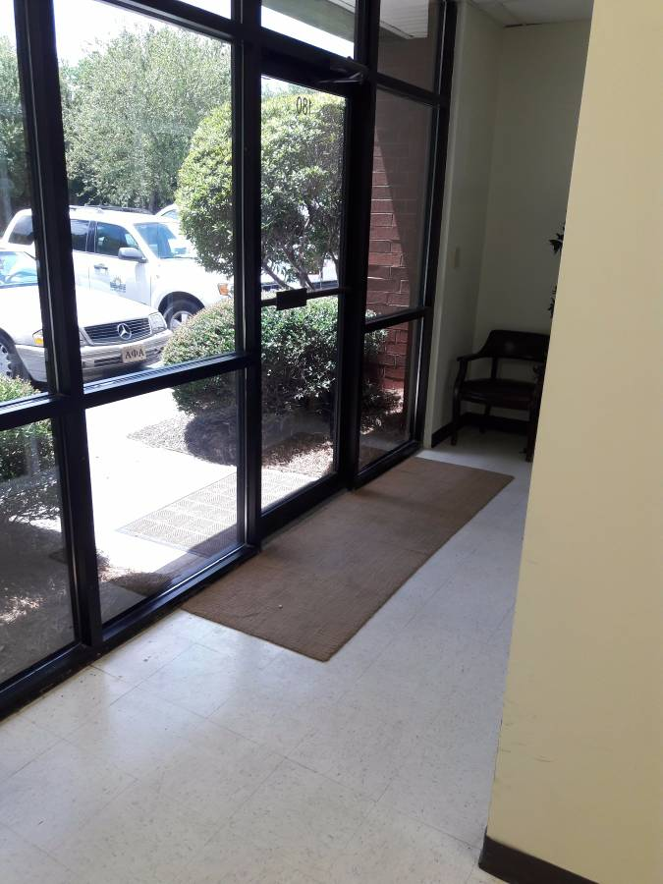
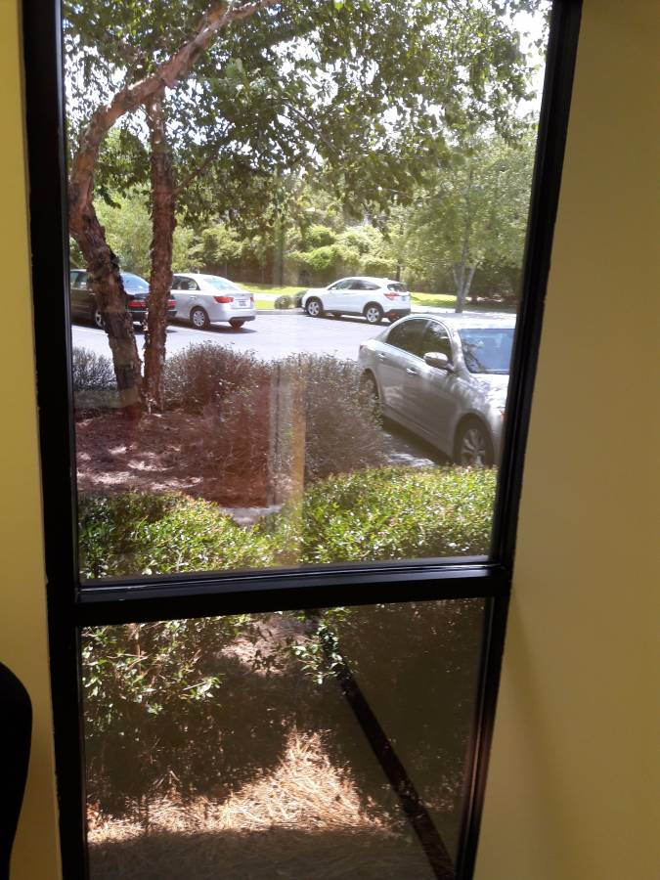
$250 ALL INCLUSIVE
EXECUTIVE OFFICE IN PRIME
WEST ASHLEY LOCATION
2090 Executive Hall Rd
Suite 108
West Ashley prime location right by 526 and St. Francis Hospital. 2090 Executive Hall RD, Suite 180. Dedicated parking. Mature landscaping and trees. Mail Kiosk. Walking green space. Windows, kitchen and bathroom. Storage for file cabinets and signage. Cable/Internet included. Water included.
3 other Executive offices held by real estate agents as well as a financial advisor. Open day and night and tenant will have their own keys. Great group of people looking for good tenant to fill 1 or 2 offices. One office could be a conf room if necessary...options are endless.
All inclusive rates include lease, cable, internet, water. Tenant responsible for their portion of electric which is usually $35+-/month per office:
104 sq.ft with window= $255/month all inclusive
105 sq.ft without window= $240/month all inclusive
Bruce Miller
charlestownehomes@comcast.net | (843) 813-4591 | www.charlestonlifestyle.com
Brand Name Real Estate | 4 Carriage Lane, Suite 106 | Charleston, SC 29407

