Slide 1
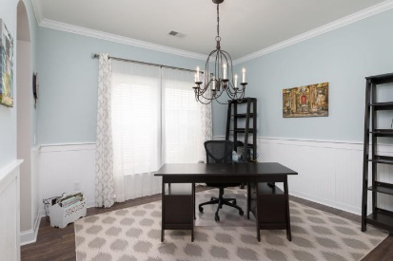
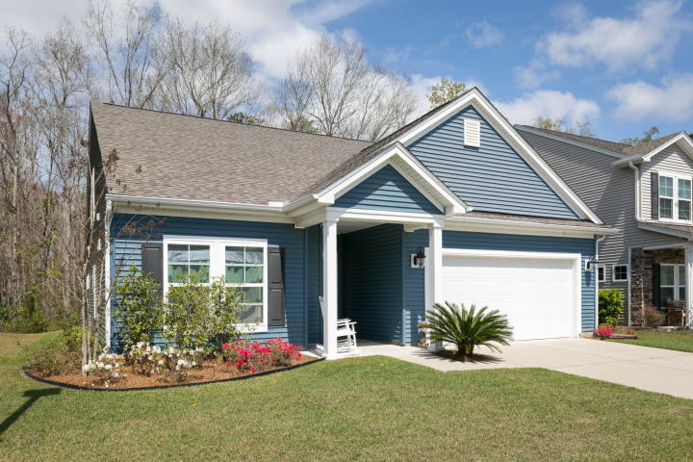
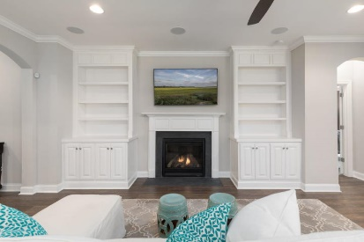
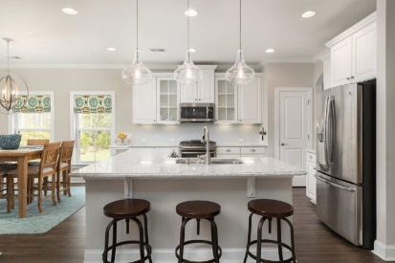
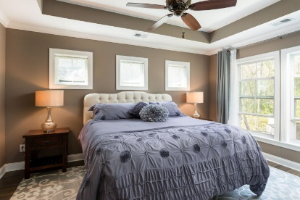
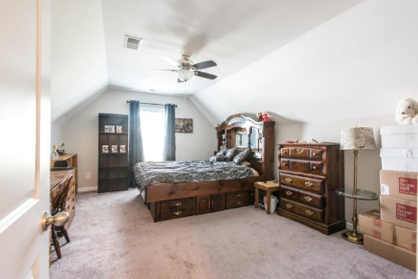
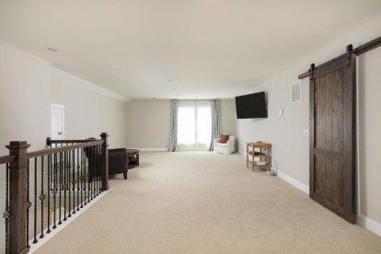
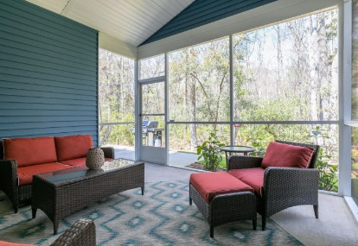
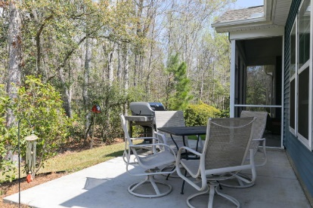


2092 Welsh Pony Drive
Tupelo · Mount Pleasant · MLS# 20008118 · $450,000
Don't Miss Out On This One!
Fabulous In Foxbank...
Sellers Say Sell!
Dreamy one story living with an upstairs bonus room. This gorgeous home is immaculate! As you enter from the front porch there is a lovely foyer and to the left are two generously sized guest bedrooms and a guest bath. As you enter into the rest of the home there is a staircase to the right that leads to the gigantic loft area that comes complete with extra walk in attic storage that is hidden with a custom made barn door. Back downstairs as you continue entering the home there is a huge laundry room with high end washer and dryer that comes with the home. Past the laundry room is a family room with a gas fireplace and lovely built-in shelving and soft close cabinetry on either side of the fireplace. Above the fireplace is in wall cable hookups. There is a formal dining area that can be used a number of ways. The current owners are utilizing it as an office. And just off of the dining/flex room is the kitchen that includes the gourmet package with upgraded appliances including a duel fuel gas range with double ovens. The quartz countertops are beautiful with the white cabinetry with crown molding included. The stainless steel double door fridge conveys as well. The island is huge and has custom headboard surrounding the base for minimal scuffing. Just off of the kitchen is the large breakfast area and off of the breakfast area is the door leading out to the lovely screened in porch with high end patio furniture that also conveys. The screened in porch overlooks the private wooded back yard that offers tranquil setting and comes complete with an irrigation system! This home also includes an extended back patio for grilling, etc. Back inside of the home just off of the family room is the master bedroom that comes complete with a tray ceiling and a huge ensuite bathroom with an enormous walk in closet. The bathroom has a gigantic tiled shower and also has custom cabinetry with a cabinet tower & soft close doors. The entire first floor has high end laminate flooring so there is no carpet to worry about, even in the bedrooms. And the home also has lovely crown molding throughout. There is custom lighting throughout and ceiling fans throughout the main floor and on the screened-in porch. Upstairs in the loft area is carpeted with an upgraded carpet that is in immaculate condition. The home also comes complete with a Nest system that includes a smart thermostat and an outdoor camera. Plus there is built in surround sound and the receiver also conveys! And one of the upgraded features of the home is insulated interior walls for sound deadening and heat efficiency. And wait there's more...the garage also includes custom monkey bar shelving to really beef up the storage capacity of the home. The home has gutters with a leaf guard system so no need to have to constantly clean out your gutters. This amazing abode sits just across from the Tupelo Amenity Center with a covered grilling area and community pool, which is almost better than having your own pool because its right there for your use but you do not have the added maintenance. This home is immaculate and and fully loaded!
Carey Nikonchuk
(843) 276-1701 M
cnikonchuk@gmail.com
www.palmettoproperty.net

