Slide 1
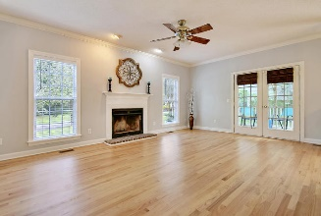
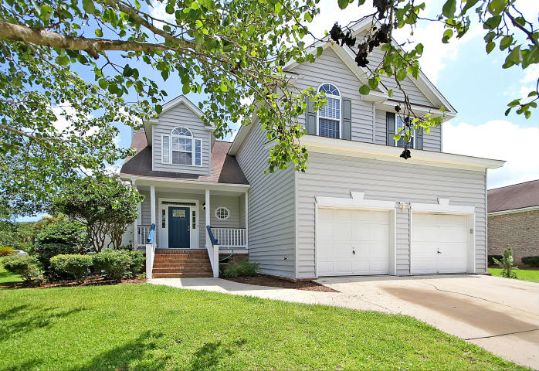
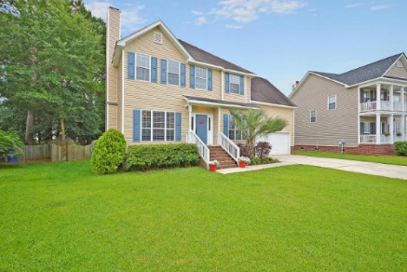
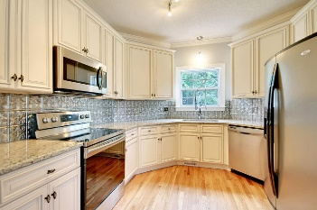
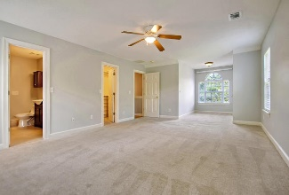
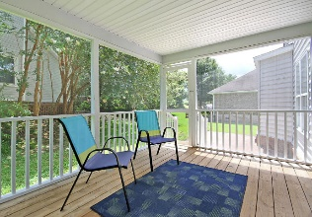
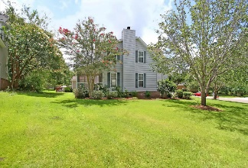

209 Archibald Drive
Laurel Hill - Goose Creek, SC 29445
MLS# 17020283 - $250,000
Price Reduced For Quick Sale!
Price Reduced For Quick Sale!
You do not want to miss this beautifully renovated home near the heart of Hanahan with Berkeley county schools! *** The perfect location for an easy commute! Just Minutes to I-26, Hwy 52, Hwy 78 & the intersection of I-526. Located in the sought-after neighborhood of Laurel Hill. This Established, Lakefront Community boasts mature, dense foliage & a variety of home styles. Enjoy boating on the lake and use of the Community Dock, Boat Ramp & Jetty! *** Renovations include a STUNNING new kitchen! 42'' Solid Wood, Soft-close cabinets with custom Glazing and Crown Molding! NEW Granite Countertops, NEW Stainless Steel Sink with Euro Faucet, NEW Backsplash, Brand NEW Samsung Stainless Steel Convection oven & Microwave. Whirlpool Gold Fridge INCLUDED! All Walls & Trim Freshly Painted with Washable Paint. Real Hardwood Floors have j just been sanded & REFINISHED! HVAC only 7 years old & Recently Serviced. Downstairs Compressor is Brand NEW *** Check out the Spacious Master bedroom with Office/Sitting Area. New Ceiling Fan. The Master Bathroom Renovation includes a Large Soaking Tub & SEAMLESS Shower enclosure. NEW Carpet, too! The Second bathroom upstairs was not left out! NEW Solid surface counter-tops, NEW Vanity, NEW Faucet & Ceramic Tile *** All the bedrooms have Great Closet Space! No lack of storage in this home! Floored storage in the master bedroom, Tons of space in the Laundry Room & Don't miss the Built-ins in the Garage! The Laundry Room is truly amazing. Enough room for clothes folding counter! Or remove this & make it a Mud Room! Upper Cabinets and NEW Luxury Vinyl flooring *** Outdoor Living is the Charleston Lifestyle. NEW Screens, NEW Fan & NEW Door on your large Screen Porch. Adorable Brick patio, too. The HUGE Side yard with mature trees is the perfect place to play ball, set up a picnic, or just enjoy the surrounding views. Your new home is wired for an alarm system and has a Classic Wood Burning Fireplace. Even the Front Door has been replaced & Painted! Close to EVERYTHING! Not in a flood zone so NO FLOOD INSURANCE REQUIRED! *** Grocery Stores, Restaurants, Doctors, the Hospital, Local Hang-outs & More are just minutes away. Sullivan's Island Beach 29 min, Downtown Charleston 26 min, Charleston International Airport 15 min, Air Force Base 17 min & Trident Technical College 10 min. Less than 5 miles to 3 Golf Courses! Near both Tanner Plantation & Hanahan Plantation.
Move In Ready And Enjoy Now!
Call or email for details: (843) 214-8451 or robin@findyourperfectnest.com

