Slide 1
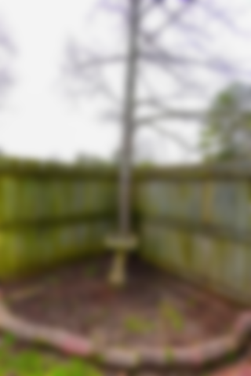
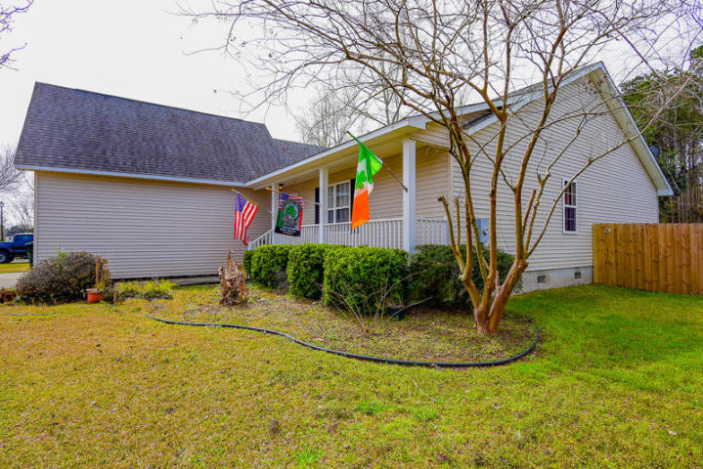
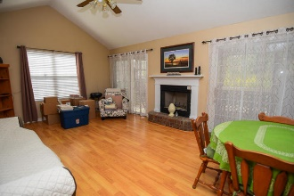
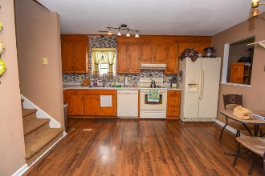
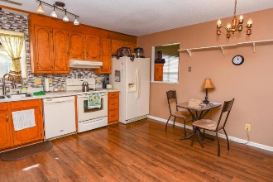
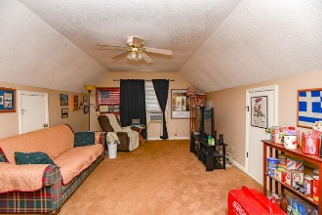
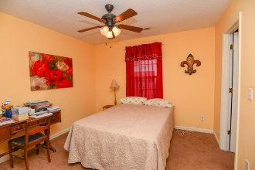

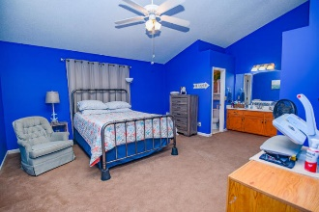
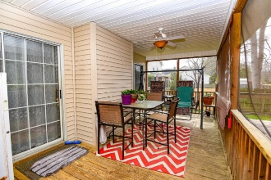
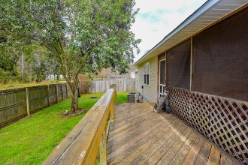
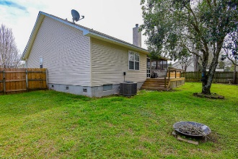
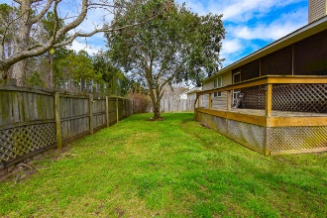


Price Reduced in Woodland Lakes
209 Cane Break Lane
Goose Creek, SC 29445 | MLS# 20007275 | $235,000
Right in the center of everything in Goose Creek! Well taken care of in the very quiet neighborhood of Woodland Lakes. Roof replaced in 2014 and water heater in 2019. No HOA!
BJ Rodgers
843-697-1409 | bjrodgerscharleston@gmail.com
www.bjrodgersrealtor.com
EXP Realty LLC | 170 Meeting Street Ste 304 | Charleston, SC 29401

