Slide 1
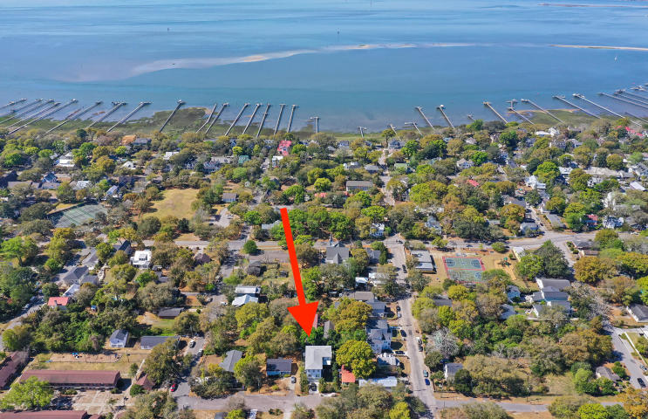
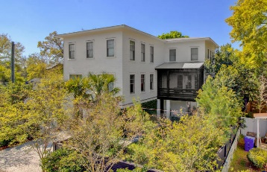
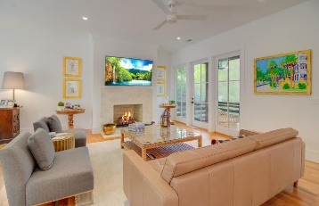
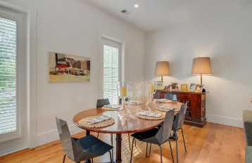
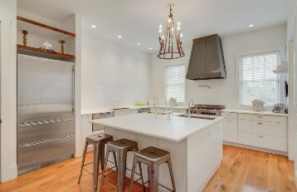
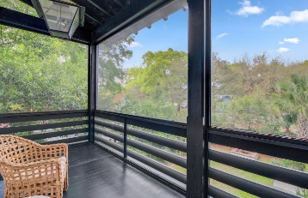
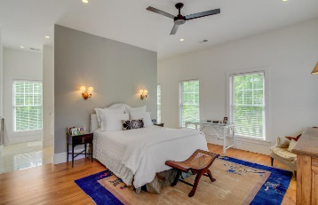
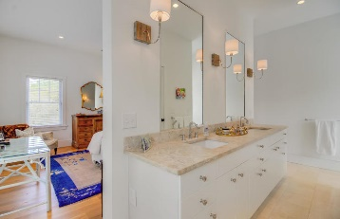
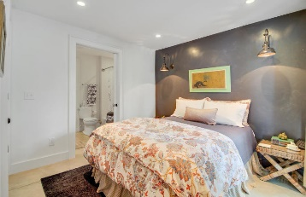
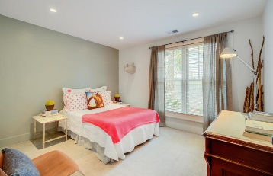
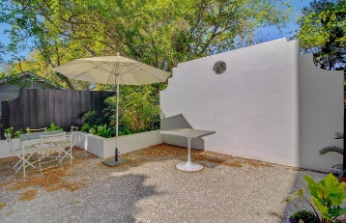


209 Greenwich Street Old Village ~ Mount Pleasant MLS# 19009893 ~ $1,242,000
Open House Lunch ~ Friday, Oct 3 from 11 - 1
Handyman Special… Bring your hard hats!
Improved Price!
New Price!
This exceptional custom built home located in the heart of Old Village in Mount Pleasant is a unique find. The owners have lovingly selected extraordinary finishes throughout. The first level features an in law suite with polished concrete floors, 2 bedrooms and separate entrance. Upstairs, the open concept main living area with white oak floors is sure to please. The spacious kitchen with light cabinetry, white rhino countertops, SubZero refrigerator, Italian cook top and butlers pantry are amazing. Throughout the home you will find top of the line Anderson windows, Kohler plumbing and European fixtures. The 3 third floor bedrooms each feature their own en-suite bathroom. Enjoy the cool breezes in your beautifully landscaped private courtyard. Home also has a rare 2 car attached garage.
Hillary Jones
(843) 709-4666 hillaryjones@sc.rr.com | www.ahomeinsummerville.com
Realty ONE Group Coastal | 1510 Trolley Rd | Summerville, SC 29485

