Slide 1
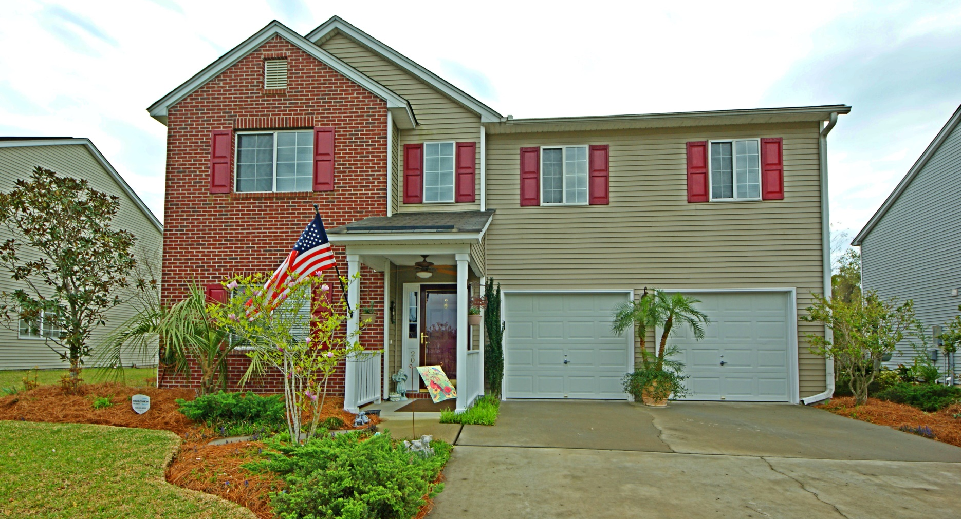
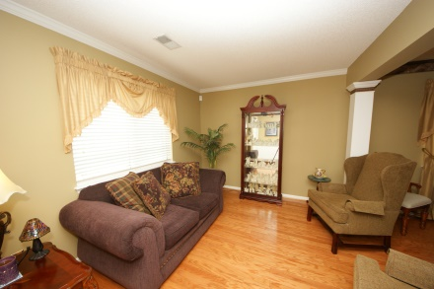
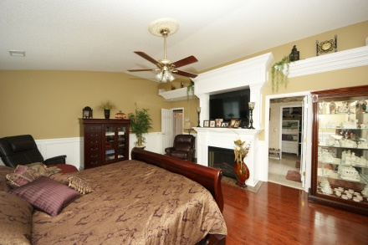
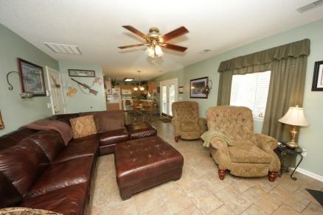
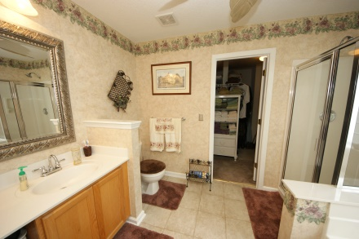
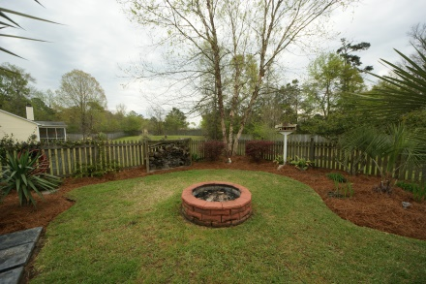
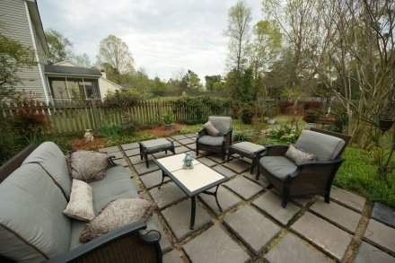


20 Creek Bend Drive
Bridges of Summerville - Summerville - MLS# 15008721 - $199,900
Priced To Sell!
Come see this beautifully maintained home in the highly sought after community Bridges of Summerville.
Conveniently located in close proximity to Boeing, and the Air force Base, this spacious 4 bedroom / 2.5 bath home is move in ready and won't last long!!!
Surrounded by an exceptional outdoor oasis with a wonderful backyard view, this home is your perfect sanctuary.
Master bedroom with fireplace, large walk in closet, garden tub and separate shower, large two car garage, amenities include pool, clubhouse and play area.
A MUST see to fully appreciate all this pristine home has to offer!
Jericha D'Elia
Mobile - (843) 568-1767
jericha@charlestonpropertyexperts.com
jericha.findhomesincharlestonarea.com

