Slide 1
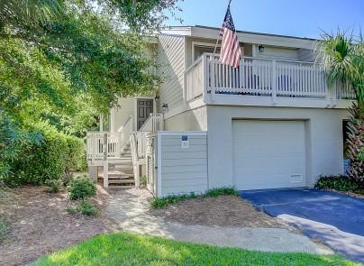
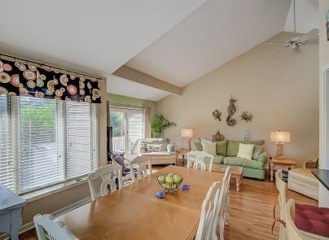
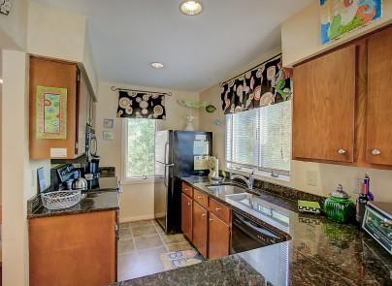
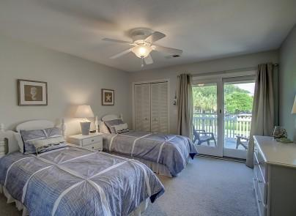
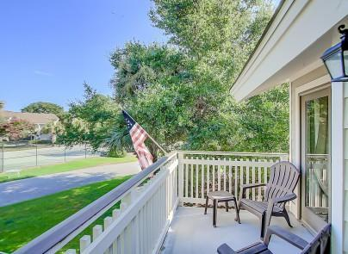
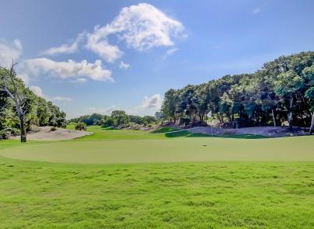
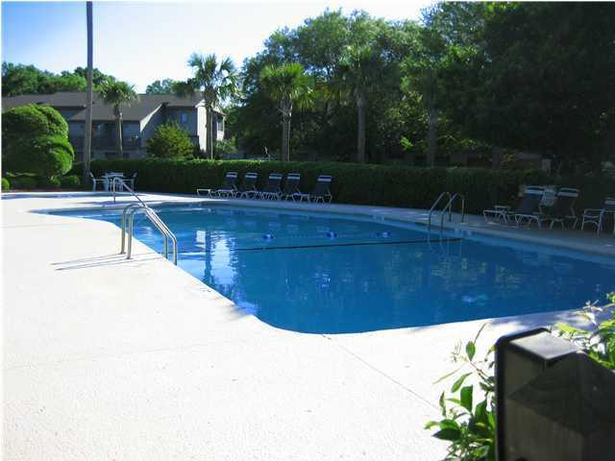


20 Fairway Dunes Lane
Wild Dunes
Isle of Palms, SC 29451
MLS# 1018883
$499,000
Sellers Very Motivated!
Exceptional End Unit
Master Down/Golf Course
Exceptional end unit in one of Wild Dunes most desirable locations--just steps to the beach. This Fairway Dunes Villa has many nice features. The large spacious great room is open to the kitchen and dining area. The large master is down in this unit. This property overlooks the Wild Dunes Links Golf Course and is only steps from the Atlantic Ocean. Fairway Dunes Villas offer a lovely community pool and tennis for your enjoyment. Great rental, second or primary home. Well maintained with many upgrades, garage parking for your convenience. Also close to the Wild Dunes Beach Owners Cabana. New HVAC.
Darlene Smith
Office - (843) 886-8110
Mobile - (843) 696-7824
darlenesmith@carolinaone.com
DarleneSmithTeam.com
Carolina One Real Estate
1503 Palm Blvd Ste
Isle of Palms, SC 29451

