Slide 1
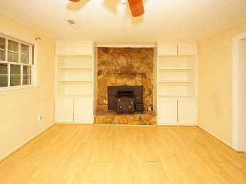
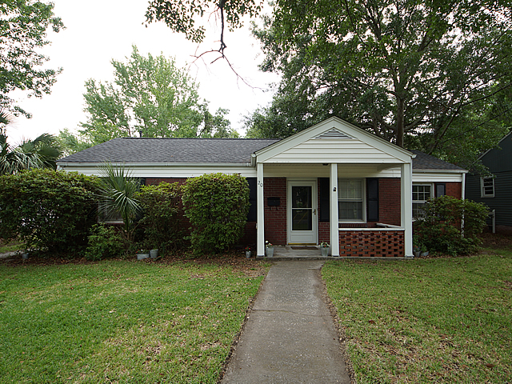
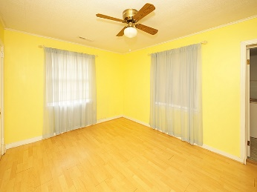
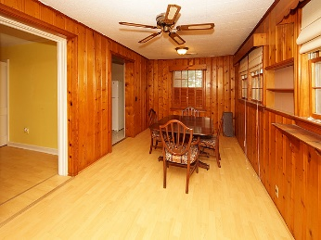
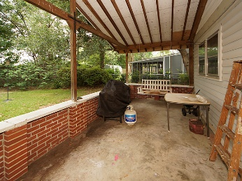
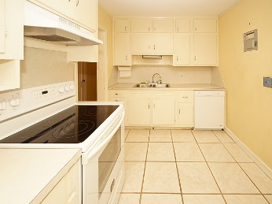
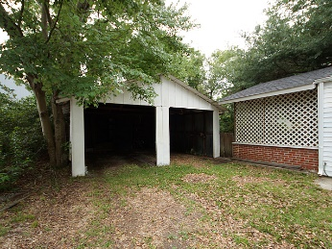
Major Price Drop!!
20 Lolandra Avenue
Carolina Terrace ~ Charleston, SC 29407
MLS# 17015441 ~ $299,000
Just 3 blocks from the heart of Avondale, this well maintained brick home has the true ''walking distance'' location so many want. With 3 bedrooms and 2 full baths it gives you the space that you need. This home has a good sized backyard that is fenced and a detached garage. Inside it features laminate flooring, tile in the kitchen and a separate dining room. The sellers had a new roof installed in 2015 & added a tankless water heater recently. Enjoy the wood stove in the family room on cool evenings. It's hard to beat walking or riding a bike to so many restaurants and stores.
Mike Goldston, Realtor
mikesellscharleston@gmail.com | 843-343-7026 | www.cometocharlestonsc.com
Brand Name Real Estate | 4 Carriage Lane, Suite 106 | Charleston, SC 29407

