Slide 1
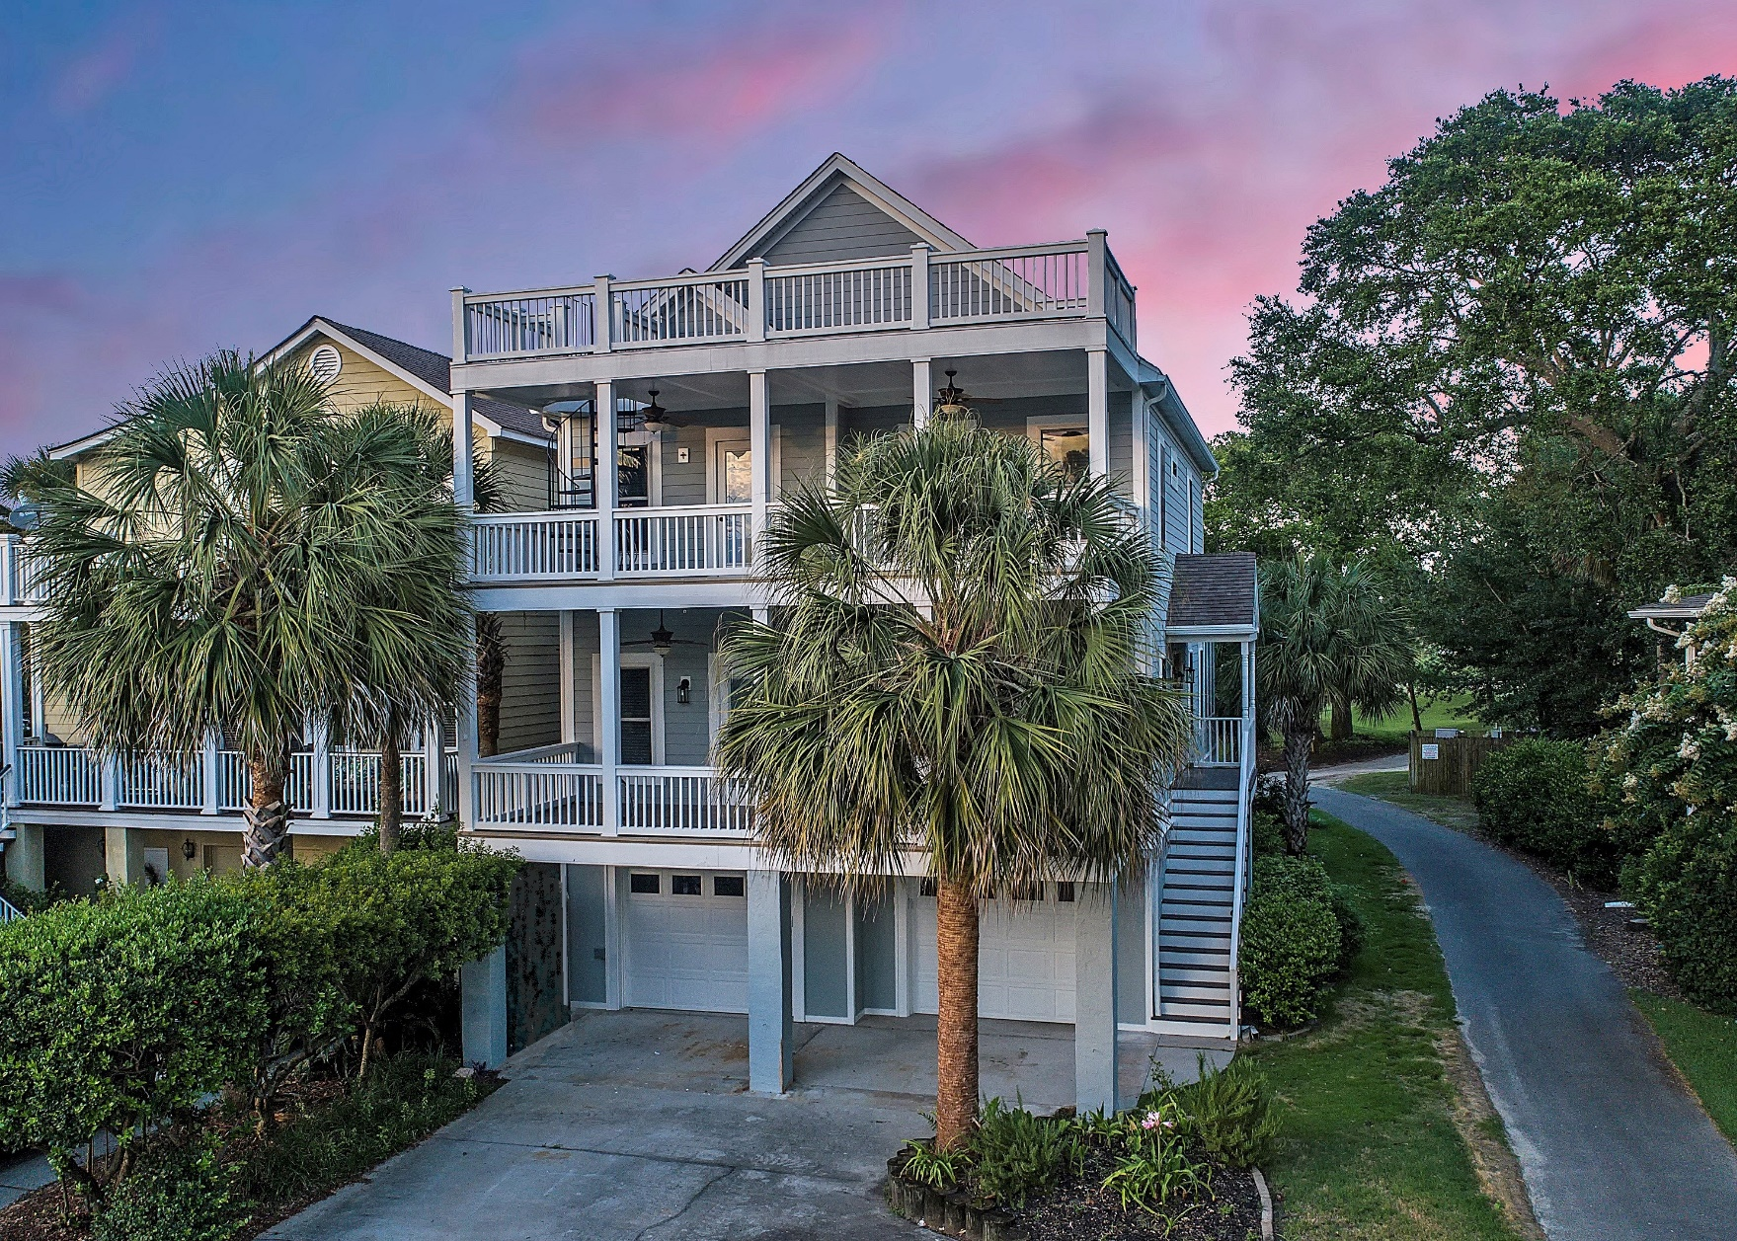
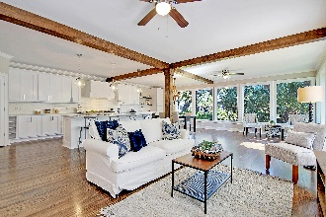
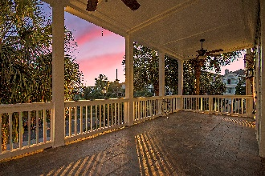
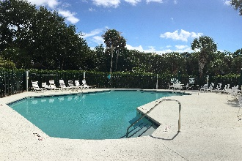
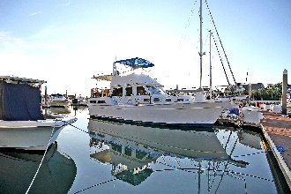


20 Morgans Cove Drive
Wild Dunes :: Isle of Palms, SC 29451
MLS# 18019600 :: $1,025,000
3 Bed / 3 Bath
Boater's Dream in Wild Dunes
40’ Deep Water Boat Slip
Just Reduced!
Boater's Dream ~ 40ft BOAT SLIP on DEEP WATER Morgan's Creek in Wild Dunes ~ A short walk, bike or cart ride to your BOAT, POOL and BEACH. Enjoy sunsets over the 13th fairway of the Harbor Course from two full-width COVERED PORCHES, or up the SPIRAL STAIRCASE to a ROOFTOP DECK. Start your day with an equally spectacular sunrise "long view" of the 14th fairway through a WALL OF WINDOWS from the brand new RENOVATED KITCHEN and OPEN FLOOR PLAN living area. Some SPECIAL FEATURES include: Refinished HARDWOOD FLOORING, new custom cabinets and quartz counter-tops, 6-burner Kucht gas range with commercial grade exhaust hood, stainless steel dishwasher, under-counter microwave, fresh exterior and interior paint, designer 3/4 light double front doors, and a WALK-IN PANTRY.
The house has a 600sqft (15'x40') floored attic which is suitable for finishing into heated and cooled living space. Fourth bedroom/mother-in-law suite plans and quotes are available.
Steve Kaul, REALTOR
(843) 817-5547 · skaul@carolinaone.com
www.charlestonhousehunt.com
Carolina One Real Estate · 195 W Coleman Blvd · Mt Pleasant, SC 29464-3495

