Slide 1
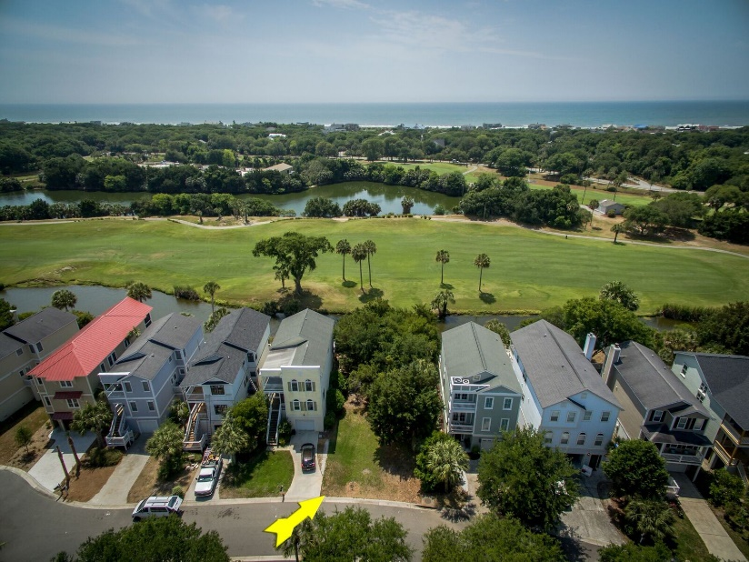
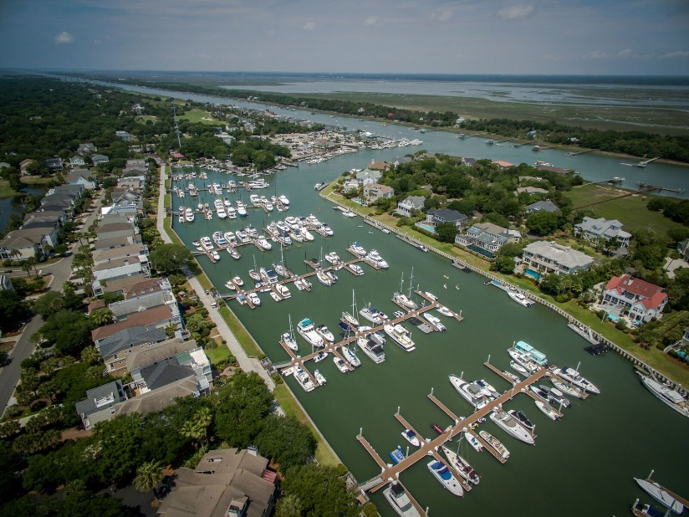
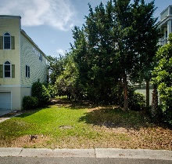
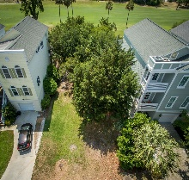
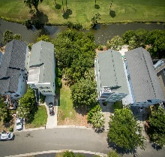
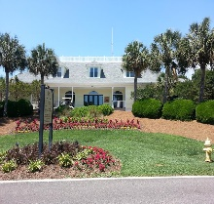
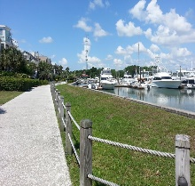
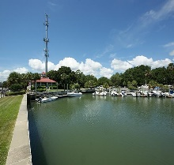


20 Yacht Harbor Court Wild Dunes | Isle of Palms | MLS# 16012634 | $359,000
Great lot in Wild Dunes with water & golf views!!
One of the few remaining lots for sale in Wild Dunes to build your dream home! Especially at this price!
This property overlooks a lagoon and the 14th tee box of the infamous Harbor Golf Course in Wild Dunes; so you have both water and golf views!
Yacht Harbor Court is an awesome street; private and quiet.
Close to the boating/marina world and your opportunity to build on a great lot at a good price in an exclusive and gated community with first class amenities!
Come check it out...
Barbara Walker
REALTOR
Office - (843) 886-8110
Mobile - (843) 906-5404
bwalker@carolinaone.com
www.barbarawalkerrealtor.com
Carolina One Real Estate
1503 Palm Blvd
Isle of Palms, SC 29451-2280

