Slide 1
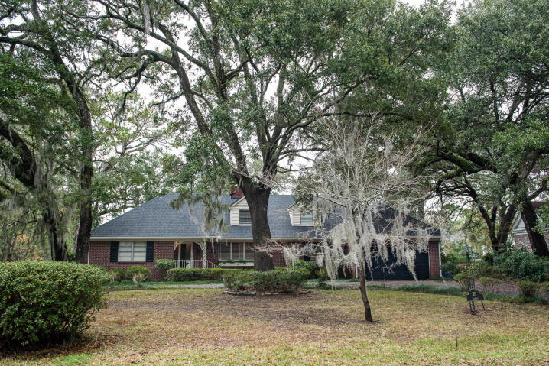
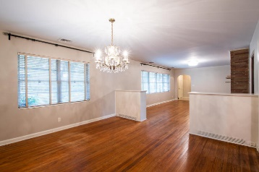
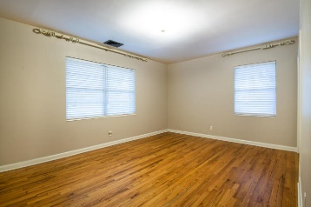
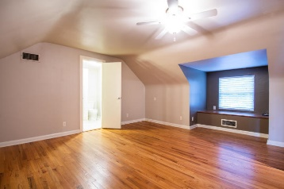
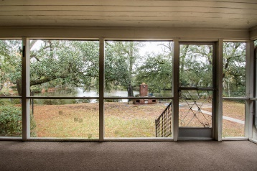
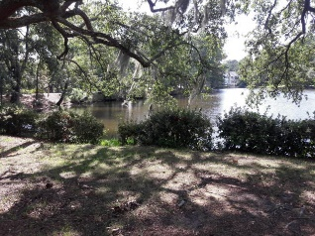
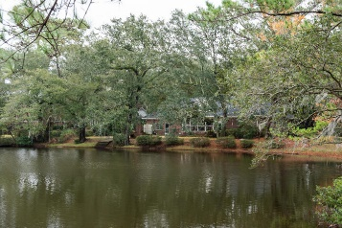
Motivated Sellers
20 Guerard Road
The Crescent | MLS# 19020800 | $1,195,000
One on the most sought-after luxury neighborhoods in Charleston just a few minutes from downtown, Porter Gaud School, shopping, and the beach. Beautiful lake front corner lot on Guerard and Broughton Rds. This one owner home has been well maintained with new roof (2018), new gutters (2018), new carpet in den (2019), new HVAC (2018), crawlspace mold remediation and encapsulation (2018), original wood floors, formal dining room, fireplace in formal living room, and 12'' tile in master bath and foyer. The original bathrooms and eat-in kitchen are waiting for your personal renovations if you choose but are very livable if you choose not to update. Utility room has washer/dryer hook-ups and work room. There are 3 bedrooms downstairs, 1 upstairs plenty of storage space.
MaryAnna Disher
(843) 224-3752
mdisher@disherproperties.com
Disher Properties Real Estate

