Slide 1
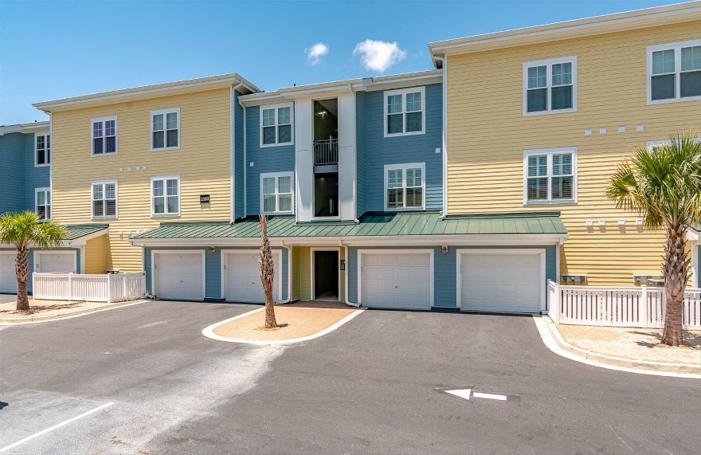
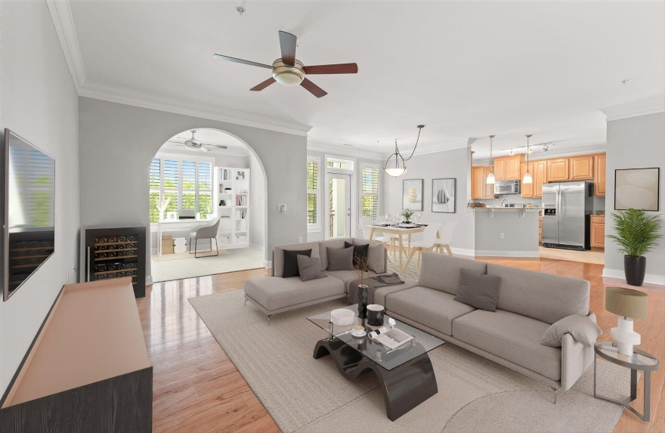
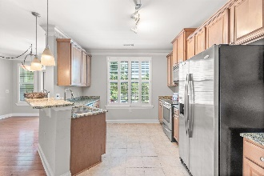
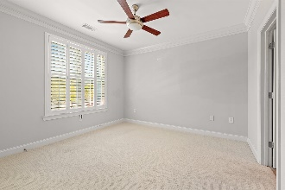
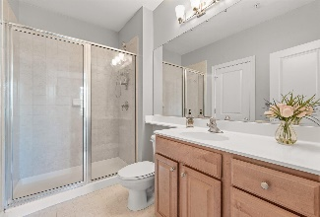
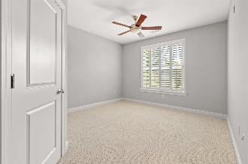
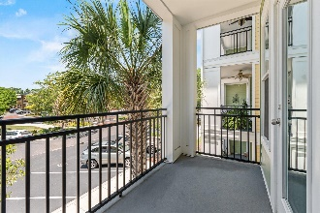

1 Year Paid HOA!
2100 Belle Isle Avenue Unit #204
One Belle Hall ~ Mount Pleasant, SC 29464 ~ MLS# 22016649 ~ $435,000
SELLER IS OFFERING ONE YEAR OF PAID HOA DUES! Buyers can use that to reduce monthly mortgage payments for one full year, when rates are expected to go down, and prices will certainly increase! HUGE price reduction also NOW! Huge relief from double whammy of rates and price increases! BEST deal for any condo with attached private garage!!! Location is amazing, out the front entrance and you have grocery shopping, many restaurants, fitness centers, adorable shops, and Starbucks. Convenience is the proximity to highway 526 and within 25 minutes to the airport, downtown Charleston, and the beaches, and you are 5 minutes to Daniel Island and the concert stadium. This area is centrally located in Mount Pleasant, and highly desirable! Secure, gated complex. Condo features NEW PAINT! NEW WINDOWS! NEW HVAC! and NEW STAINLESS APPLIANCES including a Bosch Dishwasher! Exterior HOA upgrades are new roof and new siding. When you enter the home you are in an open kitchen/living style with dining area, office/den area, and a balcony . Included are custom plantation shutters on all windows, high ceilings with crown molding that add a spacious feel to the rooms! Both bedrooms have walk-in closets and ensuite bathrooms. The kitchen also has a huge pantry, plus extra storage shelving in the laundry room which includes washer/dryer with the purchase.
Therese Jenkins
(843) 568-9748
therese@beautifulhomesllc.com
Beautiful Homes Realty
130 River Landing Dr #7322
Charleston, SC 29492
www.beautifulhomesllc.com

