Slide 1
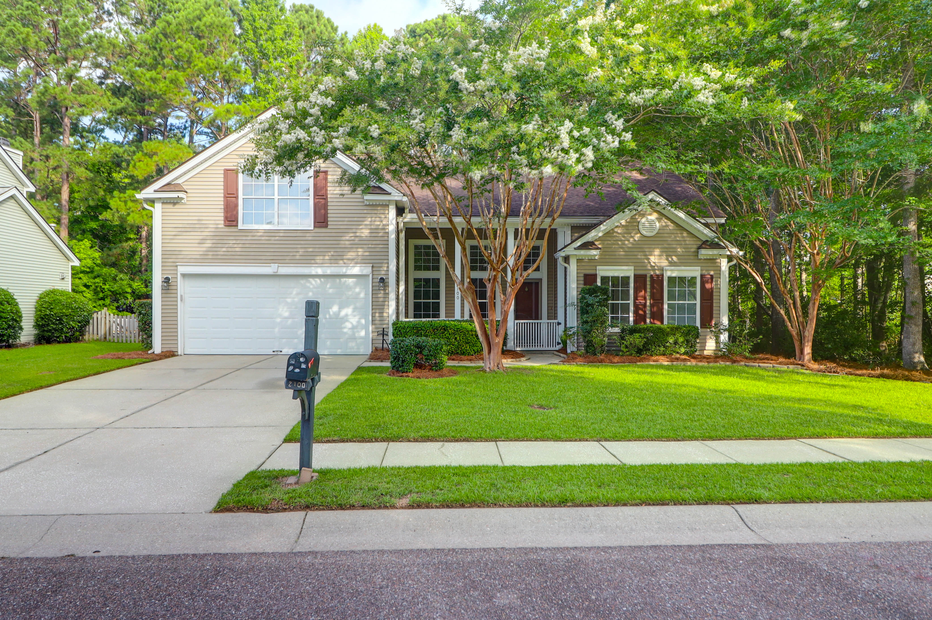
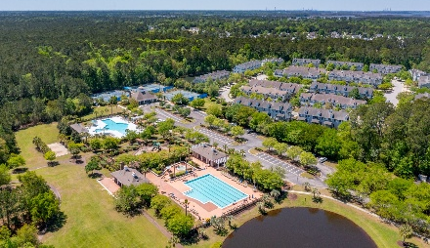
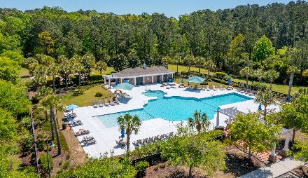
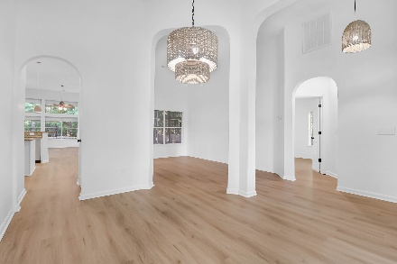
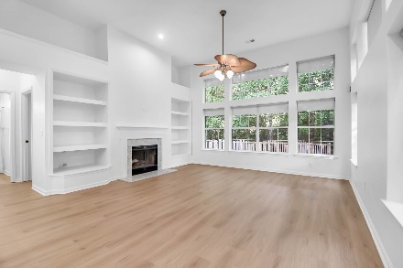
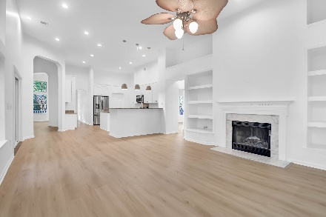
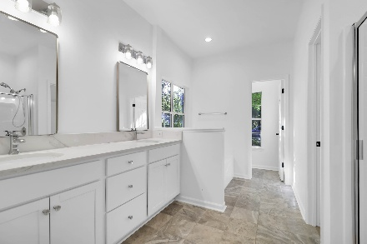


For Sale By Owner in Park West
2100 Andover Way | Mount Pleasant, SC 29466 | $785,000
4 Beds | 2 Baths | ~2500 SF
Come take a look! This charming 4-bedroom home offers a perfect blend of timeless elegance and modern comfort, capturing the essence of Lowcountry living. Nestled in the highly sought-after Park West community in Mount Pleasant, it features a picturesque backyard surrounded by mature trees, creating a peaceful and private retreat just minutes from top-rated schools, shopping, and dining.
This move-in-ready home is just a short distance from Park West’s exceptional amenities, including a pool, tennis courts, scenic trails, and a recreation center. It offers the perfect combination of style, practicality, comfort, and convenience.
Seller is a licensed real estate broker.
Avenue Realty Company
www.avenuerealtyco.com
Greg Boger
843-277-5845
gboger1@gmail.com

