Slide 1
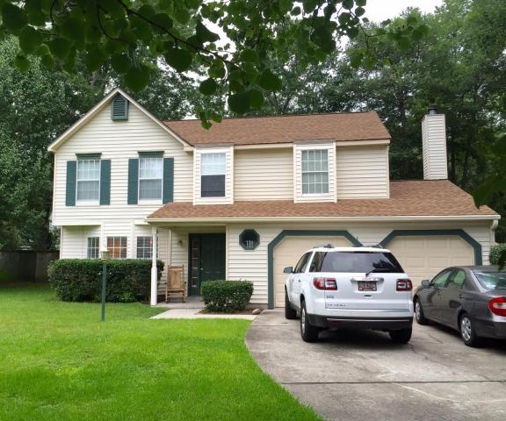
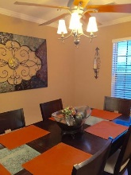
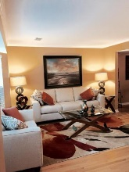
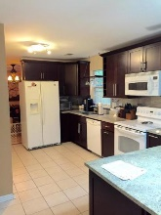
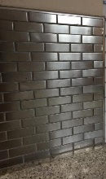
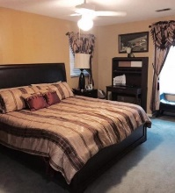
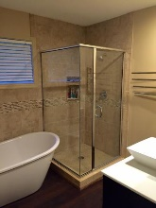
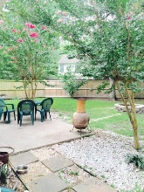
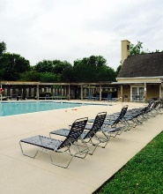
2101 Pinehurst Avenue
Canterbury Woods ~ Charleston ~ MLS# 16017588 ~ $259,000
Open House This Weekend
Sat & Sun 1-4pm
$5,000 toward buyer's closing cost.
$5000 agent bonus w/ BIC approval.
This home has been nicely renovated and maintained with lots of upgrades. The kitchen has granite countertops, new cabinets and stainless steel tile backsplash. Family room overlooking backyard, has a wonderful gas fireplace; living and dining rooms have newer Bruce hardwood flooring, and there are 2" blinds throughout the house. Upstairs, there is an incredible master bedroom suite with a soaker tub, shower, double vanity sinks, large closet, and a bright sunny room. The community has a clubhouse, saltwater pool, tennis courts, and basketball court. There is a 2 car garage and a large fenced backyard with a fire pit and patio for grilling just outside the back door.
Deborah A Hulett
(843) 814-0255
debby@hbrtwn.com
Harbourtowne Real Estate | 672 Marina Drive, Ste 110 | Daniel Island, SC 29492

