Slide 1
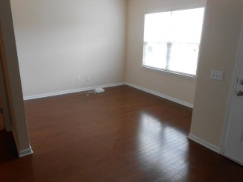
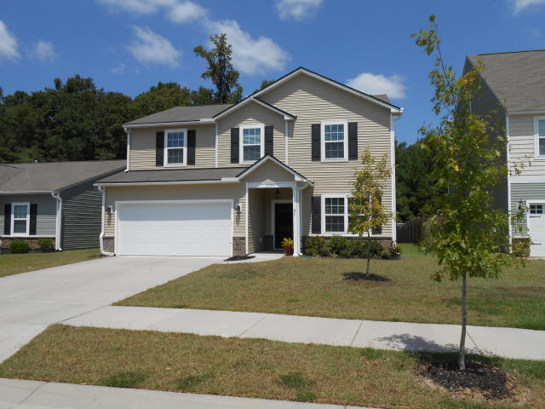
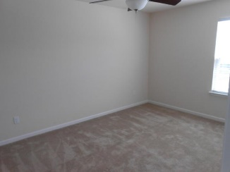
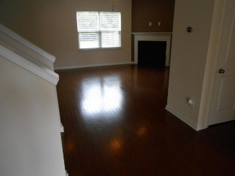
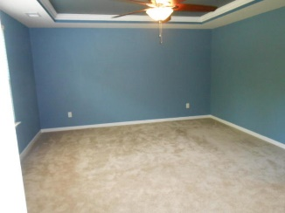
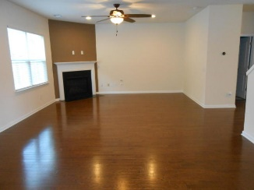
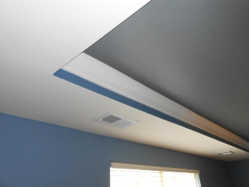
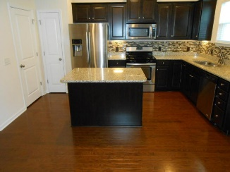
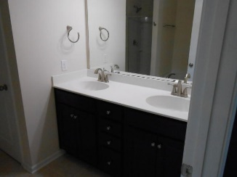
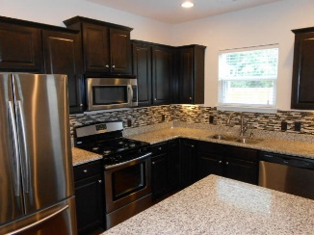
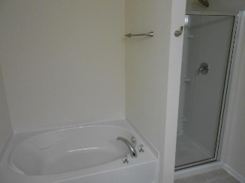
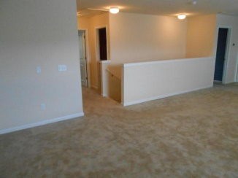
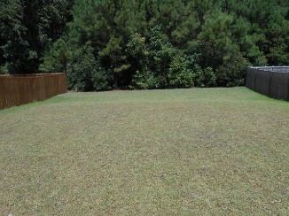


2103 Gammon Street
Carolina Bay
Charleston, SC 29414
MLS# 16023004 ~ $285,000
Like New…Only 2 Years Old!
This almost new, open floor plan features many upgraded fixtures, backs to a wooded area, and has a huge loft that can be used in many different ways! The downstairs features wood floors, a very open family room with a corner gas fireplace, a front room that can be a living room, office, music/computer room, etc. The kitchen features upgraded stainless appliance, granite counter-tops, an island and under counter lighting. There are two spaces between the kitchen and garage area that provide a tremendous amount of additional storage. The home has a termite bond, gutters, a gas water tank and a high efficiency HVAC system.
Gregg Fesler
GRI, CRS, REALTOR
Office (843) 856-3983 | Mobile (843) 797-0000
gregg@greggfesler.com
Carolina One Real Estate | 628 Long Point Rd. | Mt Pleasant, SC 29464-3032

