Slide 1
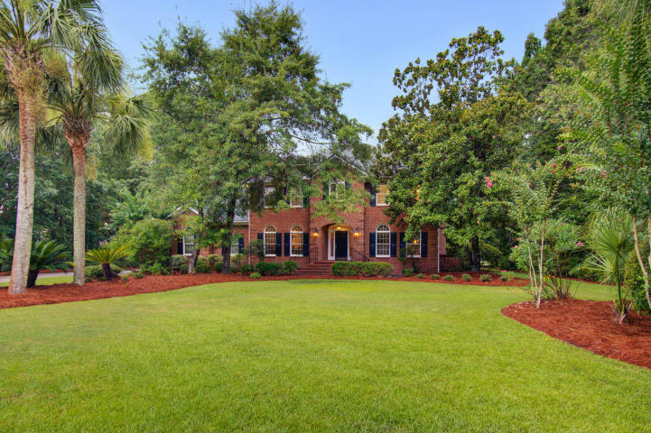
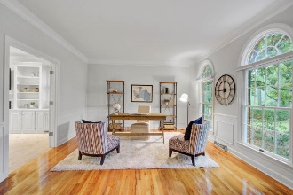
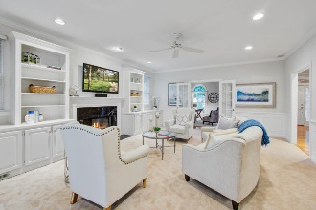
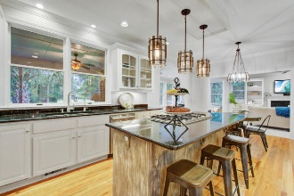
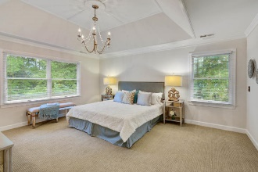
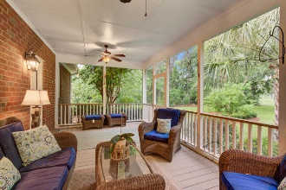
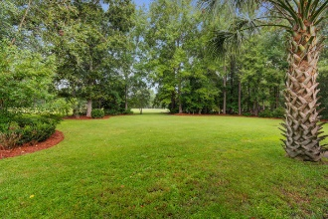


Stunning Home on Golf Course
2103 Sewee Indian Court
Dunes West ~ Mount Pleasant, SC 29466 ~ MLS# 20021214 ~ $750,000
Welcome to your stunning 5 bedroom, 3 1/2 bath stately home located in one of Mount Pleasant's premier gated communities Dunes West. Situated on over an acre of land on the golf course, this home has so much to offer. Beautiful screened in porch with golf course views allowing plenty of space for outdoor seating. Spacious living areas throughout the home, perfect for entertaining. Too many fine details to list. Must See!
There are many amenities in this community that will keep you busy all throughout the year. Just some of them are: pools, fitness center, tennis courts, play areas,18 hole championship golf course, driving range, practice green, racquet club, boat storage, boat ramp, club house, restaurant, crab dock, and miles of exercise trails, all located within a fabulous school district, beaches, shopping, downtown Charleston & Charleston International Airport.
Virtual Tour: https://my.matterport.com/show/?m=pHjxXoqtKVv
Sue Hensch
843-324-6939
sue@suehensch.com | www.suehensch.com
Carolina One Real Estate | 195 W Coleman Blvd | Mt Pleasant, SC 29464-3495

