Slide 1
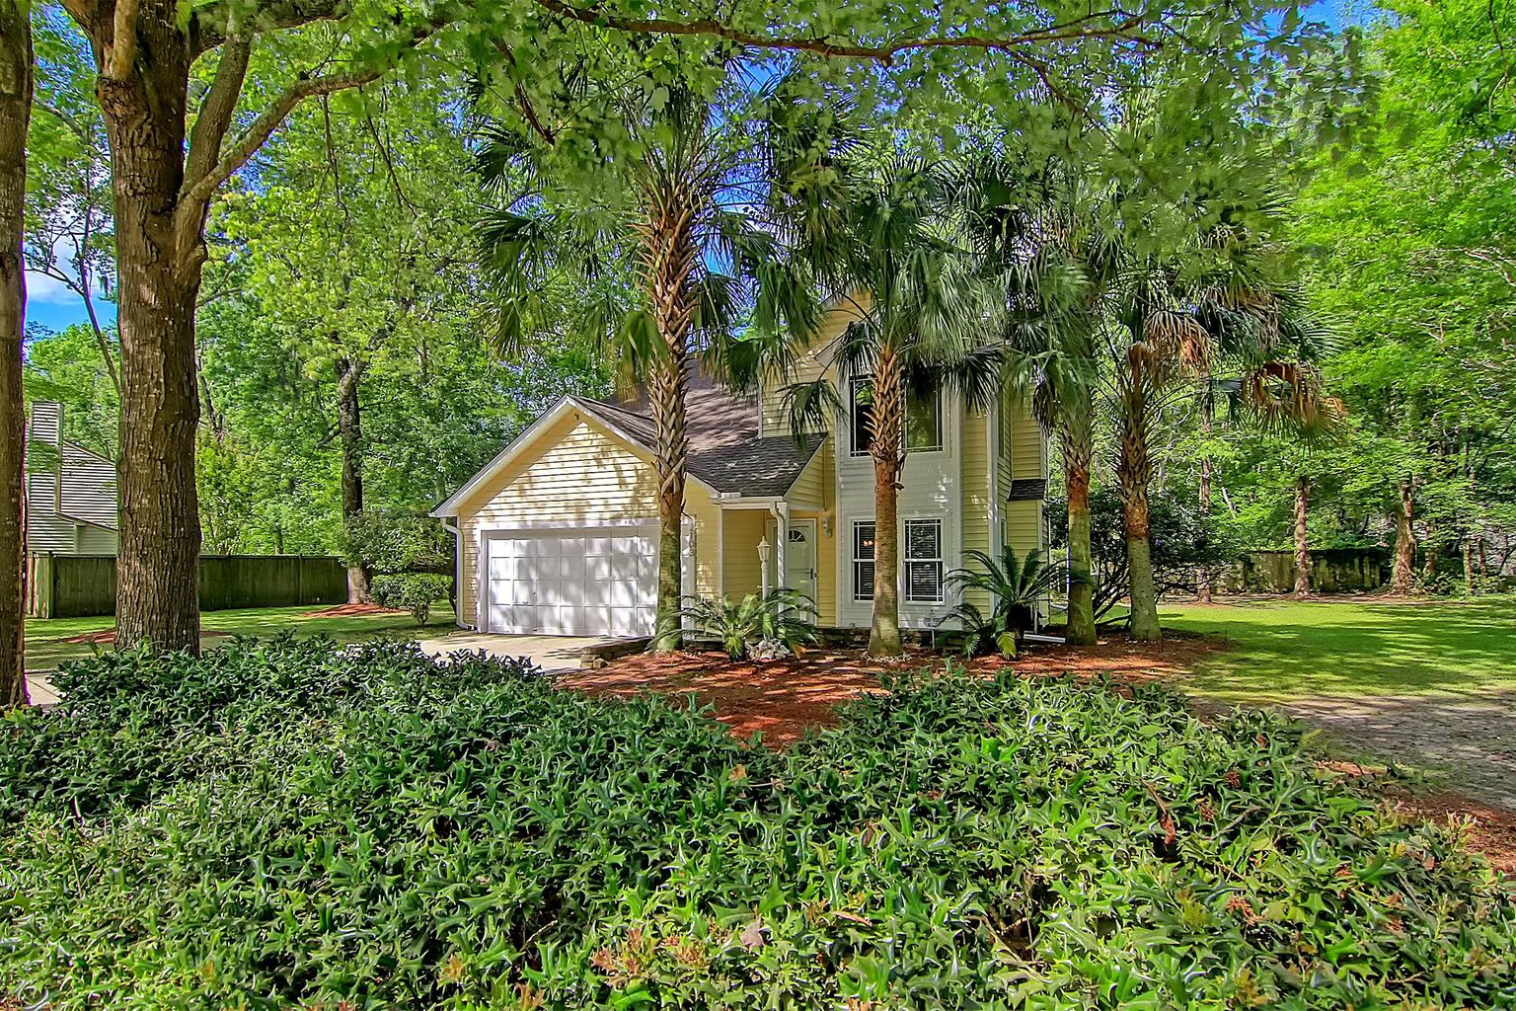

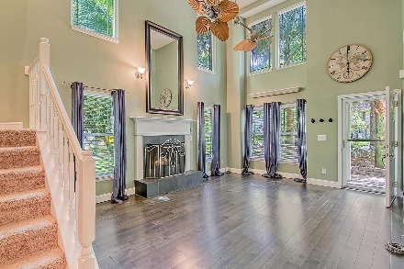
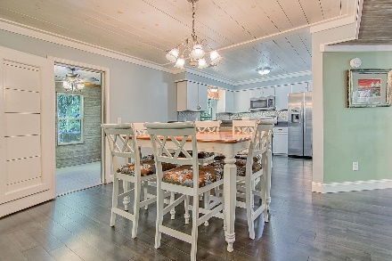
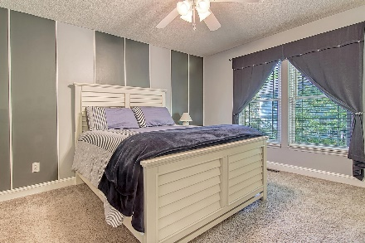
New HVAC Just Installed
OPEN HOUSE
SATURDAY 12-3
Open House Saturday 12-3
2103 Pinehurst Avenue
Canterbury Woods ~ Charleston, SC 29414 ~ MLS# 22010164 ~ $435,000
Located in the Canterbury Woods community in West Ashley, this lovely two story home has lots to love! Great curb appeal with several mature trees and a roomy driveway greet you as you approach the home. Once you enter, you'll notice new pre-engineered maple wood floors and a two-story living room with a fireplace and abundant natural light. Pass through to the kitchen where you'll find new stainless steel appliances. From here, you can access the family room as well as the study/sunroom which looks out to the backyard. A laundry room and an updated powder room complete the first level. Head to the second level to find the owner's suite with a full attached bathroom. Two additional bedrooms and a full bathroom complete the second floor. Additional noteworthy features of this home include a new HVAC being installed THIS WEEK, a new water heater, new gutters, new roof installed on 2015, a vent-free log system for the living room fireplace, a resurfaced ceiling, new fans, new light switches and outlets, new toilets, a two-car garage, and a 25 year warranty on the maple flooring. This property is conveniently located 2.7 miles from I-526, 3.4 miles to Bon Secours Saint Francis Hospital, 6.3 miles from Avondale, 8.7 miles from downtown Charleston, and 9.8 miles from Charleston International Airport.
Don't miss out on this amazing opportunity!
Book your showing today!
Katie Wishneff kwishneff@mattoneillteam.com 843-870-8784

