Slide 1
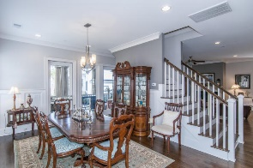
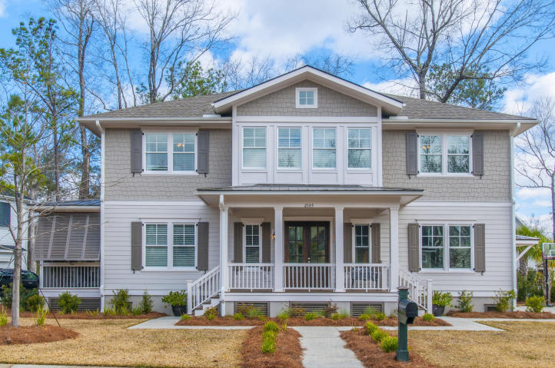
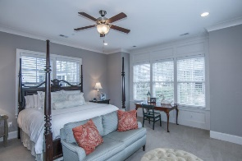
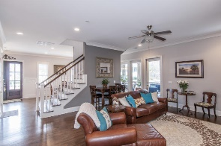
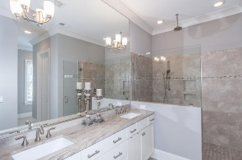
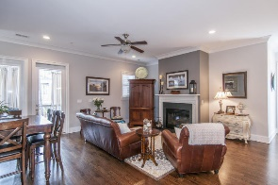
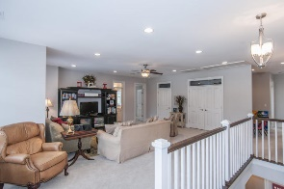
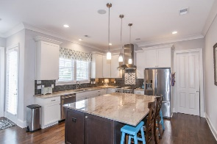
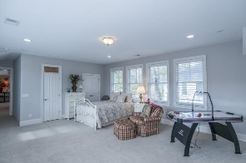
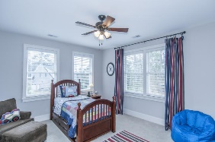
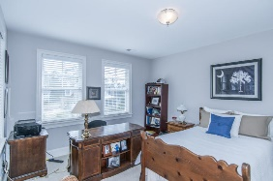
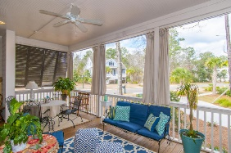
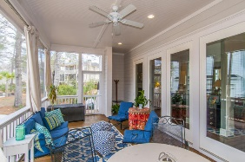
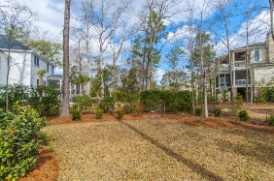
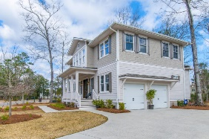


2105 Malcolm Road Park West ~ Mount Pleasant, SC 29466 ~ MLS# 16005085 ~ $675,000
Best value in Masonborough @ Park West!
Like new home just listed!
This beautiful like new home won't last long! Just built in 2015 with all the features a buyer desires. This is the most affordable home in highly desired Masonborough in Park West! Nestled on a short street this home sits among mature trees and lush landscaping right next to a cul de sac. The inviting porch welcomes you with steps on either side. Once inside there is plenty of room for entertaining in the formal dining room. Right off the dining room is the screened porch where the entertaining can continue. The chef's kitchen is open to the family room and features a sit down island and huge walk in pantry. The all stainless steel appliances include a professional range and hood. Other high end finishes include granite counters and a tiled backsplash. Beautiful hardwoods flow throughout the space while sunlight floods in all the windows. Also downstairs is the spacious master bedroom with luxurious adjoining bath. The bath features an oversized frameless shower with bench, dual vanity and top of the line fixtures. There is plenty of storage available with 2 master closets. The bedroom has windows on three sides and has plenty of room for a seating area. Upstairs find a large second family room/loft area perfect for movie night or a place for family and friends to casually gather. Off this space is a large storage closet as well as a nice sized laundry, complete with sink, cabinetry and a counter for folding. There are also set of bedrooms with a jack and jill bath as well as a fourth bedroom with its own private bath. Rounding out the space is a large bonus room with built in surround sound. This multi-purpose room could serve in many ways-bedroom, play room or media room. A large bathroom with dual vanities connects this space to the loft. All this space inside and a beautiful setting outside equals one great value! The 2 car garage was just retro-fitted with custom storage solutions by Monkey Bars. Come see what all this custom home has to offer and welcome to Masonborough!
Melodie Smith (843) 408-5067 M
melodie.smith@carolinaone.com www.melodiesmithrealestate.com

