Slide 1
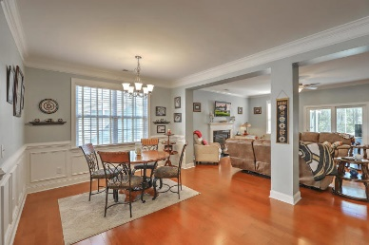
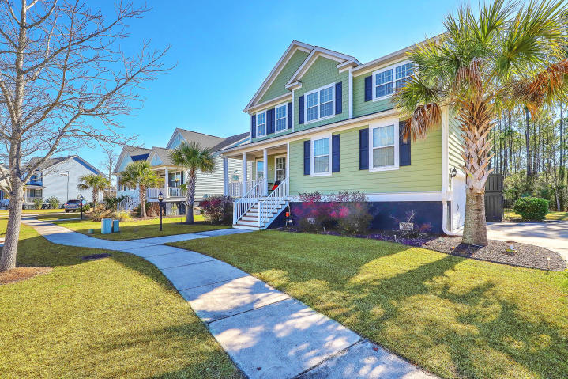
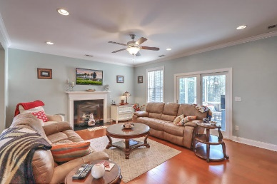
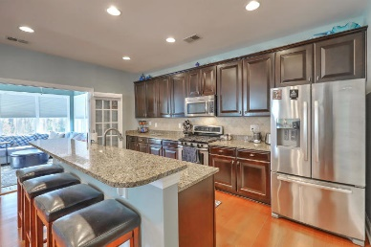
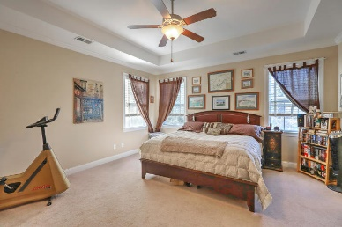
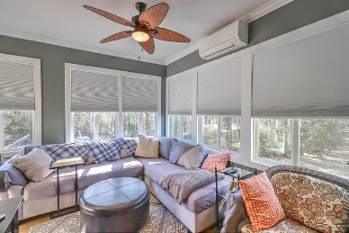
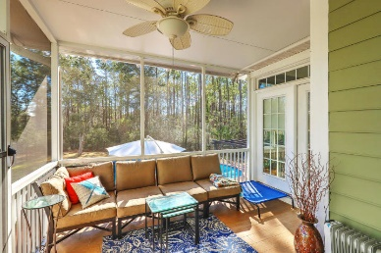
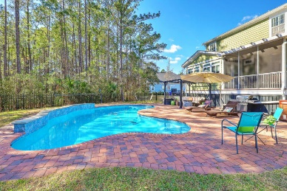
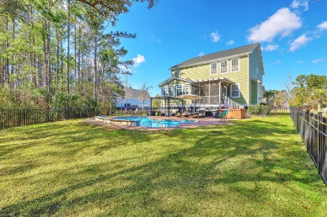


2105 Sandy Point Lane
Rivertowne On The Wando ~ Mt Pleasant
MLS# 19002869 ~ $619,000
Price Improved To $619,000
Beautiful 5 Bedroom 4 1/2 Bath Home With A Sparking Gunite Pool
Resort style living can be yours in this spacious home that features a sparkling saltwater pool nestled beside natural wetlands. The first floor open floor plan includes large foyer, dining area, family room with gas fireplace, sleek kitchen with granite countertops, large pantry, half-bath, laundry room, separate office/study, and lovely year round sunroom with full bath. Sunroom leads to screened porch and down to a large outdoor living area. Upstairs has a roomy master suite with large ensuite bathroom and walk-in closet. Bonus/5th bedroom boasts the recent addition of full bath and large closet area. Down the hall are three more bedrooms and nice sized bathroom with updated countertops. There is an abundance of closet space, and the double garage has loft area with tons of storage.
This lovely 5 bedroom/4.5 bath home is situated on a .31 acre lot. It is surrounded by wetlands which provides privacy for the beautiful backyard living area and stunning pool. Amenities are within walking distance and include soccer field, pool, play area, and tennis courts. There are blinds throughout the home. A tray ceiling in master bedroom, ceiling fans in most rooms and crown molding add to the many quality features of this home. The family/great room is open to the beautiful kitchen, and the breakfast bar provides extra seating for your family or guests. The mounted television above fireplace in family room will be included. There is a separate heat/air unit installed in sunroom for year round comfort. The sunroom has the convenience of a full-bath for your guests as they come in from a swim.
Maggie Curtis
REALTOR, EPRO, LMC, ABR
(843) 693-8207
maggiecurtis@comcast.net
Coldwell Banker Residential Brokerage
1127 Queensborough Blvd. 103
Mt Pleasant, SC 29464

