Slide 1

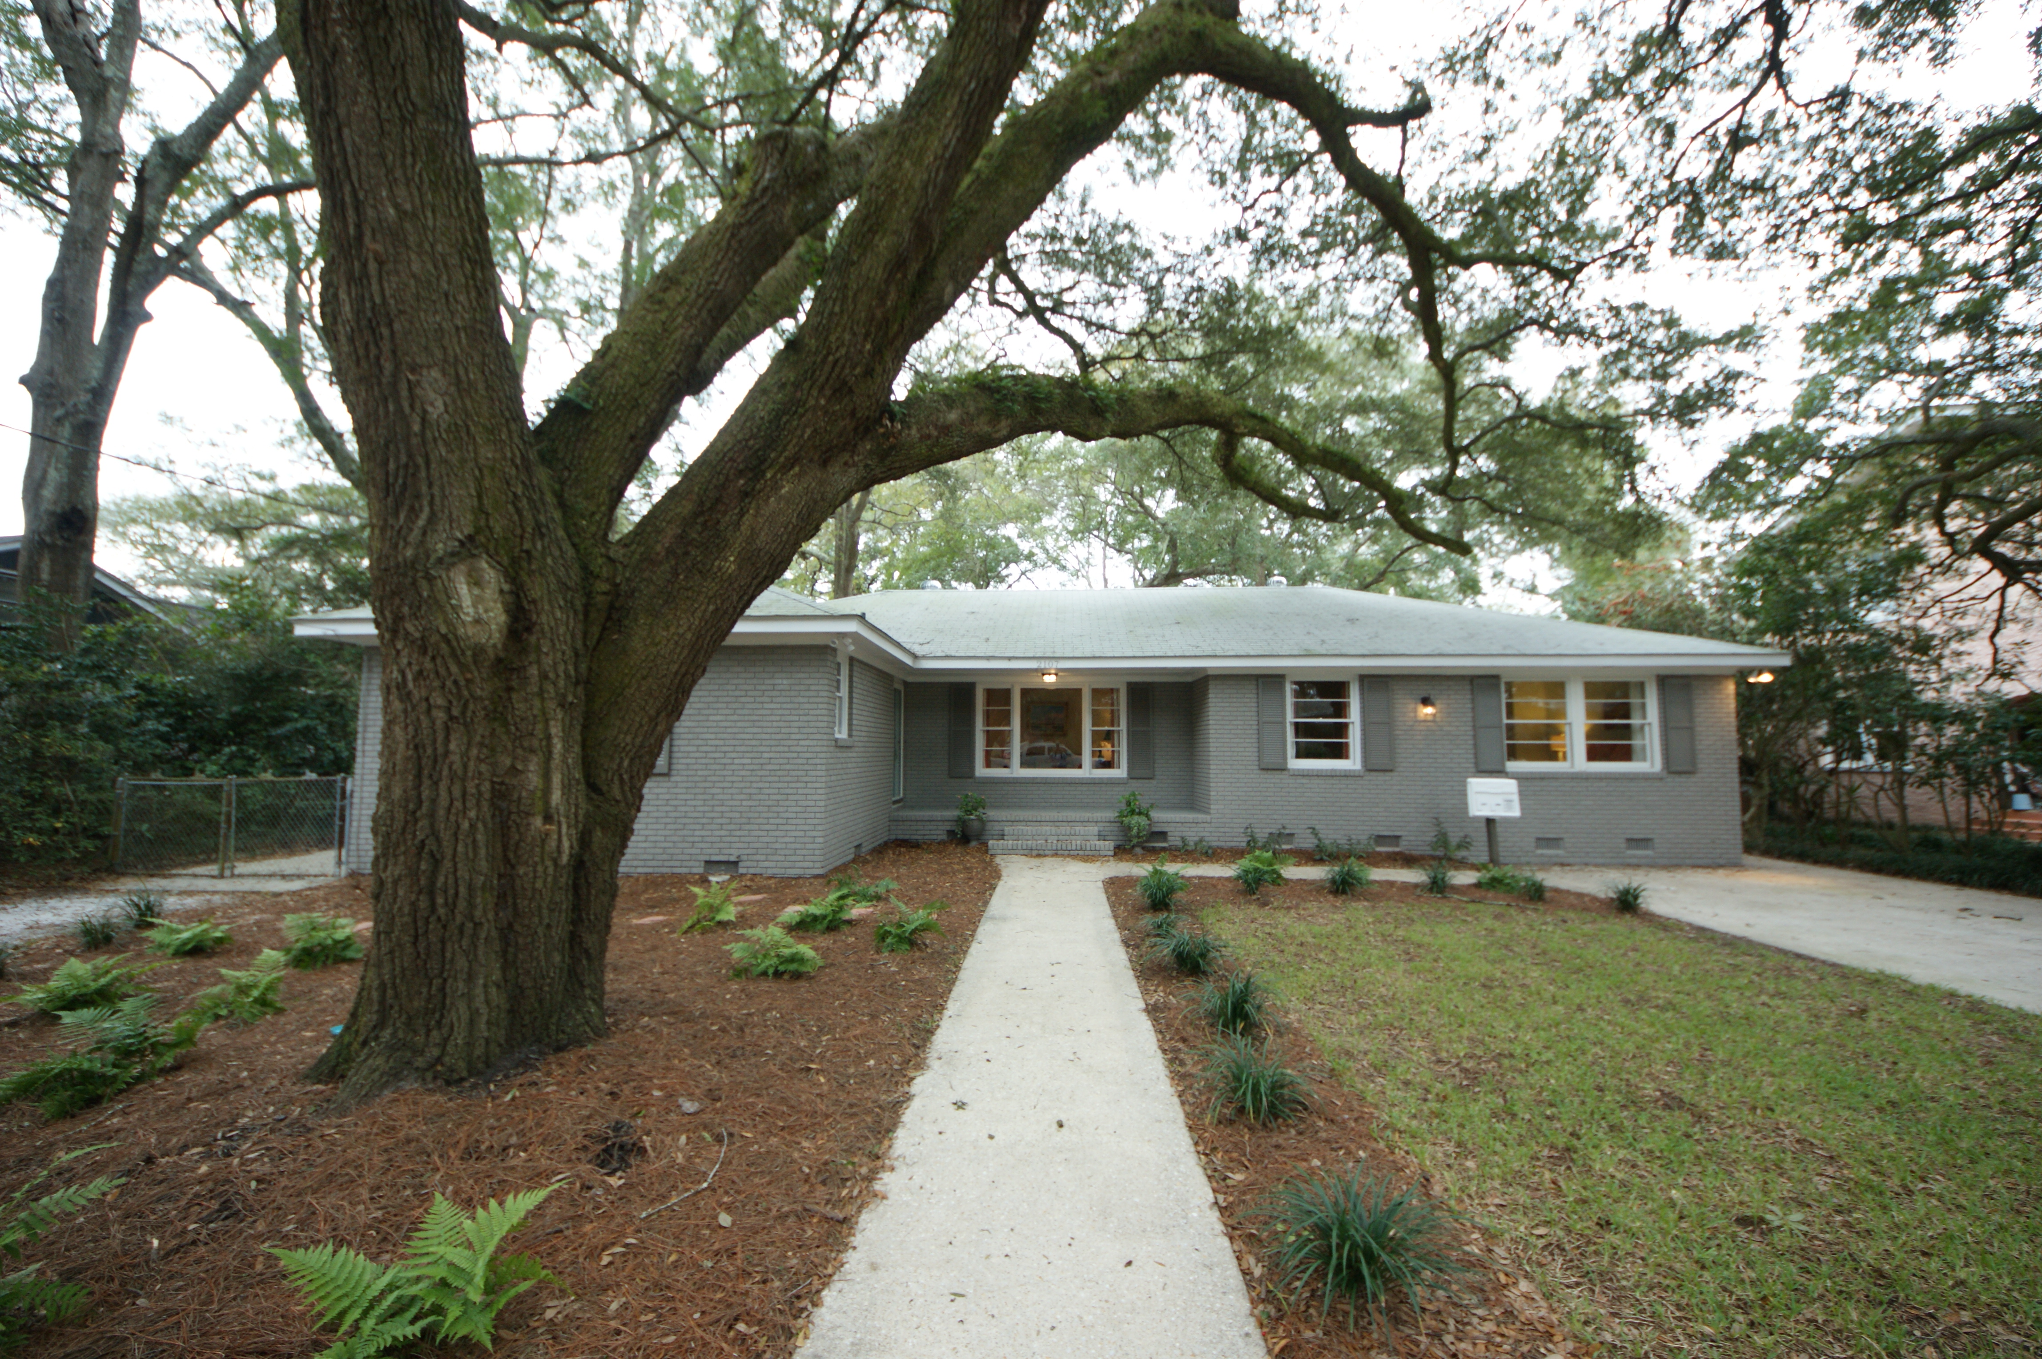
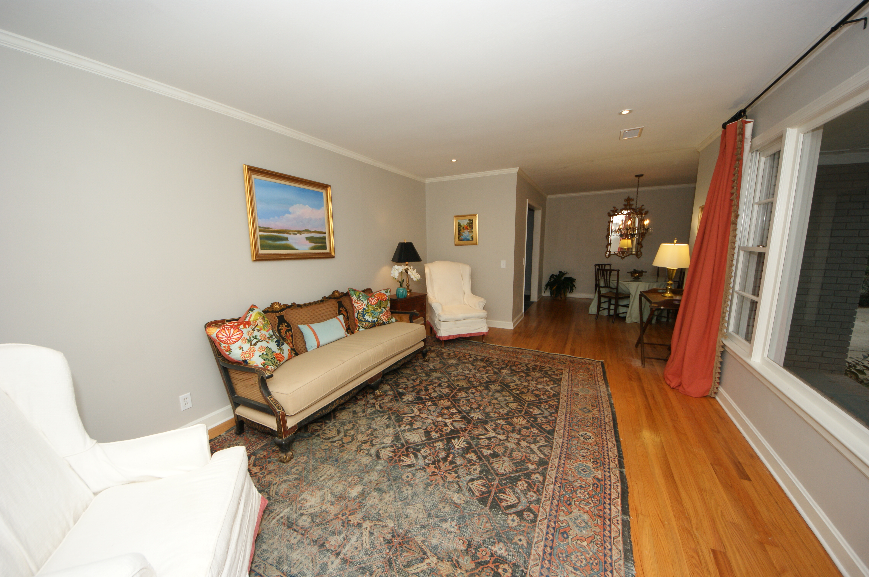
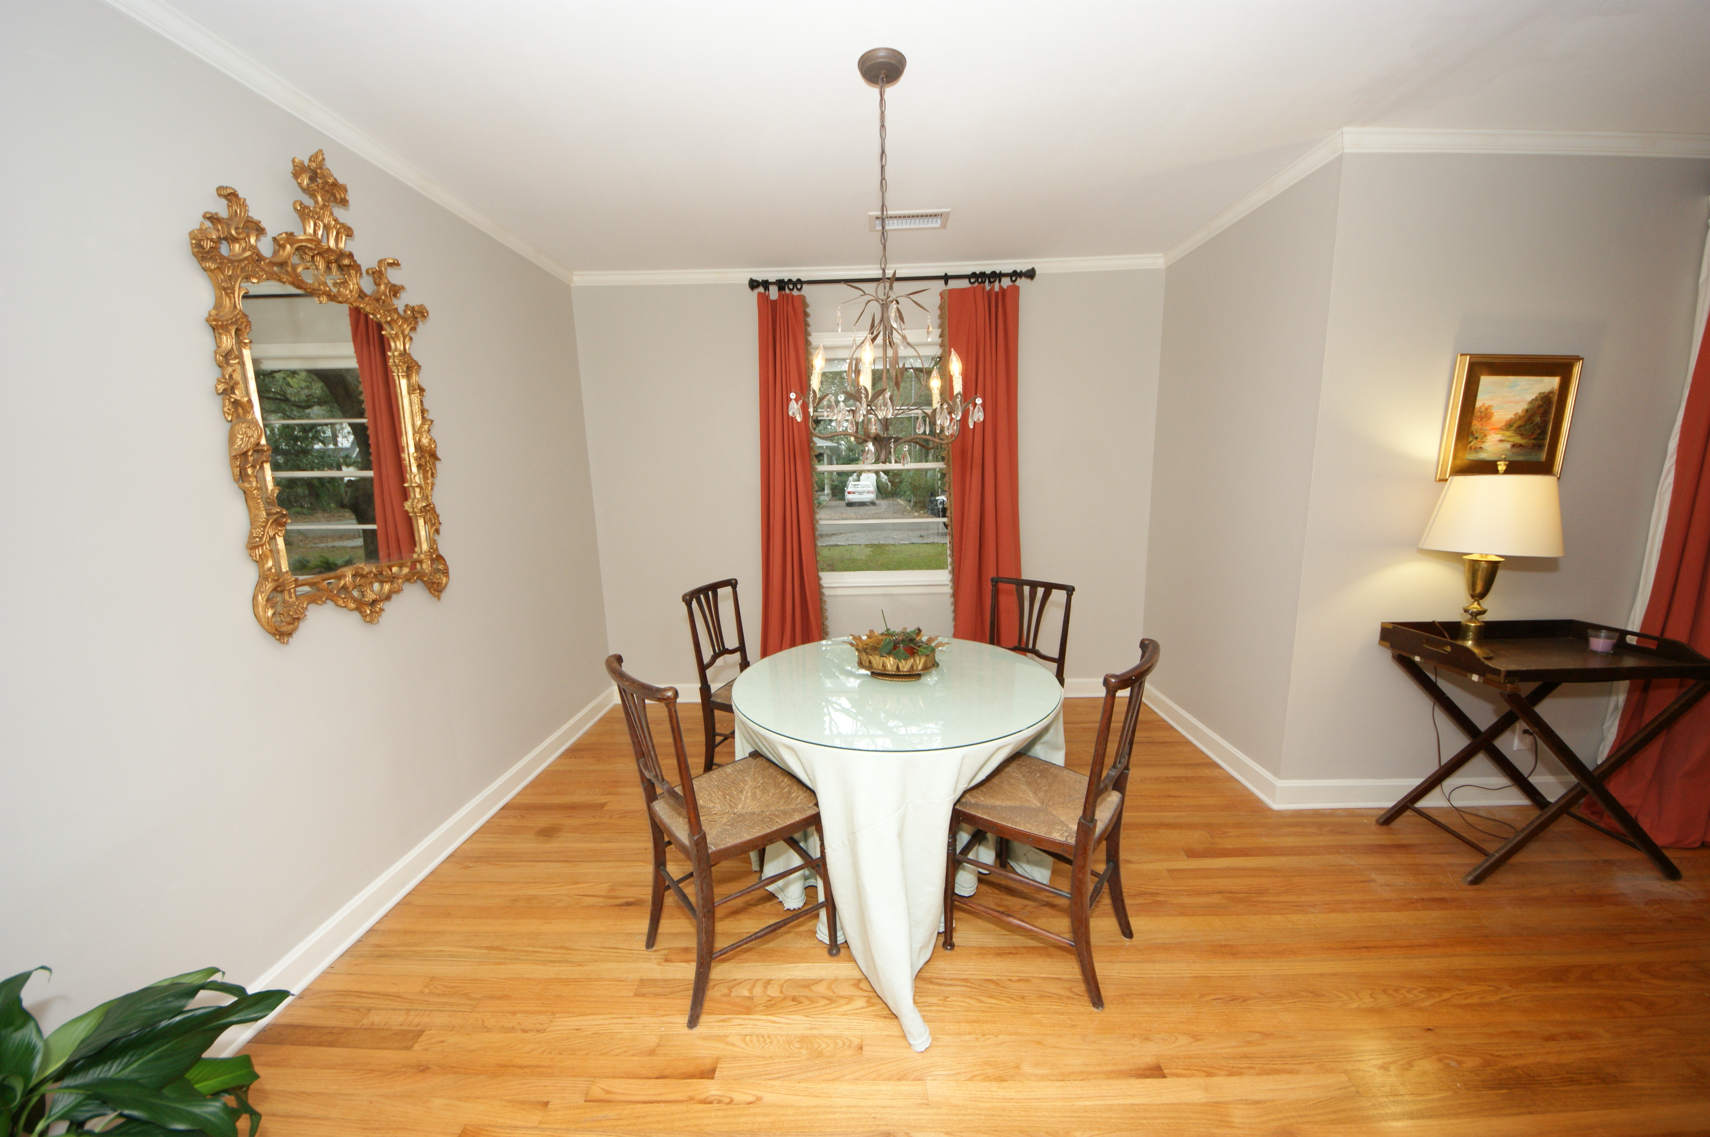
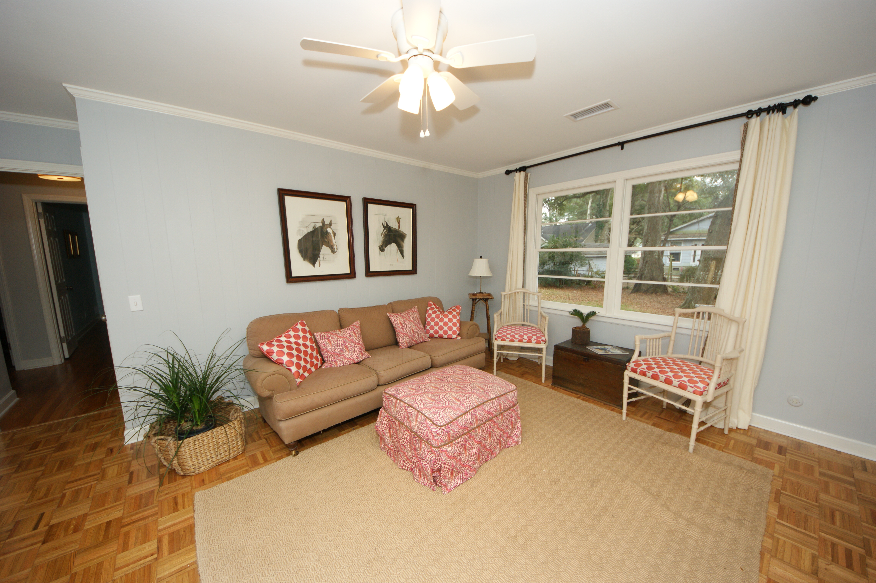
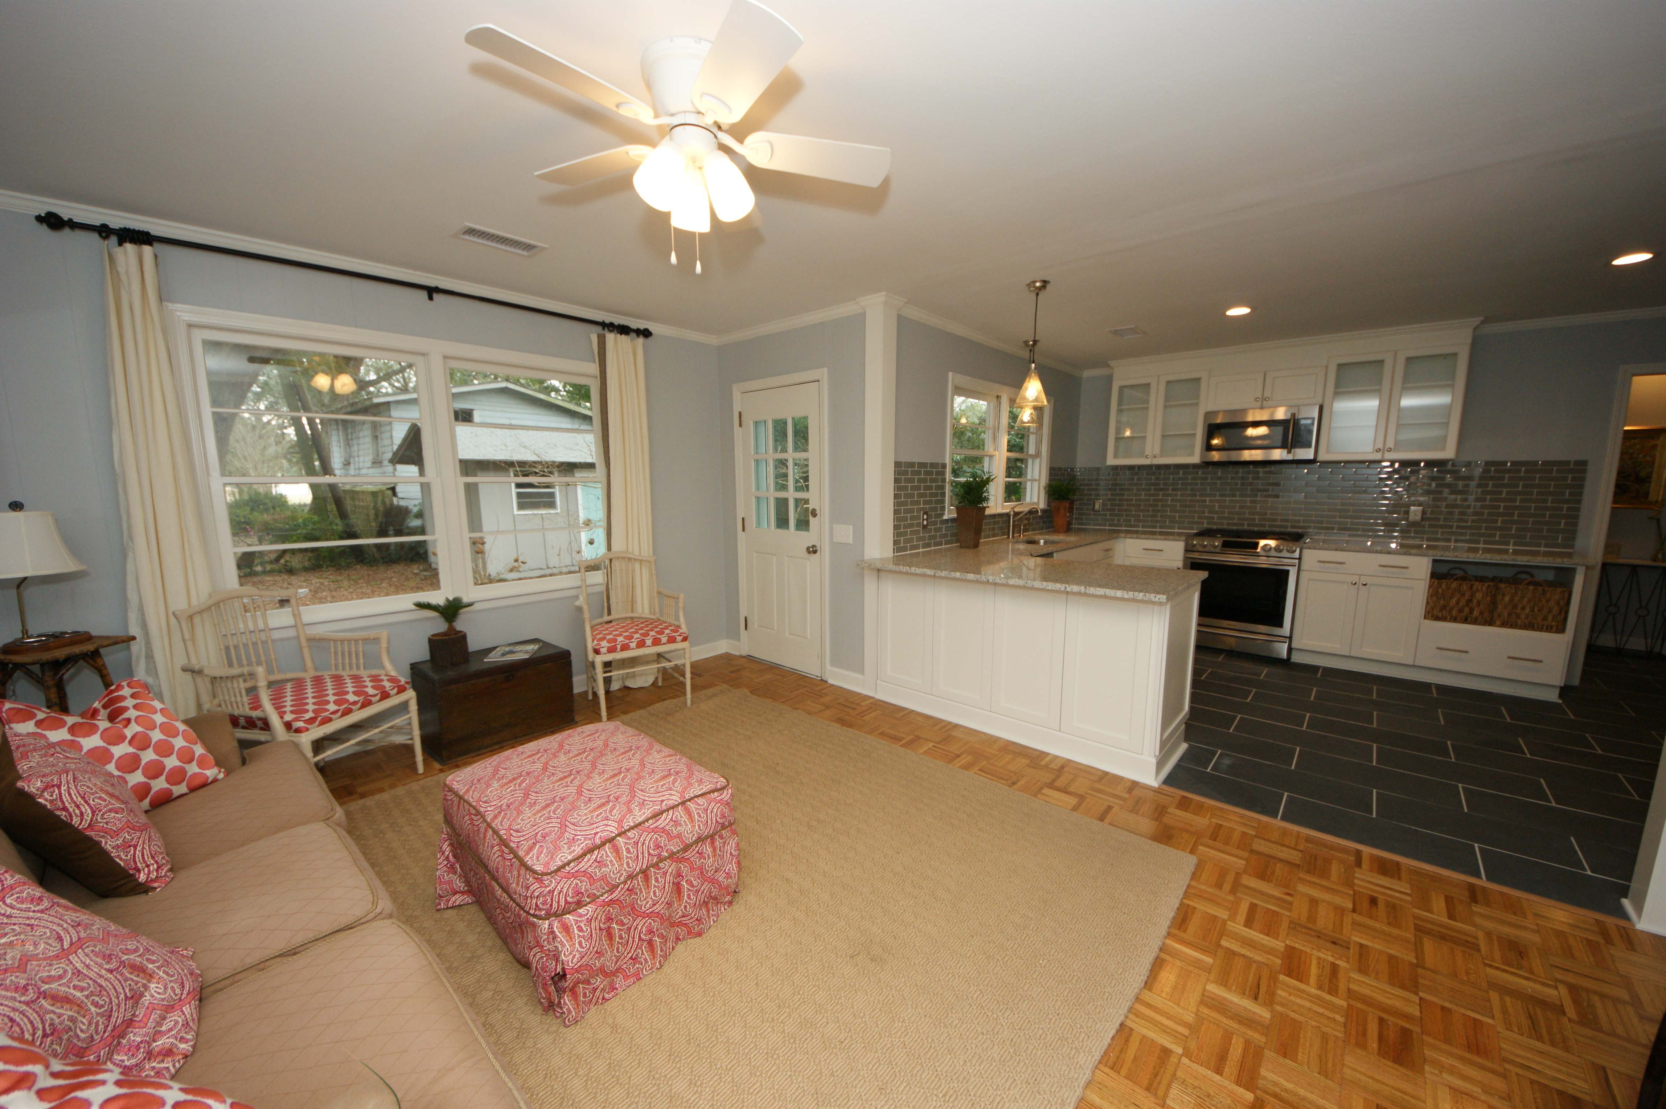
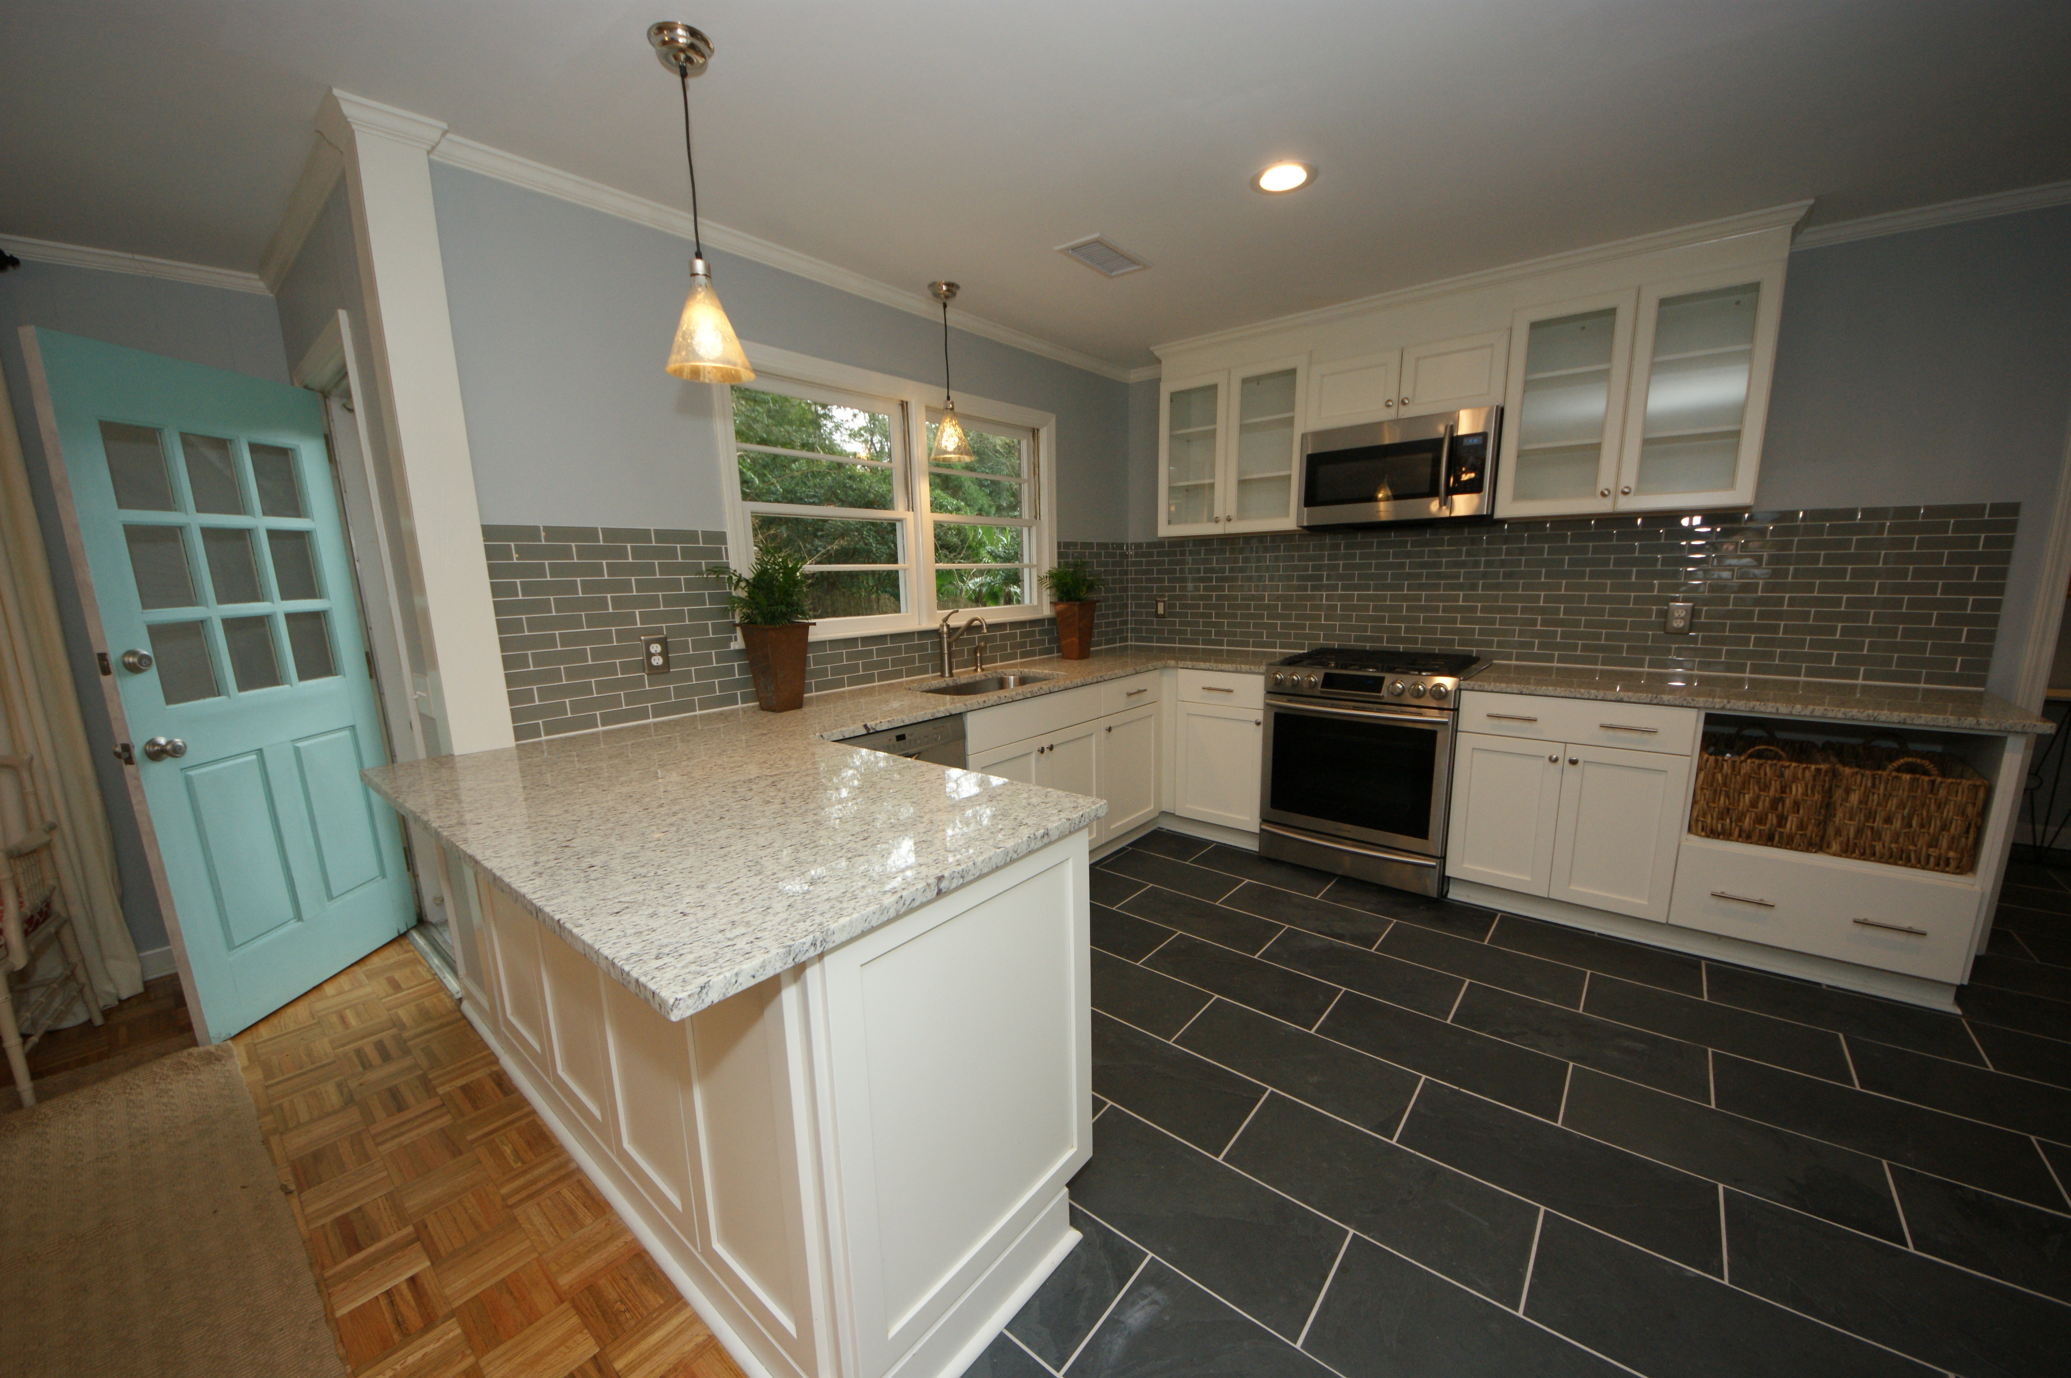
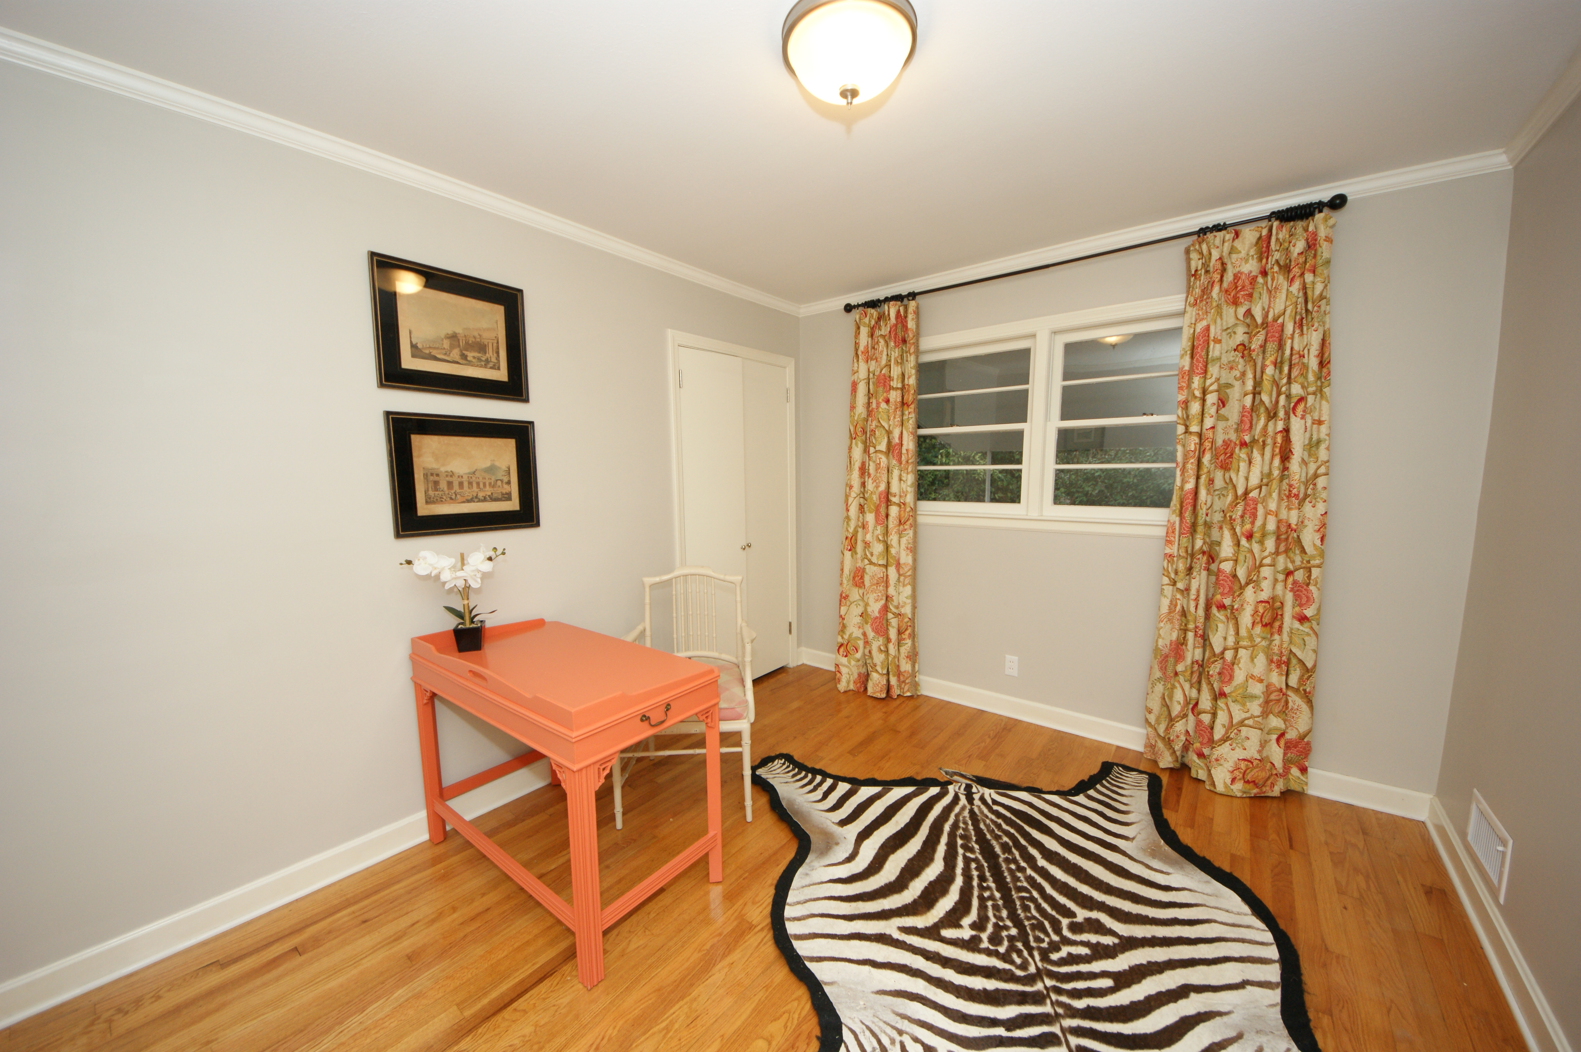
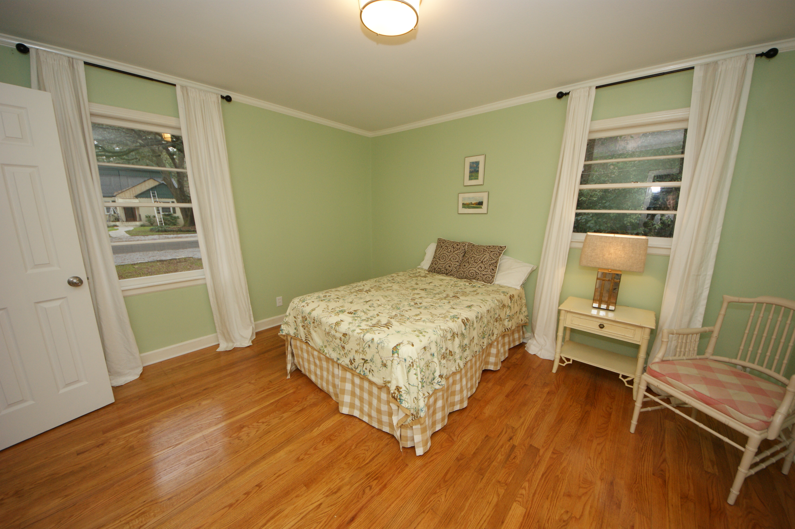
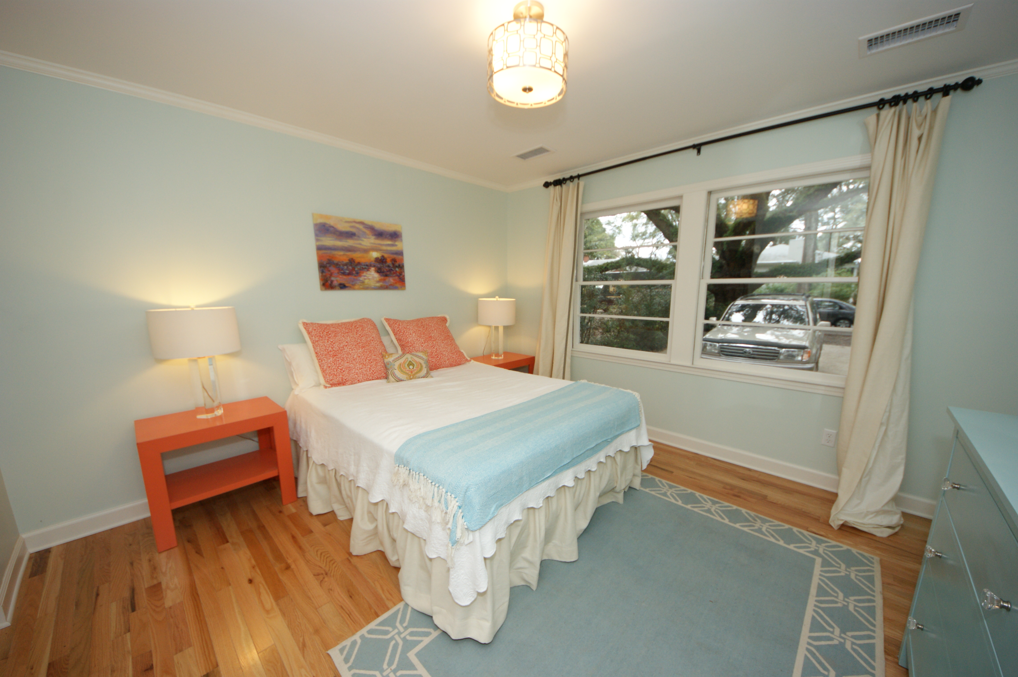
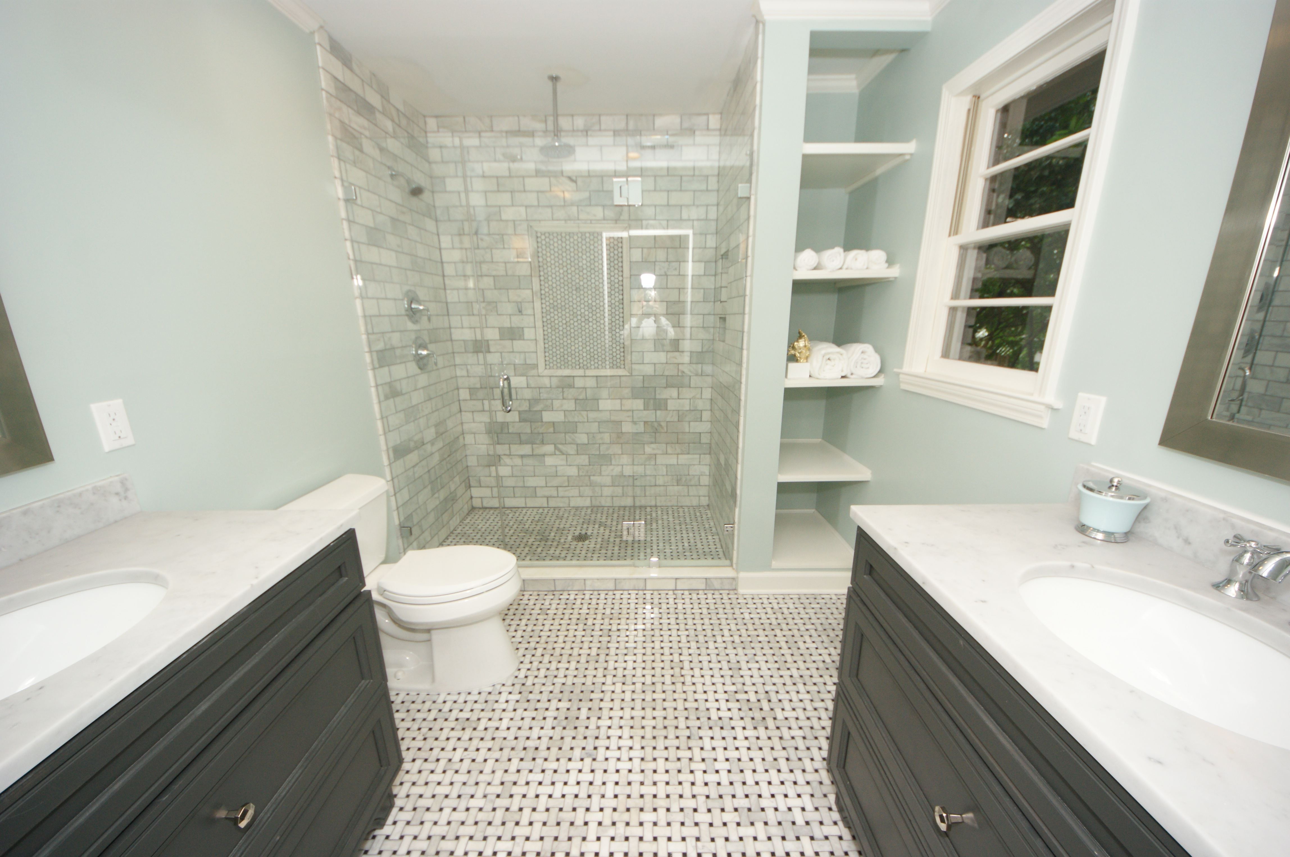
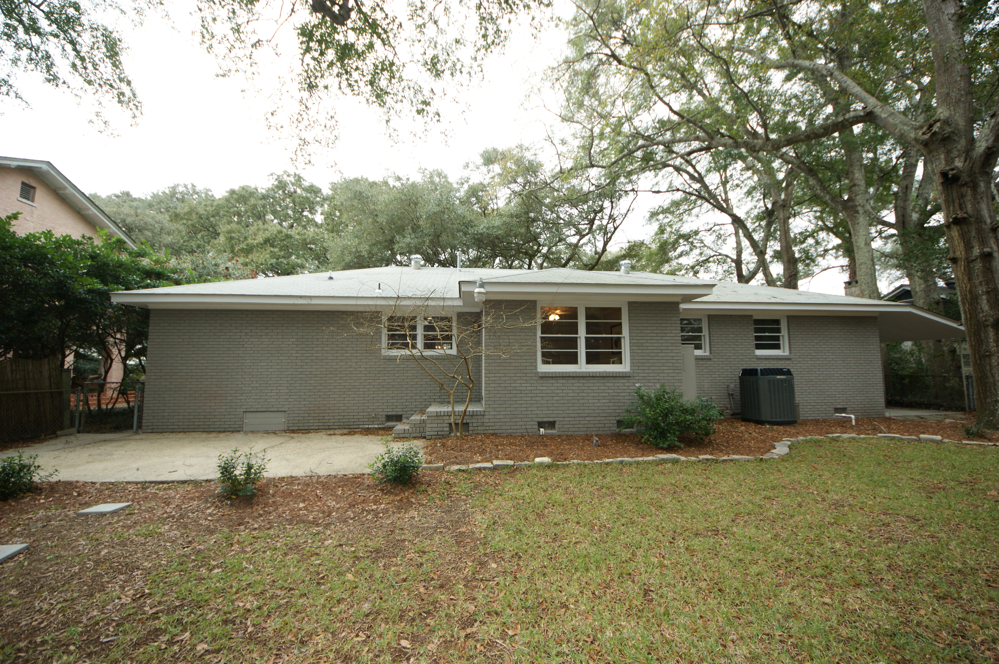


Full Renovation in Riverland Terrace!
2107 Wappoo Drive
Riverland Terrace
Charleston, SC 29412
MLS# 16007482
$525,000
1,986 SF
4 Bedrooms :: 3 Bath
Fully renovated 4 bed 3 bath on Charleston's most picturesque street!!! Grand "Avenue of Oaks" in highly sought-after Riverland Terrace!!
New cabinets, GRANITE counter tops, new BOSCH stainless appliances, New TRANE HVAC, Hardwood floors, and master suite bathroom! Boasting his & hers closets, tile walk-in shower with glass door. Large laundry room.
The fenced in back yard has a large workshop with plenty of power for the most accomplished carpenter. There is a covered area for your boat, extra vehicle or golf cart. New insulation. Save thousands of dollars as flood insurance is NOT required!
Quick and easy access to downtown or Folly Beach. Walking distance to the hip and trendy restaurants and the "Indie" Terrace Theatre. Neighborhood play park, boat landing, and Medway Park/Community garden. Motivated seller.
Eric Draper
(843) 442-7118
eric.draper@gmail.com
www.charlestonrealestategroup.com
Charleston Real Estate Group | 792 Folly Rd. C1 | Charleston, SC 29412

