Slide 1
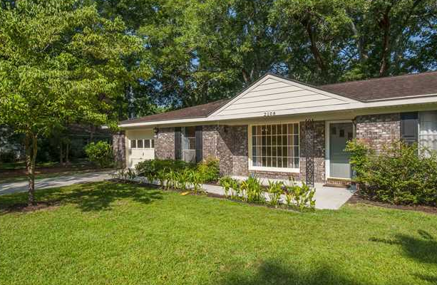
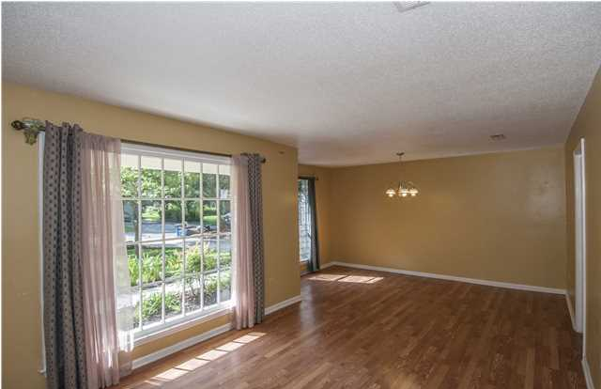
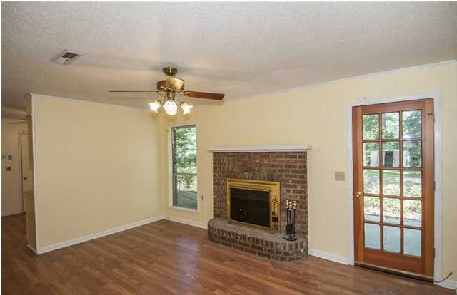
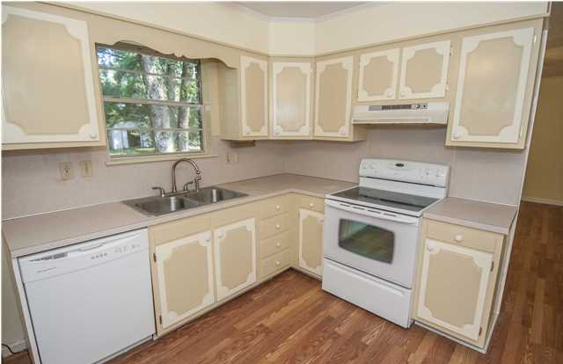
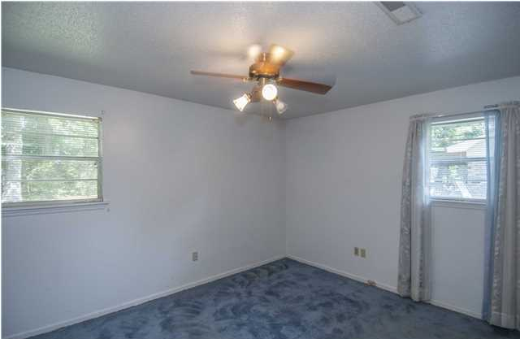
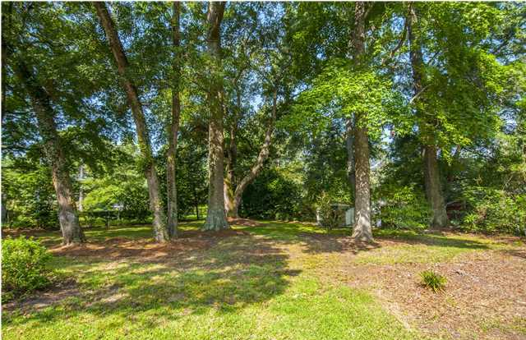
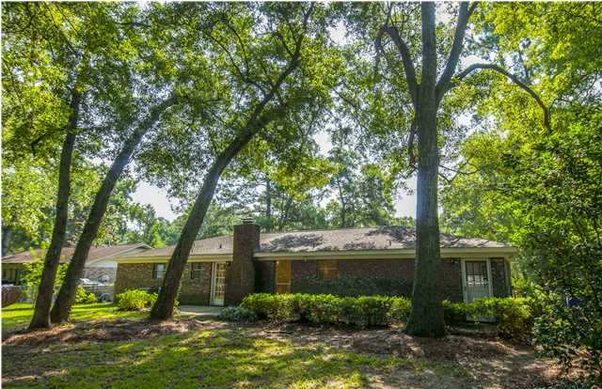
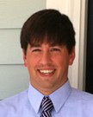

West Ashley Gem
2108 Bishop Dr
Church Creek - Charleston - MLS#1420167 - $175,000
This one story brick ranch has a great floorplan and a beautiful front yard and a huge fenced-in backyard.
Location is great as this is right off of Highway 61 and real close to Roper St. Francis Hospital, shops and restaurants.
Church Creek is a quiet and mature neighborhood. Go and show!
Del Shaffer
843.408.6821
dshaffer@carolinaoneplus.com

