Slide 1
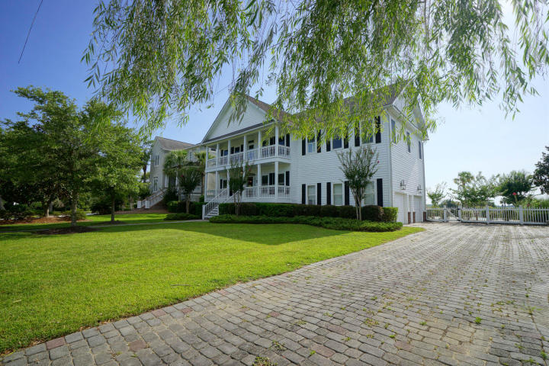
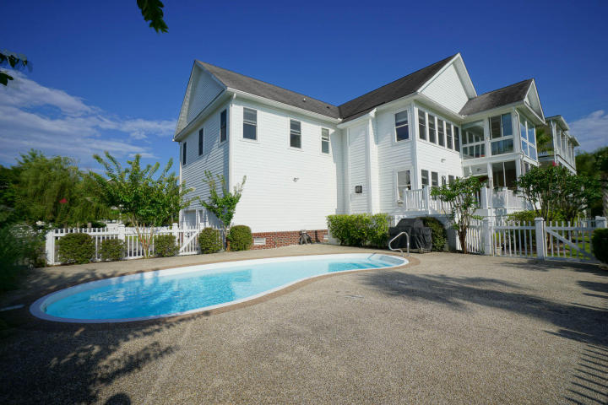
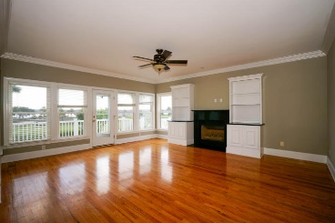
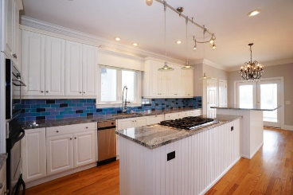
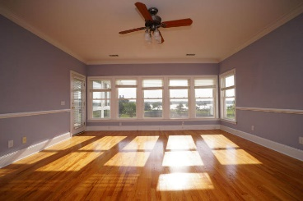
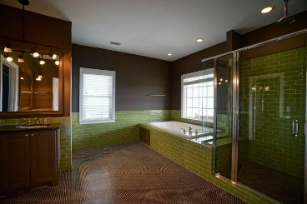
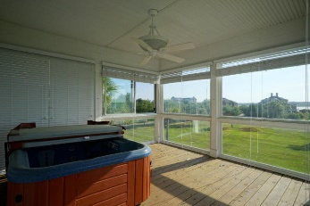
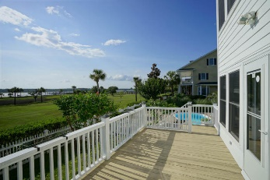

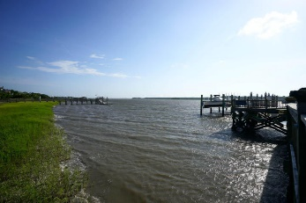
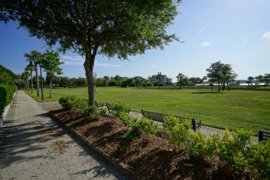


Price Reduced In Rivertowne On The Wando!!
2108 Cheswick Lane
Mount Pleasant, SC 29466 | MLS# 15017750 | $1,065,000
Sellers Stunning Deep Water dream home that is move-in ready!! Enjoy beautiful sunsets every evening overlooking the Wando River. Steps to the shared deep water dock where you have your own boat slip and 10,000 lb lift. This home has a great floor plan with a large updated kitchen that opens to the living room with a gas fireplace and expansive views of the water. Formal dining room and office are also located on the main level. Upstairs offers the master bedroom and 3 additional bedrooms each with their own private bath. The master has a beautiful updated bathroom, large his/hers closets and a private porch with a hot tub overlooking the River. Plenty of space to run, relax, and play in your front or backyard! Enjoy cooling off in your pool or take a quick boat ride.
Kristen Kern-Whitehead
Mobile - 843-670-1671
kwhitehead@kwchs.com
www.charlestonislandagents.com
Keller Williams Realty
Charleston Islands
1304 Palm Blvd
Isle Of Palms, SC 29451

