Slide 1


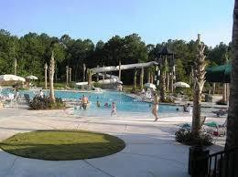
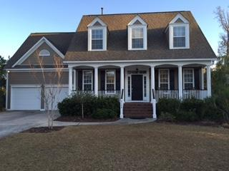
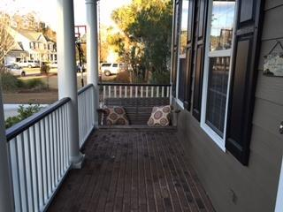
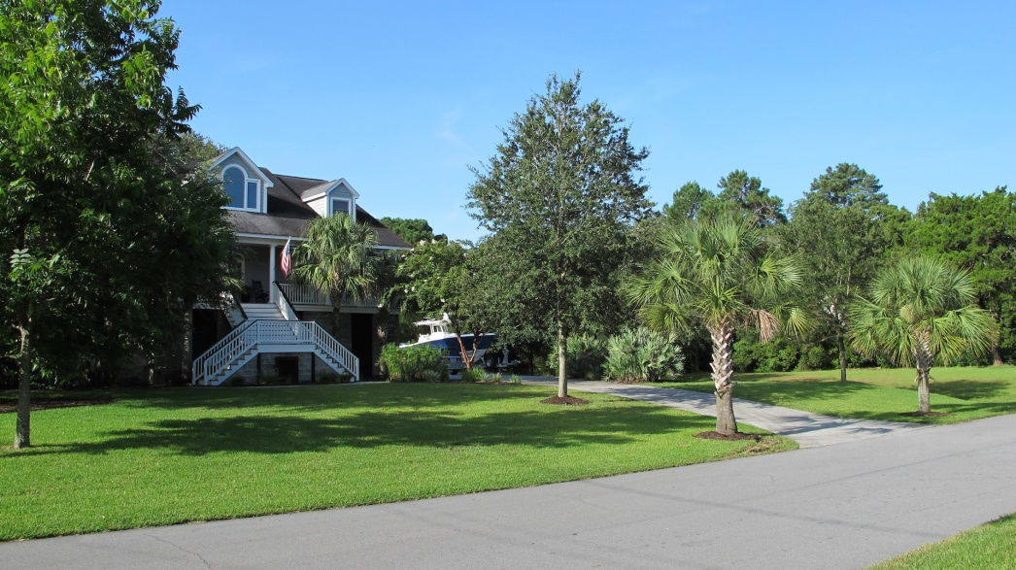
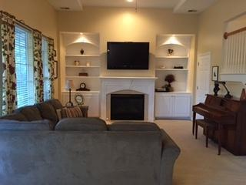
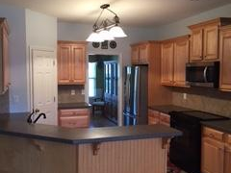
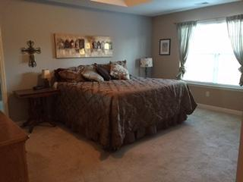
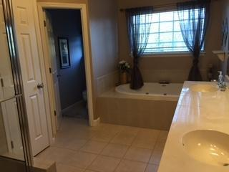
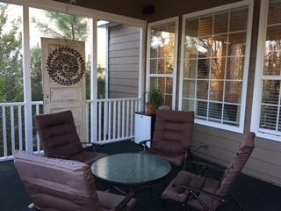
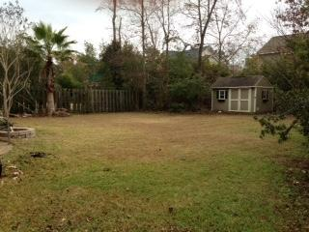

Aggressively Priced 5 Bedroom Home in Dunes West!
2108 Short Grass Ct
Mount Pleasant
MLS# 14030887
$465,000
A true five bedroom beauty behind the gates in Dunes West! This home is truly move in ready. As you approach this charming southern home with a full front porch you will notice its freshly painted exterior. Upon entering you will be impressed with the smart layout and attention to detail! The first floor has a formal dining room and an office with beautiful French doors. Both rooms have crown molding and the dining room has a tray ceiling and wainscoting. The kitchen is open to the family room and has a generous sized eating area with a pretty bay window overlooking the private back yard. The kitchen is outfitted with Corian counters, stainless steel appliances, and upgraded cabinets. In the family room you will be impressed with the built in bookshelves and base cabinets on each side of the gas fireplace. Hardwood floors are found throughout the entry, dining room, kitchen and main hall. A separate laundry room is located between the kitchen and garage. Check out the amazing space in the garage- large enough to house a boat! There is ample storage in the garage and inside the home. This layout is ideal for family living and entertaining! As you go upstairs you will immediately appreciate the open feel of the second level too! A large open hallway leads to all five bedrooms. The master bedroom, also with tray ceiling, overlooks the back yard. The master bath has an oversized garden tub and shower. The closet in the master bedroom is huge and leads to additional storage behind it! A second bedroom upstairs has its own full bathroom as well. The two bedrooms on the front of the home have built in window seats with storage. All bathrooms have tile floors and each bedroom has a ceiling fan. The driveway has been expanded and fits up to six cars. Living on a cul-de-sac has many benefits, and this home has an amazing yard, too! The entire yard is professionally landscaped with irrigation system. The large back yard is enclosed with privacy fence! There is a 10'x12' garden shed which will convey with the home as well as the six person Jacuzzi! Notice a paver patio off the screened porch which is perfect for grilling, outdoor dining or sitting by a fire pit. Enjoy the privacy and beauty of the yard while relaxing in the large screened porch during the beautiful South Carolina days and evenings we are spoiled to have. This home is priced to sell and won't last long so make an appointment to see it today!
Ellen O'Neil
843-300-8530
ekoneil@sbcglobal.net
www.southernlivingre.com
Southern Living Real Estate 2249 Salt Wind Way, Mt. Pleasant, SC 29466

