Slide 1
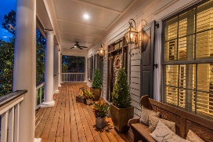
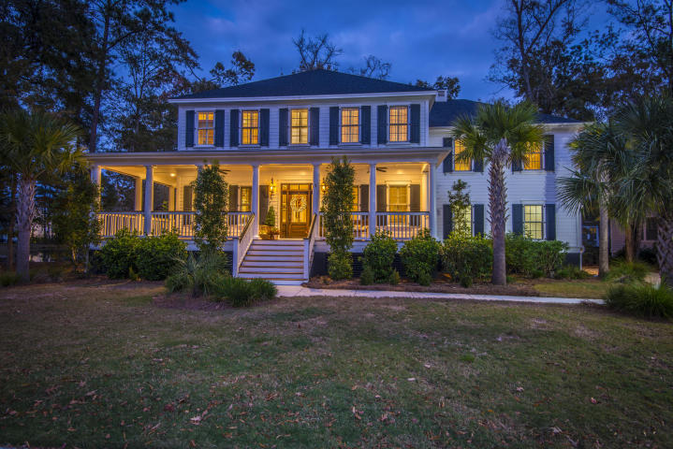
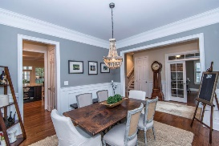
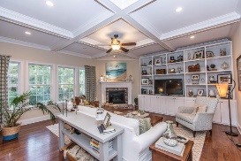
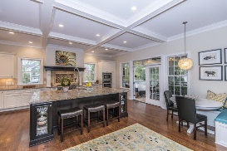
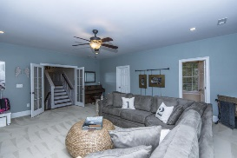
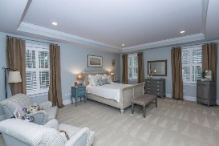
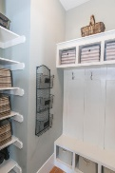
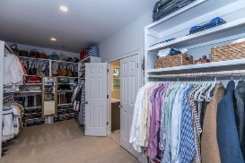
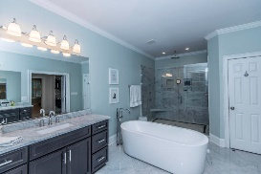
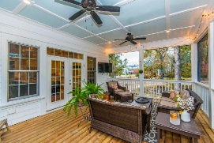
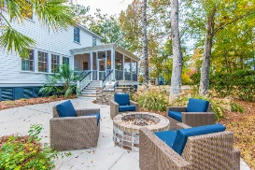


2109 Malcolm Road
Mount Pleasant, SC 29466
MLS# 17031843 ~ $800,000
This home has it all!
Like new construction in established Masonborough...move in ready!
$70,000+
Price Reduction
This stunning low country home checks all the boxes! Looks like a new construction model home! Situated next to a pond and HOA space there is plenty of nature to appreciate. Inside features many beautiful upgrades from the coffered ceilings to the huge oversized island and custom range hood to the built-in desk area and butlers pantry with wine fridge. Also notice the built in kitchen dining nook, built in cabinetry/book shelves and plantation blinds. Downstairs flows easily with your study and dining room flanking the entryway and the open concept kitchen, breakfast nook and family room off the back of the home. The oversized screened porch right off the kitchen lends itself to easy entertaining or relaxing outdoors. Also off the screened porch is the built in BBQ grill and fire pit.
On your way upstairs you'll find the large bonus room with it's own full bathroom and extra large closet. This could be the 4th bedroom or just the perfect hang out space/guest suite. On the top floor are two additional bedrooms adjoined by a jack and jill bath with dual vanities. The stylish laundry room is conveniently located at the end of the hall. Finally the large master retreat rounds out the bedrooms. It has an enormous walk through closet and spectacular master bath complete with marble flooring, a free standing tub, oversized shower and dual vanities.
This home is move in ready and is sure to impress the pickiest of buyers! Hurry before this rare beauty is gone!
Park West offers wonderful amenities including two pools, tennis courts, a club house, play parks, and miles of walking/jogging trails. Public schools are within the neighborhood as well as shopping, dining, recreational fields, professional offices and a gym. Downtown Charleston and the beaches are only 20-25 min away!
Melodie Smith
(843) 408-5067 M
melodie.smith@carolinaone.com
www.melodiesmithrealestate.com

