Slide 1
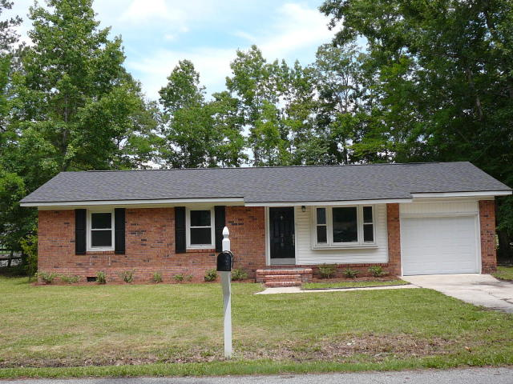
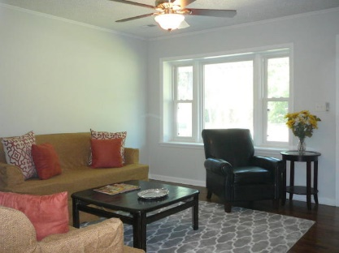
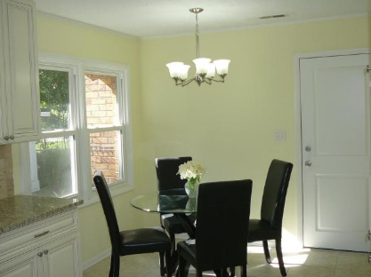
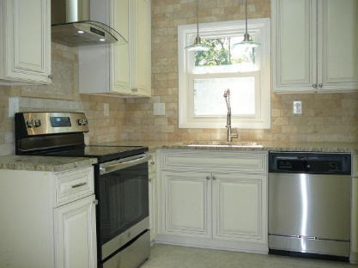
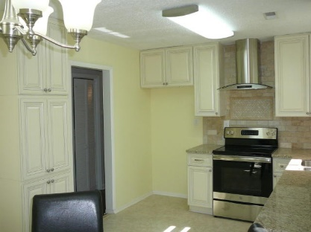
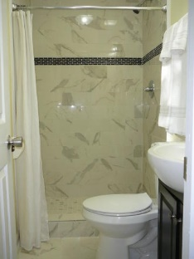
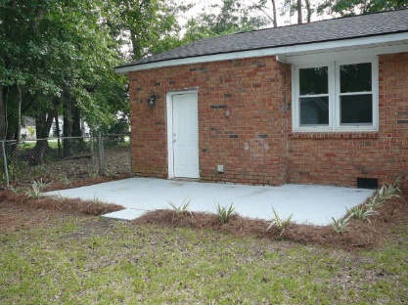
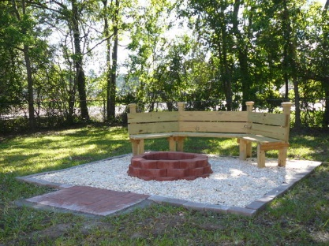

210 Amy Drive Beverly Hills Goose Creek, SC 29445 MLS# 19017608 $179,000 3 Bed · 2 Bath · 1,107sf
3.5% AGENT COMPENSATION BEING OFFERED IF A CONTRACT IS RATIFIED PRIOR TO OCTOBER 22, 2018.
3.5% AGENT COMPENSATION BEING OFFERED
IF A CONTRACT IS RATIFIED PRIOR TO OCTOBER 20, 2019
BEAUTIFUL NEWLY RENOVATED HOME ON A NICE SIZED LOT IN DESIRABLE BEVERLY HILLS SUBDIVISION!!
New 30 year architectural shingles on roof
New HVAC condensing unit
New wood cabinets, granite countertops, and stainless appliances
New windows and light fixtures throughout
New garage door with new remote controlled opener
Kitchen and both bathrooms newly tiled
Hardwood floors newly sanded and finished
Nicely landscaped with new fire pit
Bryant Pearson
(843) 860-7667
Bryant@SouthernShoresRE.com
Southern Shores Real Estate Group
834 Wappoo Rd
Charleston, SC 29407

