Slide 1
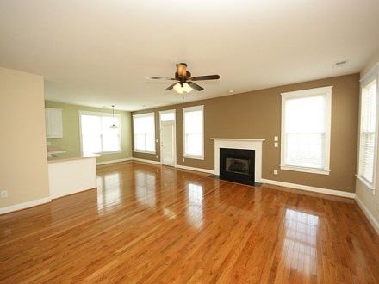
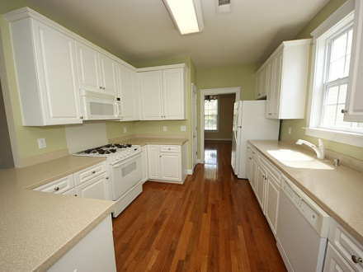
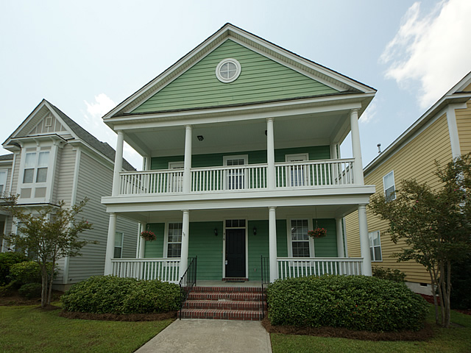
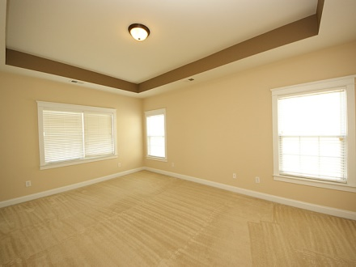
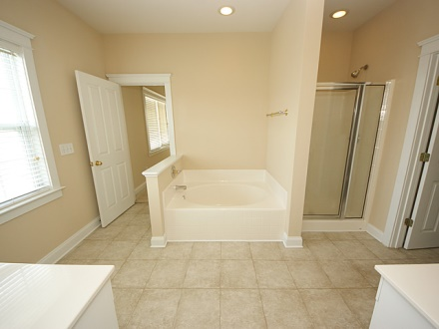
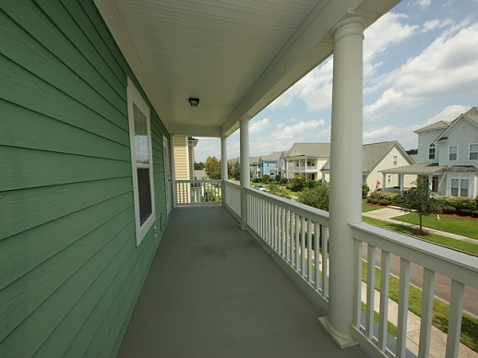
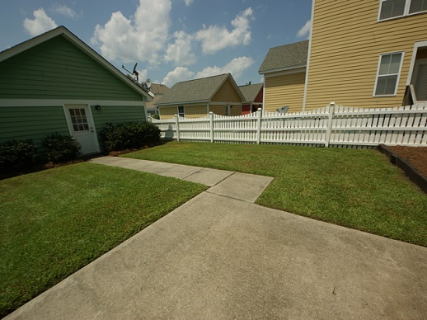
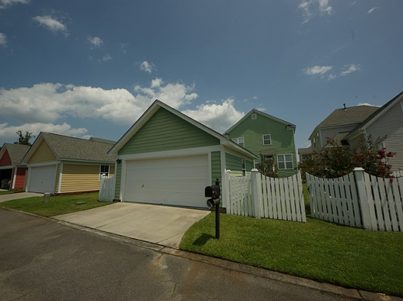
OPEN HOUSE ~ Sunday August 24th from 1-4
210 Barberry St
White Gables
Summerville
MLS# 1417492
$209,900
MUST SEE!! This is a beautiful home located in the desirable White Gables Neighborhood. With full double porches this home is a stunner. Brand New Paint throughout! Full of natural light. Enter the home to find the first floor covered in beautiful hardwood. Formal living and dining rooms welcome you to the left and right as you enter the foyer. The family offers a beautiful gas fireplace and large open space for entertaining. The open floor plans allows you to oversee the living room from the kitchen. The kitchen offers corian countertops and lots of cabinets. This floorplan offers excellent sized bedrooms. Enjoy a large master bedroom and master bathroom. Separate his and her sinks, stand up shower, garden tub and large walk in closet. Bedroom 2 and 3 are good size and have their own half bath with adjoining jack and jill bathtub. Enjoy your upstairs balcony and over look the beautiful landscaping of Barberry Street. Adorable fenced in backyard with outside patio. Large detached two car garage. White Gables has the most amazing amenity center. It offers a pool, playground, basketball courts, soccer field, walking trails, and also beautiful ponds. Don't let this one pass you by. Who wants to wait to move into beautiful White Gables! Seller is willing to pay $2000 in buyers closing costs with acceptable offer.
Jennifer Laffey-Foster, MRP
Real Estate Agent
Miler Properties
Office: 843-821-1111
Cell: 843-708-1582
jlfoster86@gmail.com
www.milerproperties.com

