Slide 1
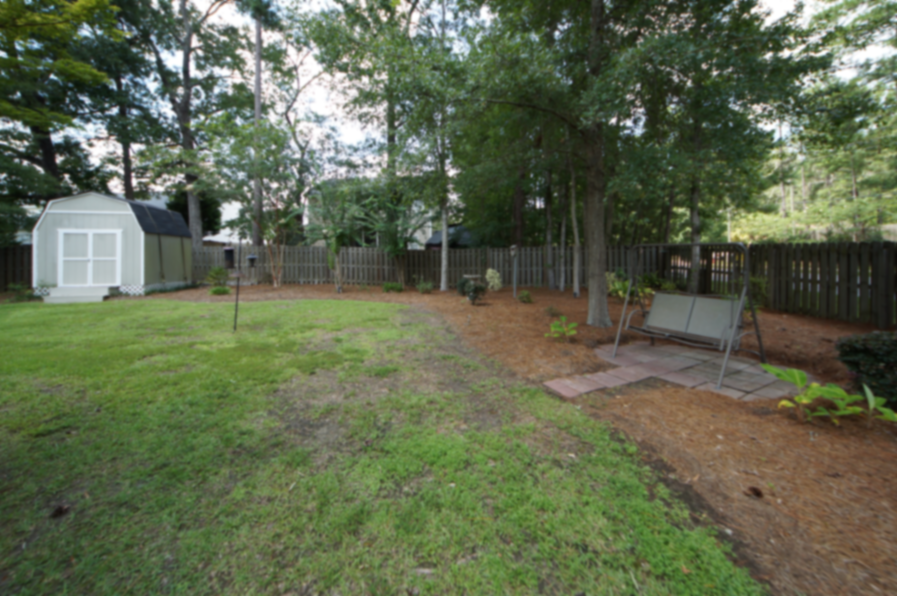
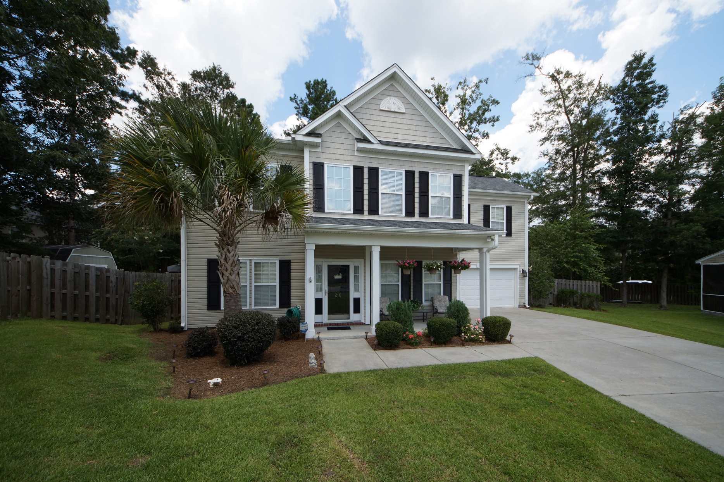
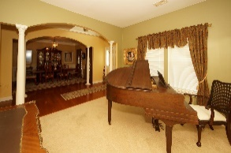
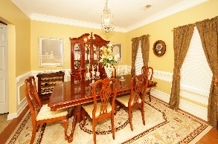
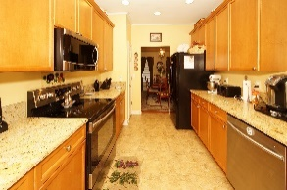
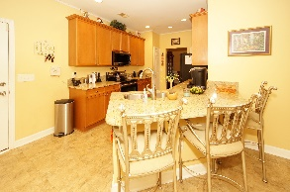
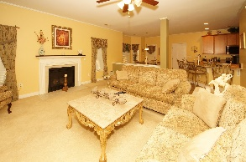
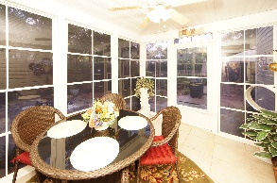
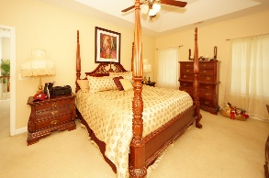
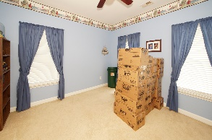
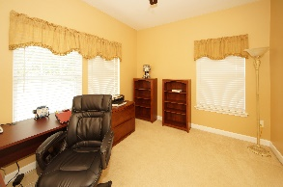
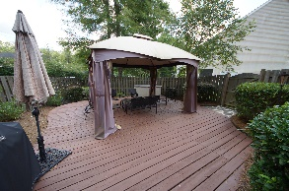
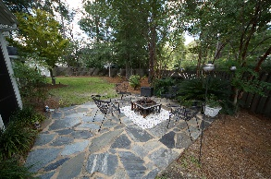

210 Curico Lane Plum Creek ~ Summerville, SC 29483 MLS# 17018173 ~ $270,000
Price Reduced in Dorchester District 2
This well maintained, beautiful home is in immaculate shape, has a ton of extras, and is in the DD2 school district!
The kitchen is open with lovely granite counter tops. Washer and dryer as well as all appliances convey, and a home warranty is also included! Crown molding throughout, lovely sun room, and a spacious back deck are featured in this home.
There is a large utility room/man cave upstairs that could also be used a bedroom. With so many extras included with this home, like hurricane shutters, it is an excellent value.
Storage building in the expertly landscaped back yard also conveys.
Motivated seller!
Chris Phillips
(843) 446-9199
chris.phillips@cbcarolinas.com
www. cbcarolinas.com
Coldwell Banker Residential Brokerage
4969 Centre Pointe Dr
Suite 203
Charleston, SC 29418

