Slide 1
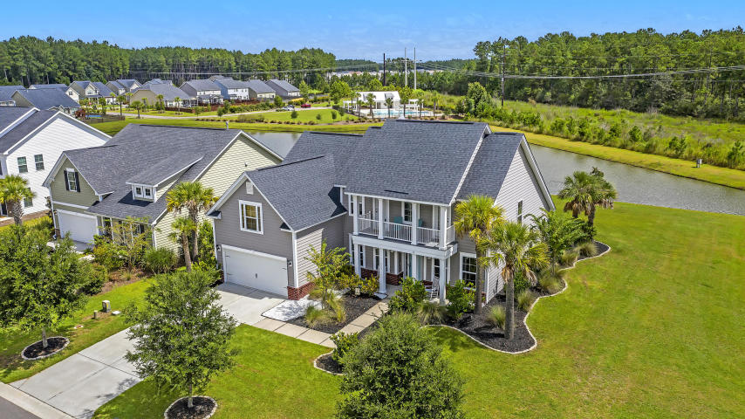

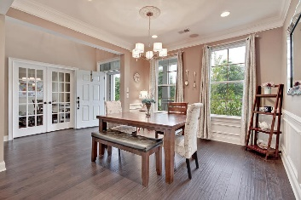
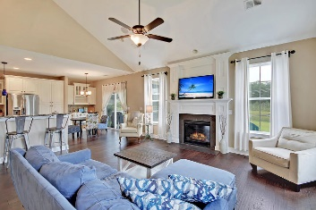
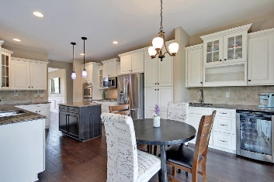
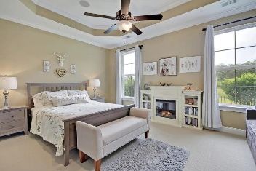
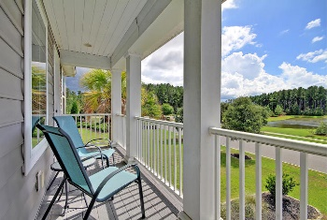
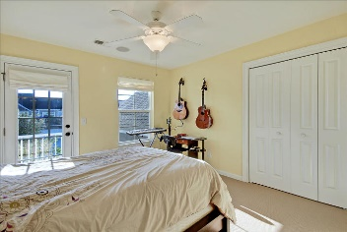
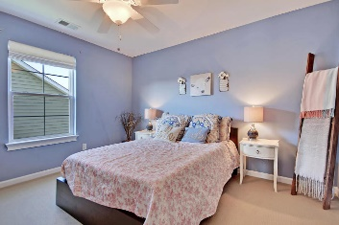
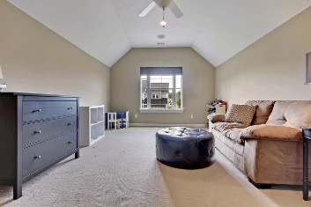
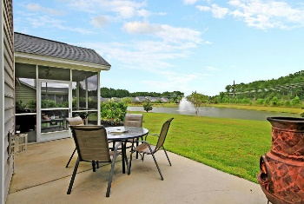
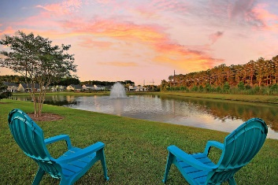
Price Reduced in Dunes West!
New A/C Units With Nest Controllers PLUS a 10 Year Warranty
$2,500 Agent Bonus
Motivated Seller! Price Recently Reduced!
$2500 Agent Bonus!
210 Daybreak Boulevard
Cane Bay Plantation ~ Summerville, SC 29486 ~ MLS# 19025439 ~ $369,900
Formerly the model home for Magnolia in Cane Bay, this stunning two story home not only has all the bells and whistles but boasts the best location in the neighborhood. Peacefully situated on the pond with its calming water fountain, the pond wraps around the side of the home and also backs to towering trees. This floorplan features a two story foyer with a ship lap accent wall, soaring, vaulted ceiling with fireplace in the living room, eat-in kitchen with breakfast bar seating, center island and coffee bar area and an amazing first floor master suite. The FROG makes a great bonus room or 4th bedroom with en-suite bath and the outdoor living spaces include a front porch, front balcony, screened-in back porch and patio that look out to the water. Don't miss out on this one!
Book your viewing today!
Nate Gainey nate@mattoneillteam.com 843-513-2038

