Slide 1
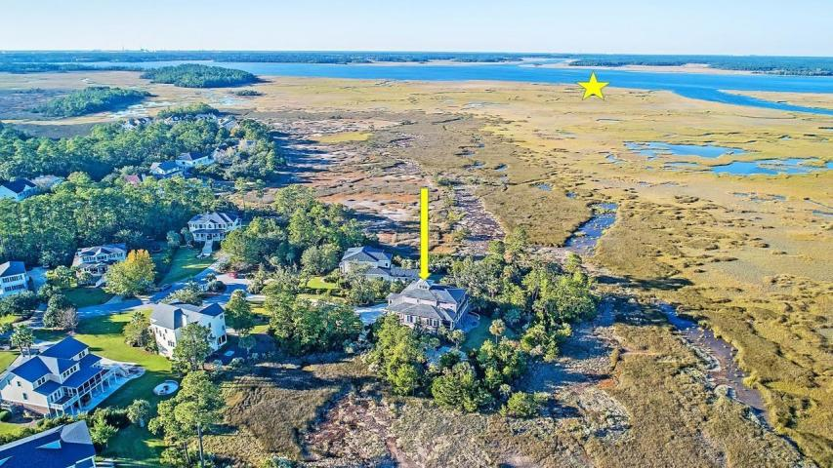

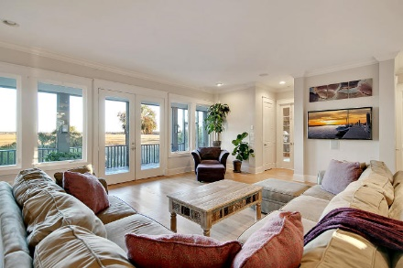
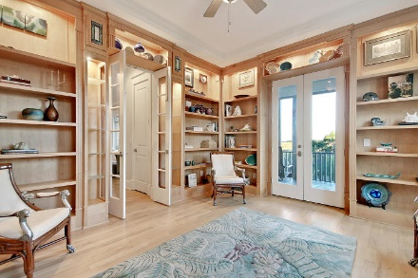
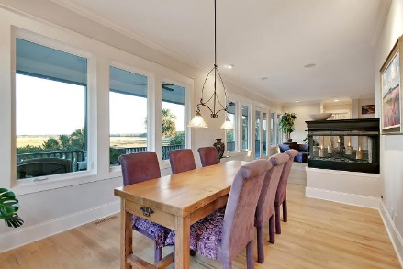
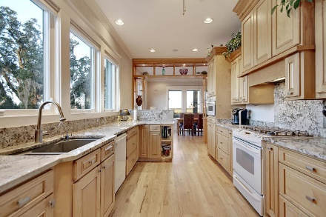
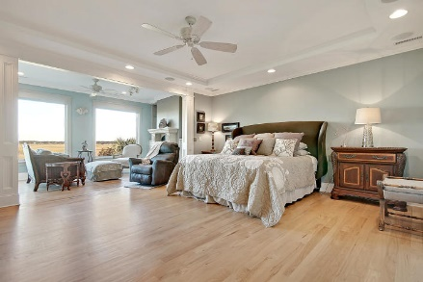
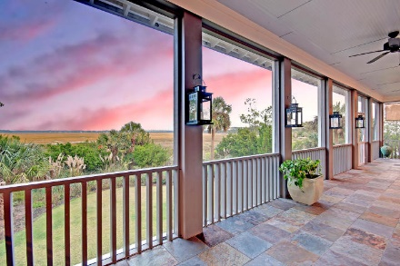
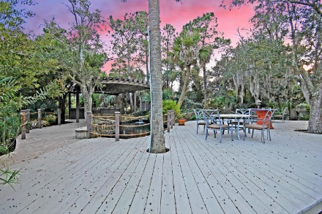
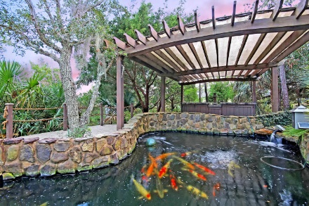
Price Reduced in Dunes West!
New A/C Units With Nest Controllers PLUS a 10 Year Warranty
Stunning Custom Home With Exquisite Views!
210 Island Point Court
Belle Hall ~ Mount Pleasant, SC 29464 ~ MLS# 19008093 ~ $1,375,000
NEW ROOF!
Located on the most private cul-de-sac in the neighborhood
Custom designed library has walls of maple wood built-ins for books and displays
Turret runs from the foyer up to above the third level creating great natural light and a beautiful architectural detail
Custom built-ins throughout entire interior
Nate Gainey nate@mattoneillteam.com 843-513-2038

