Slide 1
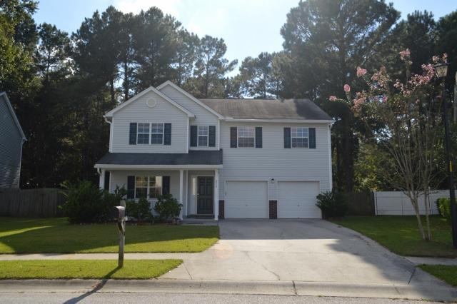
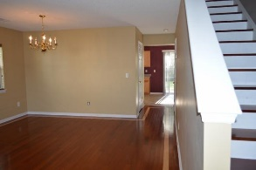
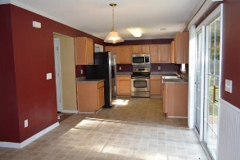
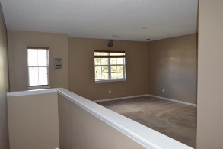
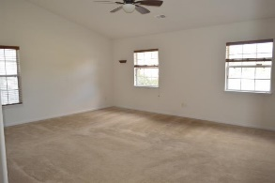
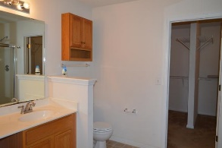
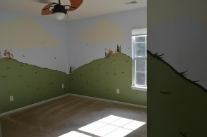
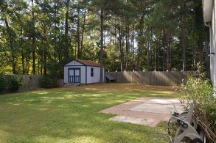
Just Listed
210 Ponderosa Drive
Tall Pines
Ladson, SC 29456
MLS# 16027430
$205,000
Exquisite home in Tall Pines has a very popular floorplan and numerous upgrades throughout the house! You are greeted with amazing Brazilian cherry wood hardwood floors throughout the living areas and stairs. Kitchen hosts upgraded stainless steel appliances, along with a massive pantry. The additional family room, located adjacent to the eat-in kitchen, has in-wall surround sound wiring for movie night! The back yard has a full privacy fence, and in-ground automatic irrigation (front yard also). Upstairs you'll find, including an enormous master bedroom and master bathroom that boasts a garden tub, separate shower and massive walk in closet. Not enough room? Enjoy the bonus area upstairs as a loft, or close it in for a 4th bedroom. With this much flexibility, you can't go wrong!
Brooke Madsen | (843) 834-1241 | brookemadsen.realtor@gmail.com | www.brookemadsenrealestate.com
Omni Carolina Real Estate | 126 Eston Dr | Goose Creek, SC 29445

