Slide 1


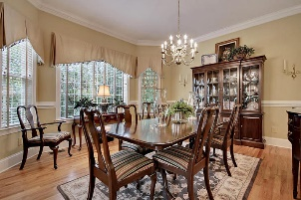
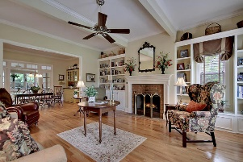
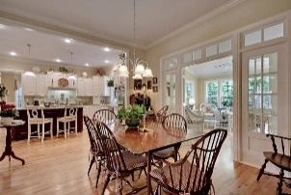
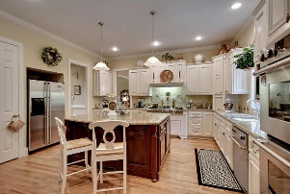
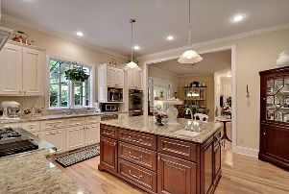
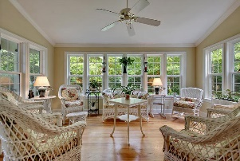

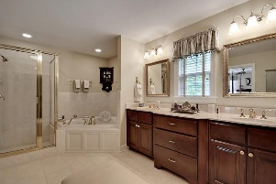
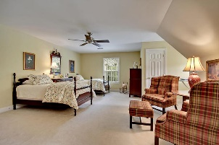
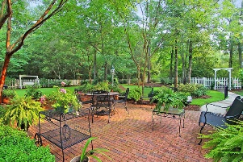



Walnut Farms Beauty!
210 Scalybark Road
Walnut Farms
Summerville, SC 29485
MLS# 15017193
$549,900
4 Bedrooms | 3 Baths | 4,152 sf
Get ready to be wowed! This home has it all and is ready for you to move in! Upon entering, you'll notice the welcoming two story foyer, 10' ceilings and the gorgeous wood floors throughout the first floor. Great floor plan with very large rooms. To your left upon entering, you'll find a lovely formal living room that can also be used as an office. Off this room is the very large dining room. Plenty of room for entertaining! To the right upon entering is a family room with built in cabinetry, shelving, surround sound, a stunning beamed ceiling as well as a wood burning fireplace. The gourmet kitchen is a great gathering spot with a double oven, gas cooktop with four burners plus a griddle as well as a huge island that offers seating and a vegetable sink! Ample cabinet space, pantry and lovely views from of the gorgeous backyard from the double casement kitchen windows. Off the kitchen and family room is a large eat in area as well. Through double doors off the eat in kitchen area, you enter the sunroom. This room can be used many ways! You can dine here, read and relax here, whatever you choose! Enjoy the great views of the picturesque landscaped backyard which offers a brick patio, fully fenced in yard, wooded area for extra privacy. There are twenty crepe myrtles alone in this yard! Owners have even installed potting sink on the side patio. A full bath with a custom vanity, as well as a laundry room with cabinet space and a sink round out the first floor. Upstairs, you'll find a beautiful master suite with a sitting area. The master bath offers a jetted tub, separate shower and water closet, dual sinks in custom raised vanity and a walk in closet with built in shelving. Down the hall you'll find two very large bedrooms, both with ample closet space. One bedroom has direct access to a full bath and it's own private vanity sink area, separate from the shower area. This bathroom links to the hall with another vanity sink area. Every nook well thought out! There's even a window seat for extra storage. Down the hall you'll find the FROG that can also be used as a 4th bedroom. This room is so versatile and has plenty of storage! One very large closet is shelved and air conditioned! The owners have thought of everything while building this home. It is extremely energy efficient, offers tons of storage options, lots of crown molding and special touches. This home will not last long! Make it yours today!
Larry & Kathy Mazalatis
Larry Cell 843-693-0529
Kathy Cell 843-693-0159
Office 843-871-9133
AGENTOWNED PREMIERE GROUP | 1800 TROLLEY RD | SUMMERVILLE, SC 29485

