Slide 1
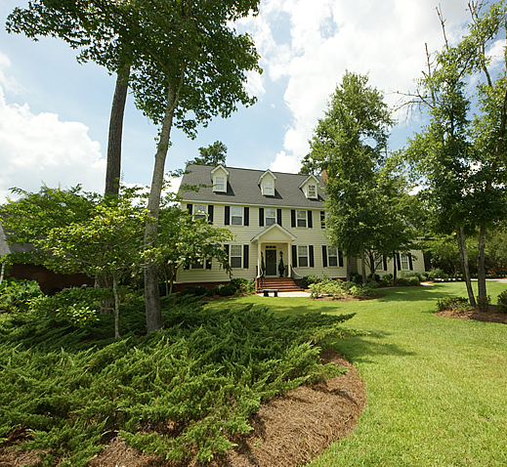
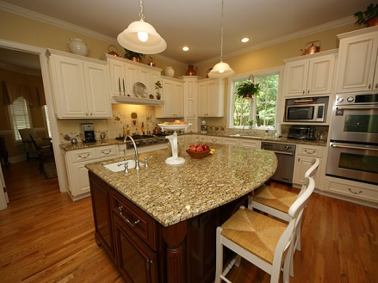
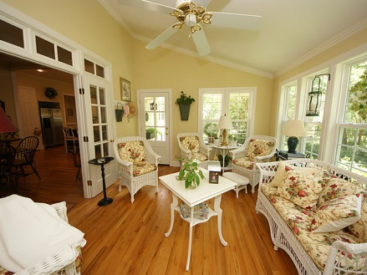
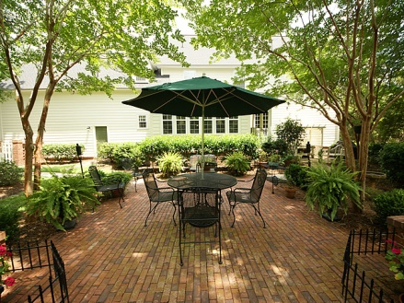
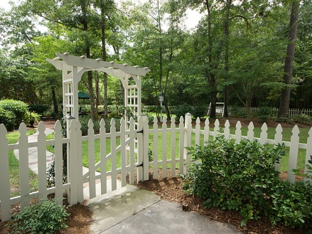
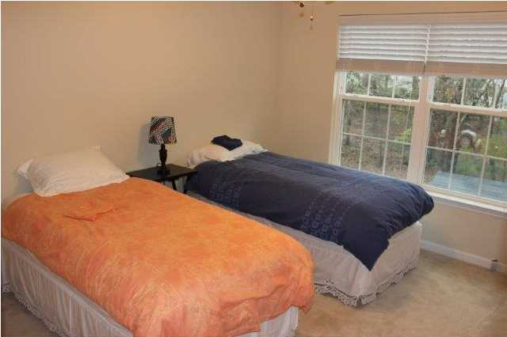


New Listing - Walnut Farms
210 Scalybark Rd
Summerville ~ MLS# 1418810 ~ $570,000
Perfect for entertaining! This spacious custom built home with 4 bedrooms and 3 full baths on over a half acre wooded and landscaped lot will be a joy for your clients to view. This home, built in 2005 under newer stringent building codes (including added hurricane and earthquake protection and higher environmental standards), may benefit your buyers with possible homeowners' insurance discounts and increased energy efficiency savings. Low maintenance Hardi-board siding with Virginia brick skirting, chimney and front portico with columns add to the street appeal of this wonderful home. Upon entering you will see a two story foyer with an elegant open staircase. Formal living and dining rooms are to the left and feature custom Williamsburg chair rail and crown moldings-window treatments will remain with the home in these rooms as well as the foyer. The foyer opens to the family areas, with a center hall vestibule leading to the designer kitchen which boasts a large center island, granite counters and Pro-series Jenn Air stainless appliances to include double convection wall ovens, huge gas cooktop, dishwasher and refrigerator. To the right of the foyer, double doors lead to the family room with wood burning fireplace, built-in bookcases, architectural ceiling and pre-wired surround sound system. With large arched openings, both the kitchen and family room open to the center point of family life, the keeping room. Rear double french doors lead to the sunroom overlooking the brick patio and large fenced backyard. A cozy columned side porch to the left of the sunroom leads down to a trellised potting table with utility tub and hot and cold water supply. A center hall off the keeping room leads to large utility area with custom cabinets, tiled flooring, sink, closet and refrigerator area. Across the hall is a full bath with shower and antique cabinet for sink. 10 ft ceilings and crown moldings are throughout the first floor as well as oak hardwood flooring except in tiled utility room. Upstairs, the master suite occupies the entire left side of home and includes a sitting area. The tiled master bath features a corner Jacuzzi jetted tub, separate shower, dual sinks in a raised custom vanity and water closet. Down the 2nd floor hall are 2 oversized 12'x 16' guest rooms. The back guest room has direct access to the guest bath by way of a separate sink area. The guest bath features raised custom vanity, window seat with built-in hamper, built-in shelving, tub with shower and water closet. The upstairs hall has a double door linen closet with solid shelves and a fully air conditioned 6'x 12' locked "owners" storage closet with solid shelving great for seasonal decorations, valuables etc. Finally the huge 4th bedroom serves as a multi-purpose room with a comfortable sitting area, wiring for entertainment center, office nook and currently 2 beds. Ample storage includes a walk-in closet and access to unheated attic space. Additional attic space is available on some unheated 3rd floor area.
Libby Hearn, ABR
Office: 843-871-9133
Mobile: 843-725-1079
lhearn@sc.rr.com
www.agentownedrealty.com
AgentOwned Premiere Group
1800 Trolley Rd
Summerville, SC 29485

