Slide 1
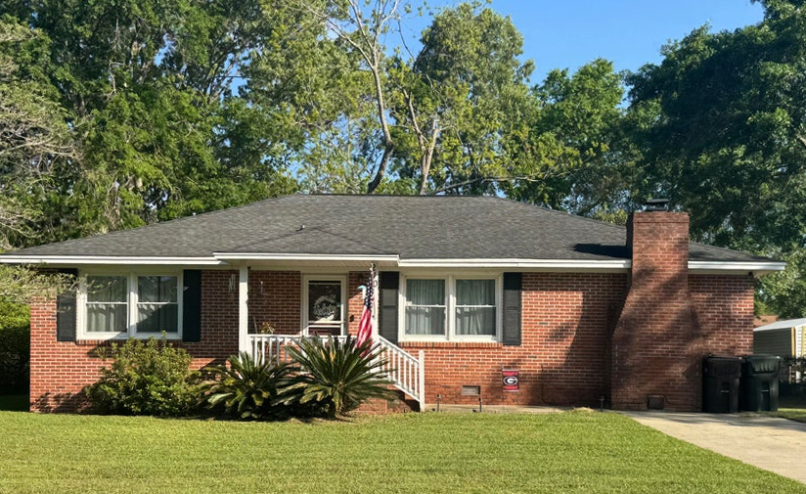
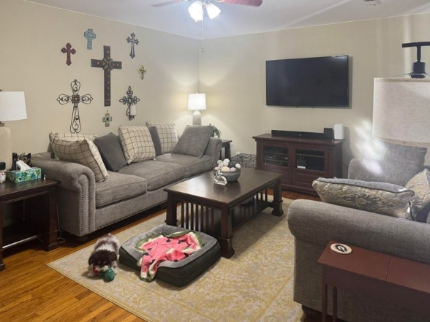
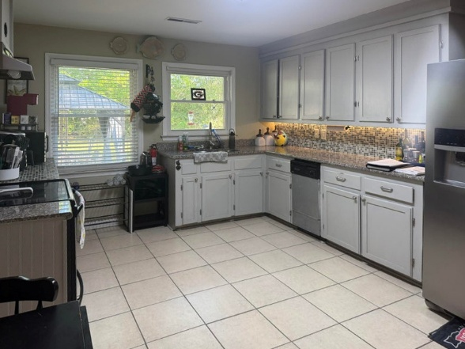
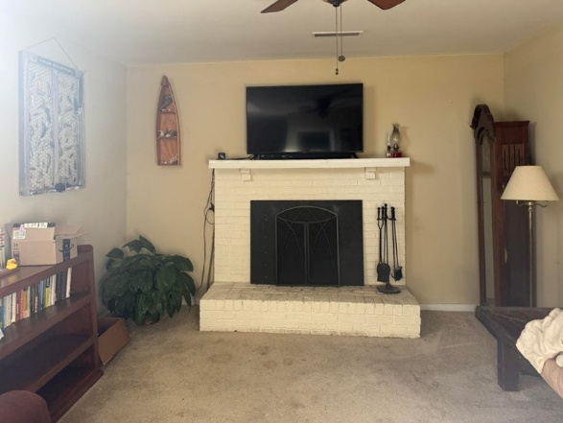
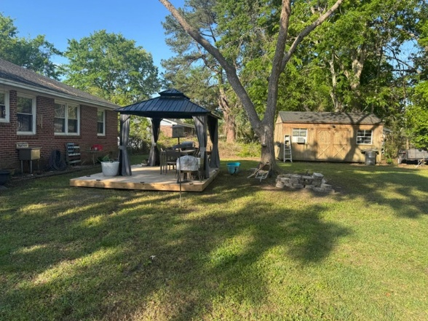


Just Listed
210 Ellen Street
Pineview Acres | Goose Creek
MLS# 25010105 | $325,000
THIS LOVELY THREE BEDROOM AND TWO BATHS HOME HAS SOME ORIGINAL HARDWOOD FLOORS.
NO HOA. QUIET AND ESTABLISHED NEIGHBORHOOD NEAR SHOPPING AND RESTAURANTS. CLOSE TO MAJOR HIGHWAYS FOR COMMUTE AND CLOSE TO SCHOOLS.
BUYER AND BUYERS AGENT PLEASE VERIFY ALL INFORMATION OF IMPORTANCE.
Carla Davis
843-437-4873
gaweber@tds.net
Adler Realty
518 Parrot Point Dr
Charleston, SC 29412
www.adlerrealtychs.com

