Slide 1
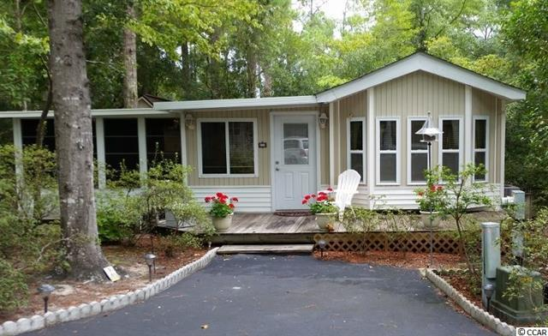
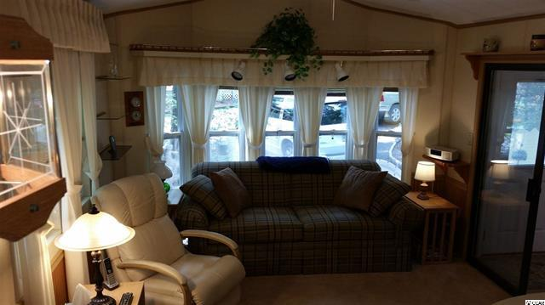
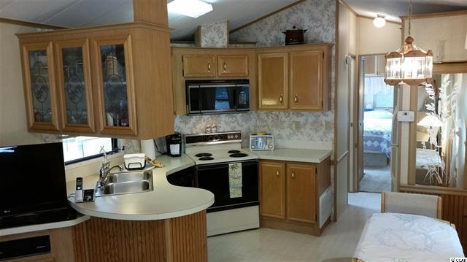
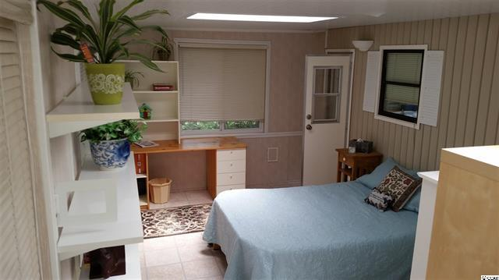
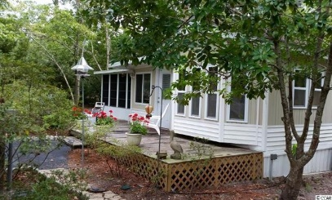






2110 Adams Circle
Windjammer Village
Little River, SC 29566
MLS: 1517047
$124,900
Agent Open House / Lunch
Revisit Windjammer Village Spring Tour!
Friday, March 25, 2016, 11 a.m. - 1 p.m.
Charming Cottage on 4 Lots
Low HOA and Amenity Rich!
Get away to quaint, singular Windjammer Village today! GATED. Close to shops, restaurants, attractions and all the North Strand has to offer. Accessible to major roads and highways yet private and secluded. Stunning storybook setting, thoughtfully landscaped into a rare park-like retreat environment of flowering foliage and hardwood pines. Charming, serene cottage on three lots, with fourth lot optional with purchase of home. Additional features in home include translucent skylights in bedrooms and bath; planned, efficient indoor storage/workshop and storage building on site. Immaculately kept interior with pleasing neutral decor and fully equipped eat-in kitchen, washer/dryer, full bath, cozy living area and sun room being used as a dining/game room. Two nice bedrooms, office, foyer and relaxing porches. Lots of built-in nooks, niches and surprises. Leave your cares street side as you relax in this safe, tranquil 1,000 sq. ft. enclave with the added privacy of mature, well-planned landscaping, resplendent with songbirds. Two parking areas, including driveway. One owner since 1979. Perfect for home, second home or vacation property, wonderful investment in family fun! Community amenities include: Minutes from the Atlantic Ocean -- direct Intracoastal Waterway access, marsh walk, fishing pier, boat dock, boat ramp, lighted tennis courts, Olympic-size swimming pool, childrens' pool, rec room for children, playground, basketball court, horseshoes, and shuffle-board court. Large storage yard for boats, RVs, motorcycles, kayaks, etc., meeting/social room with kitchen facilities, library and exercise room. Landmark Windjammer Village boasts 36 years of successfully blending the best of secured, uncrowded residential and recreational living in Horry County.
Deborah Collins
843-424-9013
dctidewater@yahoo.com
Connie Ross-Karl
702-306-2643
conniesross@aol.com
NEW WAY PROPERTIES MYRTLE BEACH

